Slide 1

Superintendents as
Instructional Leaders and Developing Systems that Promote Learning
COSA New Superintendent Academy
Thursday, July 19, 2018
Dr. Krista D. Parent, COSA
Director of Executive Leadership

Slide 2
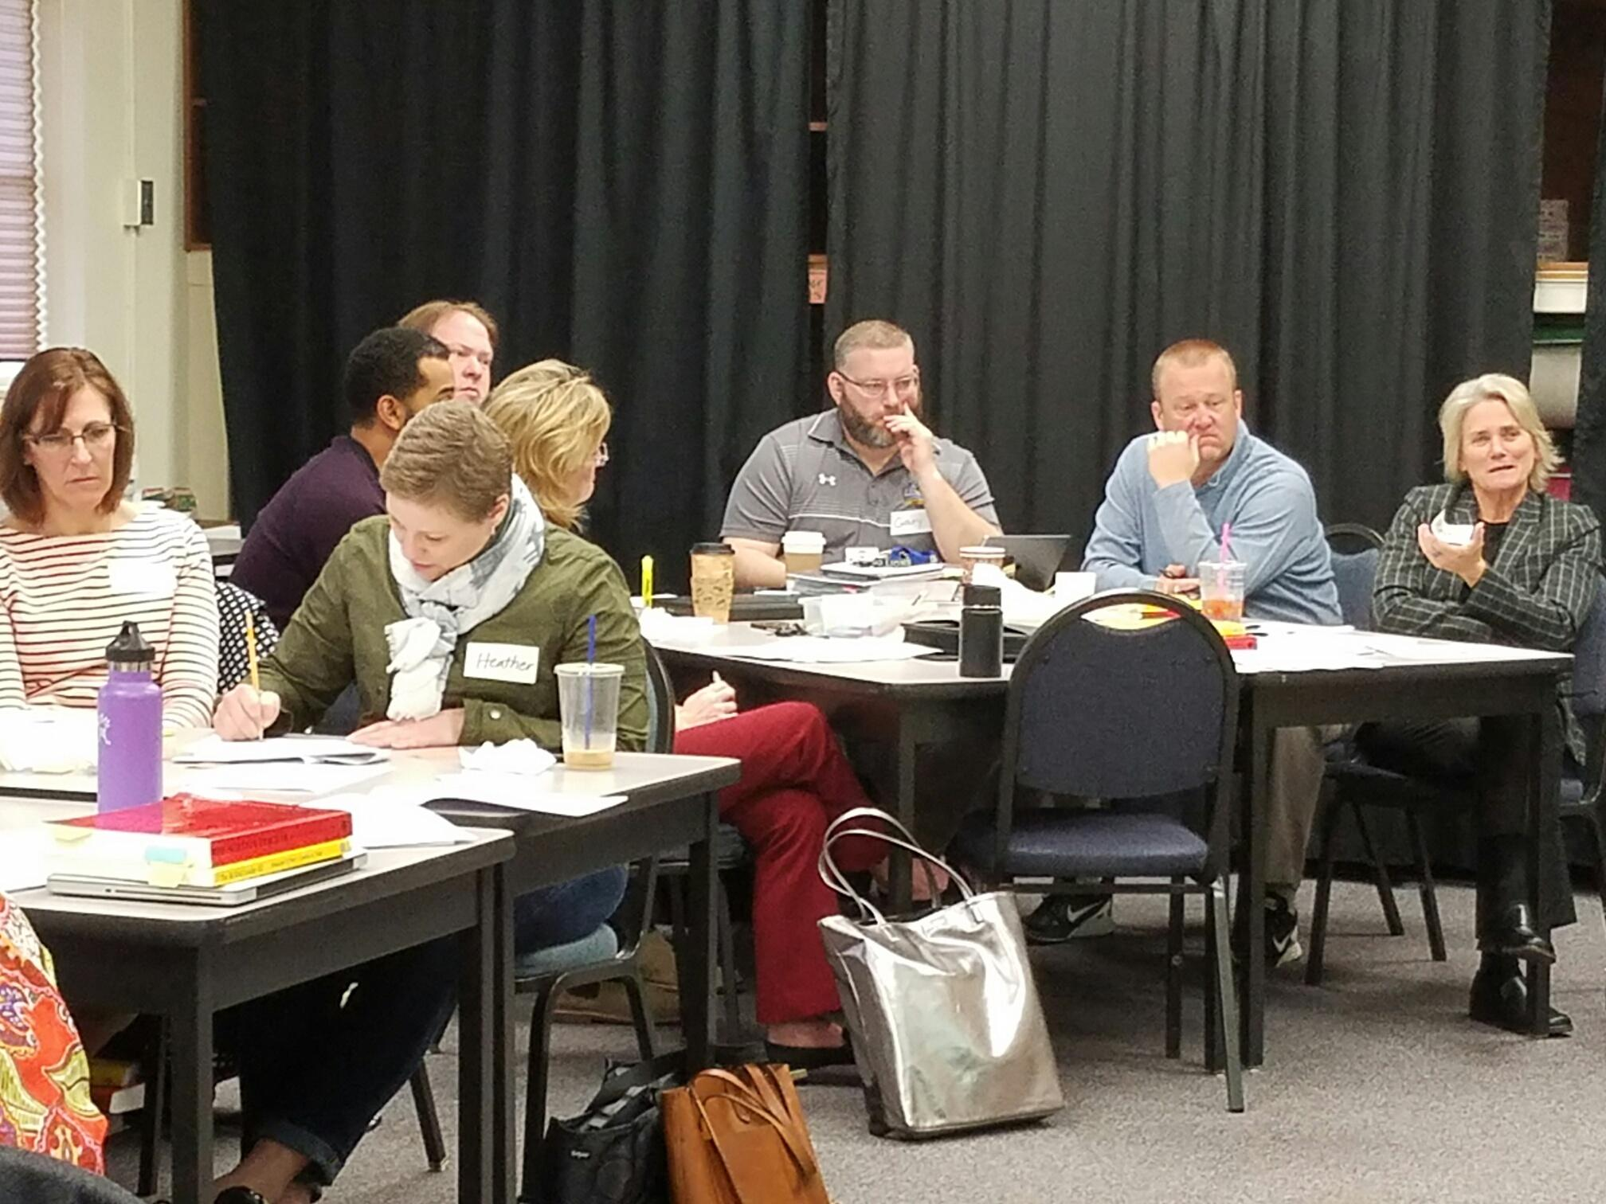
Leading Learning . . .
“You can’t change learning and performance at scale without creating a strong, visible, transparent common practice and actually engaging in the practice yourself.”
(Liz City, 2009)
Notes:
I’m really passionate about this topic and hope you are too. It’s an overused term - “instructional leadership” and there are multiple definitions of what that is and looks like. You’ll get my biased version today.
I love this quote and I chose to use this photo - describe Donn and how he wasn’t an instructional leader and turned into one of the finest. You can teach an old dog . . . please don’t tell Donn I called him an old dog!

Slide 3

“School systems exist to support learning for ALL students.”
First, the purpose of school systems is student learning. Period.
Everything we do should contribute to that goal, or it should not be done.
Second, when we say “all,” we mean each and every child regardless of their unique characteristics.
Notes:
I believe that sometimes we forget that our sole purpose is student learning and everything else that we do is just to support that focus.

Slide 4
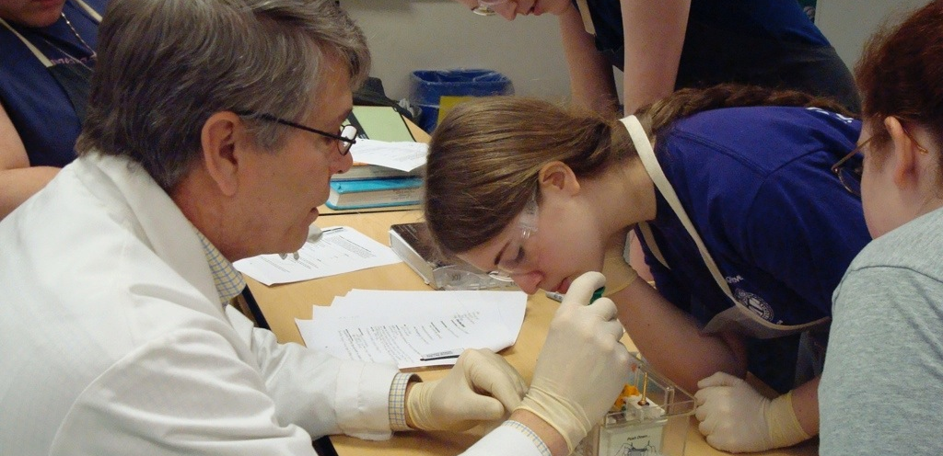
“The top performing school systems recognize
that the only way to improve outcomes
is to improve instruction . . .”
How the World’s Best-Performing School Systems Come Out on Top, McKinsey & Co., September, 2007

Slide 5

Six+ District-Level Responsibilities
Affecting Student Achievement (Marzano & Waters, 2009)
Collaborative goal-setting - including board, principals and district staff focused on enhancing student achievement not maintaining the status quo.
Non-negotiable goals for achievement and instruction - achievement and instruction are the top goals in the district. Everything else is a supporting goal.
Board alignment and support of district goals - provides P.D. for board members and maintains board support for goals.
Use of resources to support achievement and instruction goals - extensive professional development for principals and staff focused on teaching and learning.
Monitoring goals for achievement and instruction - monitors progress toward instructional goals, evaluates principals in relationship to these goals, participates in classroom observations, and and reports results.
Defined autonomy: Relationship with schools - the superintendent provides autonomy to principals to lead their schools, but expects alignment on district goals and P.D.
Modeling Learning - this begins at the top. Talk about and share your new learning on a regular basis.
Notes:
So what does the research say about our ability to impact student achievement? It is in our power to affect student achievement.
Introduce “District Leadership That Works” and “Strategies in Action.”
Here are the 6 District Level actions that affect student achievement and one of my own that I’ve added for good measure.
Go through the 7 actions and use examples.

Slide 6
Leading Learning
“The research is clear, if principals don’t provide the instructional leadership, the school won’t perform.” Dr. Beverly Hall (2009 National Superintendent of the Year)
“Principals can’t do this work if the Superintendent and Central Office staff don’t provide the instructional leadership for principals.” Dr. Krista Parent (2007 National Superintendent of the Year)

Slide 7
The Instructional Core
“School systems focus on the core by paying attention to what is happening in classrooms every day and making classroom practice everyone’s work.”
Examples: Instructional Rounds, Learning Walks, Studio Classrooms, Problems of Practice
Notes:
David Cohen and Deborah Ball originally identified this notion of the instructional core and it has been elaborated on by Liz City and colleagues from Harvard.

Slide 8
System Strategies to Promote Learning
Understanding your system’s current work.
Developing a high-functioning team.
Team norms. What are they?
Agenda strategies.
Data and evidence. What you count, what you hear and what you see.
Developing a “Theory of Action.” Identify strategic objectives.
Notes:
Strategy in Action - How School Systems Can Support Powerful Learning.
I wished I would have read this my first year as a supt but I didn’t - it just came out in 2009.
We did much of this work looking back while looking forward. I’ll show you how we operationalized each of these strategies.

Slide 9

District Initiatives Analysis
LITERACY | MATHEMATICS | TECHNOLOGY INTEGRATION
Gallagher Strategies and website resources Districtwide Writing Task Force Writing Studio Book Clubs Literacy Interventions and refinement Response to Intervention Standards development Development of Literacy Coaches and Reading Specialists | Math adoption process and research-standards work Doing the Math Course Bridges Group Development of Math Coach OMLI Studio Classrooms | Ed Tech Writing Grant SLSD Tech Cadre Technology Book Club Fiber Build-out Project Wireless at all sites Teacher work-station standard Online resources for teaching support
INSTRUCTIONAL LEADERSHIP | EXTENDED LEARNING OPPORTUNITIES | COMMUNICATIONS
Ad Council work Communities of Practice work Core standards work Learning walks Studio Classrooms Instructional Rounds OLN Network | LMS & CGHS Pride TAG After School Reaching Out Mentoring Gear Up Counseling Grant Charter support Summer School | What’s Right in SLSD? District web-site Superintendent’s Student Advisory Team District Parent Club District Site Council Monthly Press Releases Flash News Alerts Membership in Service Clubs
INSTRUCTIONAL IMPROVEMENTS | DATA ANALYSIS & SUPPORT | SUPPORT STRUCTURES & HIRING
New grad requirements Work sample implementation Summer Rookie Camp Mentoring for Novices New Teacher Symposium Arts Integration Eco Arts Project EMT, Health Occupations LMS Academic Focus KAHS Sustainability Themes | Data Warehouse School Level Collections Oaks, ORF, CBM, Attendance, SRI/Lexile Common Assessments State level collections District annual profile Learning walks Instructional Rounds | Key new hires, CG Principal, Business Mgr. Restructuring Food Services Facilities & Property Development Supervisors PD Closing D. Valley AA Writing Training
Notes:
Describe the sticky note activity and then grouping the stickies.

Slide 10
Developing a High-Functioning Team
4 = Outstanding, 3 = Above Average, 2 = Needs Improvement, 1 = Not evident
Team Member | Title | Big Picture Thinker | Teaching & Learning Knowledge | Team Player | Fun | Truth Speaker
Krista | Superintendent
Julie | Asst. Superintendent
Todd | Director of Student Services
Tim | Director of Staff Services
Chris | Director of Special Services
Connie | Business Manager
Notes:
Assessing our team members to see if we had the right people on the bus.
Describe the team - Krista 26 years, Chris 24 years, Julie originally in the district in 1986, Tim originally in the district in 1982, Todd 3 years in the district and Sue 32 years and retired.
Chris present at the birth of my children, Tim and I taught together, Julie was my boss, etc.
Started with the question - “what brought each of us to education?”

Slide 11
Norms and Group Agreements for Cabinet Team
1. Tactical Meetings are scheduled every Friday from 8:30 a.m. to approximately 1:00 p.m.
2. We start on time but the ending time may vary and may go beyond 1:00 by mutual agreement.
3. Agenda items are written on Krista’s white board prior to the meeting and a meeting agenda is provided for each cabinet member.
4. Time should be spent by each cabinet member preparing their agenda items and thinking prior to the meeting (be prepared).
5. Agenda items may include problems/issues to discuss and/or solve and items of information for the team.
6. There is an obligation to bring “need to know” information to the meetings.
7. There is an expectation of follow through on decisions that are made at the meeting.
8. There is an expectation to provide input and support for each other as issues are put forward to the team.
9. Confidential information is often shared and confidentiality is important to the team.
10. Cabinet members typically sit in the same seats for the meeting, but for the month of November we are asking everyone to sit in a different seat.
11. It is expected that all team members bring their best listening skills to the table.
12. Consensus on an issue means full support and one voice when we walk out of the meeting.
13. It is okay to take risks with the cabinet team and try out new ideas or thinking.
14. Equity of voice is essential for making the best decisions. All cabinet members have a responsibility to work to involve all voices.
15. Each cabinet member has the responsibility to speak their concern about agenda items presented even if others do not agree with their opinion.
Notes:
I asked the question - what do you believe are our norms for our team. We always facilitate teams to develop group agreements but had never done it for our own team. Pretty revealing, some hurt feelings, but stronger in the end.

Slide 12
Meeting Agenda Strategies
Stand Up Meetings -short duration, quick check-in, no longer than 5 minutes, literally must “stand up”, regularly scheduled.
Tactical Agendas - usually weekly, process for agenda items, take turns, keep everyone informed, generate ideas, etc.
Strategic Agendas - one topic agendas that need extended work and preparation, scheduled as need arises.
Ideas originated from “Death by Meeting” Patrick Lencioni

Slide 13



District Initiatives:
1. Leadership
2. Literacy
3. Mathematics
4. Communication
LIGHTENING ROUND:
Krista | Work Session Instructional Rounds Motivation 3.0 Book Club | Todd Gear Up Teacher Work Stations
Julie | Children’s Lit Book Club Instructional Rounds Assessment Training | Tim Title IIA New Teacher Symposium United Way
Sue | None
POTENTIAL STRATEGIC TOPICS:
Next Ad Council Read - Ideas . . .
Catching Up or Leading the Way
The Mesh
Outliers
Once a Runner
Team of Rivals
TACTICAL AGENDA:
KRISTA | JULIE | TIM | TODD
10/4 Board Agenda 10/4 Ad Council 10/14 Instructional Rounds 10/18 Work Session Student Advisory Team DV Sale Date AS Cash Receipts Classified Contract Reopener Ad Council Read | School Report Cards Assessment Training Math Pilot Math Changes - state Instructional Rounds Problems of Practice | EA Vacancy Promise Neighborhoods | Gear Up Equipment OSTX Dashboard Update Online Learning Update
DECISIONS/ACTIONS/COMMUNICATIONS OUT:
Student Advisory reminder to principals. Bring journal and IR books to 10/4 Ad Council.

Slide 14
Developing Theories of Action & Strategic Objectives
Theory of Action (they “why”)
A theory of action describes the beliefs that undergird an organization’s strategy and links the strategy to the organization’s vision; a theory of action can be thought of as the storyline that makes a vision and strategy concrete. It is a hypothesis using an if-then statement to articulate what will be achieved and how, in the broadest sense, it will be achieved. The power of a theory of action is that the theory helps an organization be explicit about why it is doing something and how it expects those actions will lead to improved outcomes, such as student achievement.
Strategic Objectives
Strategy is about filtering the noise. The set of actions an organization chooses to pursue in order to achieve its objectives. Developing strategy requires us to identify a few high-leverage ways to improve instruction and student learning. It provides a focus based on data and beliefs about what will be most effective in helping students learn.
1. Instructional Core – the focus of the strategy is to improve the quality of the learning and teaching of content.
2. Focused, coherent and synergistic – the design of the strategy focuses on trying to do just a few things deeply; these things are interrelated and add up to a whole that is greater than the sum of the parts.
3. Visionary and problem solving – the strategy balances addressing identified problems and moves beyond them to pursue the system’s vision.
4. Discussed and understood – people in the system talk about the strategy, understand it, and organize their work in support of it.

Slide 15
Theories of Action
INSTRUCTIONAL LEADERSHIP
If district leaders maintain a laser focus on teaching and learning in words and in actions, and if the professional development reflects that focus, then the system will develop a culture where teaching and learning is the priority.
If district leaders are instructional leaders, and if the support provided teachers is grounded in strong instructional practices, then student achievement will continuously improve.

Slide 16
Superintendent Leadership Must . . .
Strategy must also look forward and encourage innovation, driven by a compelling vision of what is possible. Vision is what inspires; it gets people to stretch in hopes of reaching a new level of performance and learning for students.
Notes:
Conclusion: If time permits give them work time to develop 2-3 ideas they want to implement to improve their instructional leadership.

