Slide 1

Chronic Absenteeism in Oregon: What We Know and Why It Matters
Isabelle Barbour, MPH Oregon Public Health Division
Robin Shobe, MS CCC-SLP Oregon Department of Education

Slide 2
Participants will:
Be able to describe the problem of chronic absenteeism in Oregon.
Identify 2-3 root causes of chronic absenteeism.
Identify potential partnerships that can support student attendance.

Slide 3
Scenario:
What do you do?
Notes:
Student who frequently misses school has a test today and doesn't show up
What is the consequence?
Student tells you when she returns that she had to stay home and take care of her younger ill sibling
Should there be a consequence?
The parent s a single parent and will lose her job if she stays home with the younger sibling
Does this change the consequence or should there be considerations for additional support for this

Slide 4
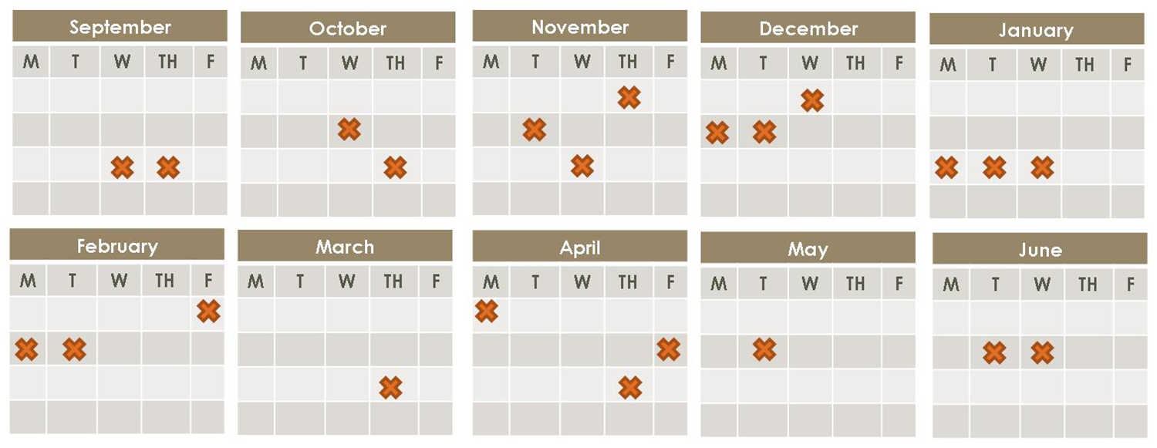
What is Chronic Absenteeism?
Definition: Missing 10% of school for any reason.
Excused
Unexcused
Suspension
Expulsion
Notes:
ADM masks chronic absenteeism
Need to look per kid

Slide 5
Why Does It Matter?
Chronic Absenteeism is the strongest predictor of dropping out of high school - stronger than other factors such as number of suspensions or student test scores, even when taking into account student demographics (Byrnes & Reyna, 2012).
Significant gaps in academic performance are apparent in third grade and persist all the way through high school for students who are chronically absent, leading to increased dropout and decreased graduation rates (Buehler, Tapogna & Chang, 2012).

Slide 6
Oregon Statistics
Approximately one-in-five students in Oregon in the 2013/14 school year were chronically absent
Chronic absenteeism affected schools in every Oregon community
Problems with chronic absenteeism were apparent at every grade level, starting with 24 percent of kindergarten students and dipping to about 14 percent of third graders before climbing to 38 percent in the 12th-grade.
Related Resource: Buehler, Taponga & Chang (2012). Why being at school matters: Chronic Absenteeism in Oregon
Public Schools. The Chalkboard Project. Retrieved:
http://chalkboardproject.org/wp-content/uploads/2012/06/Oregon-Research-Brief-June-20-2012.pdf

Slide 7
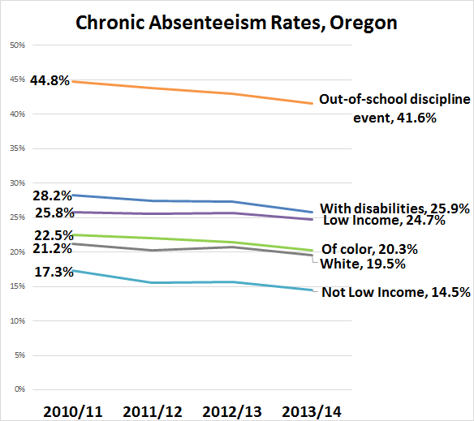

Slide 8
Populations Most Impacted
Children with one (or more) out of school suspension
Children with disabilities
Children of color
Children from economically disadvantaged homes
K-3rd grade children in rural communities
Buehler, Tapanoga, & Chang, (2012). Why being at school matters: Chronic Absenteeism in Oregon Public Schools. The Chalkboard Project. Retreived: http://chalkboardproject.org/wp-content/uploads/2012/06/Oregon-Research-Brief-June-20-2012.pdf

Slide 9
Education is a Predictor of Health
Children who do not complete high school are likely to become adults who have employment problems, lower health literacy, higher rates of illness, and earlier deaths than those who graduate from high school.
Improving high school graduation rates may be more cost-effective than most medical interventions in reducing health disparities.
Graduation from high school is associated with an increase in the average lifespan of 6 to 9 years.
People that do not complete high school are disproportionately represented in the criminal justice system.

Slide 10
Health is a Predictor of Education
Healthy Kids Learn Better!
Children who report greater health challenges also report poorer average school grades.
Students with poorer health report missing more days of school.
Greater numbers of health challenges are associated with poorer educational outcomes.
High schools with more complete health infrastructure have higher graduation rates.

Slide 11
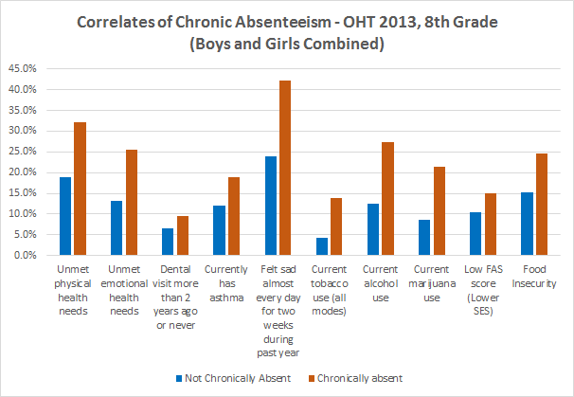

Slide 12
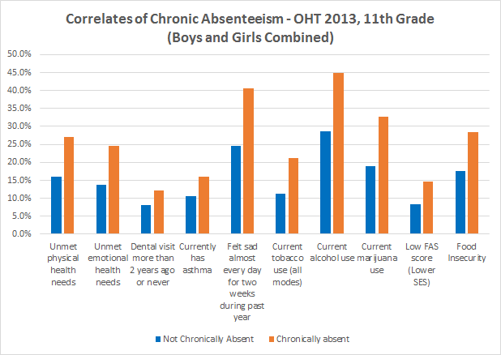

Slide 13
Key Health Issues Associated with Chronic Absenteeism
Illness or injury
Pregnancy and parenthood
Sexual harassment and bullying
Oral/Dental Pain
Unmanaged Asthma
Substance Use
Mental Health Problems
Food Insecurity
Obesity

Slide 14
Student absence is complex
Myths | Barriers (can’t) | Aversion
Absences are only a problem if they are unexcused | Lack of access to health care | Child struggling academically
Sporadic versus consecutive absences aren’t a problem | Poor transportation | Lack of engaging instruction
Attendance only matters in the older grades | No safe path to school | Poor school climate and ineffective discipline
 |  | Parent had negative school experience

Slide 15
What can you do to improve attendance at your school?
Challenge assumptions
Understand attendance data
Gather Partners
Get more information about the problem
Determine a range of strategies & best practices to support a culture of attendance in your school

Slide 16
Challenge Assumptions
Attendance is complex; aversion, myths & barriers
Students and their families suffer the most when their students do not achieve

Slide 17
Understand Attendance Data
Average Daily Membership (ADM) can mask the problem of chronic absenteeism.
School districts that boast 95% ADM can still present with dozens of chronically absent students.
Attendance in the early grades is just as important as attendance in middle and high school.

Slide 18
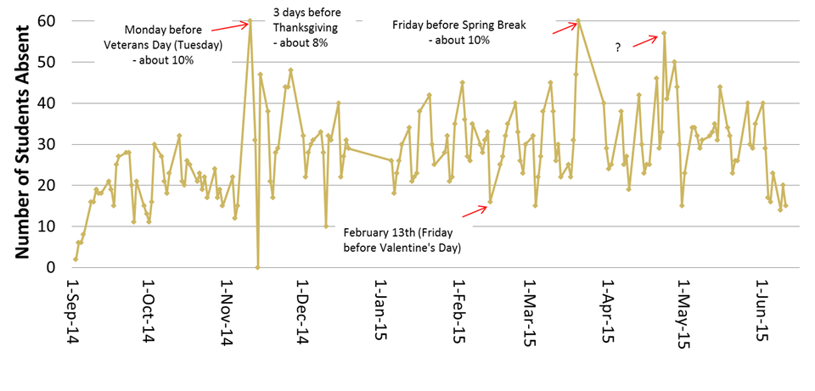
Year at a Glance: All Absences
Chelsea to put slide here
Notes:
One elementary school with about 600 students. On-going research project at ODE.

Slide 19
Gather Partners
Schools may not be able to address the causes of chronic absence alone.
Engage community partners that can help support the work (eg. engaging parents and bringing in health expertise).
Notes:
Popcorn, elbow partner

Slide 20
Get more information about the problem
This can include talking with students and parents about this issue, looking at data that can identify chronically absent students and conducting an audit of your school’s attendance policies and practices.
Ex. Attendance Audit (Scott Perry)
Notes:
Scott Perry of Southern Oregon ESD will be working with ODE to make his Attendance Audit work available to interested districts through training and access to materials.

Slide 21
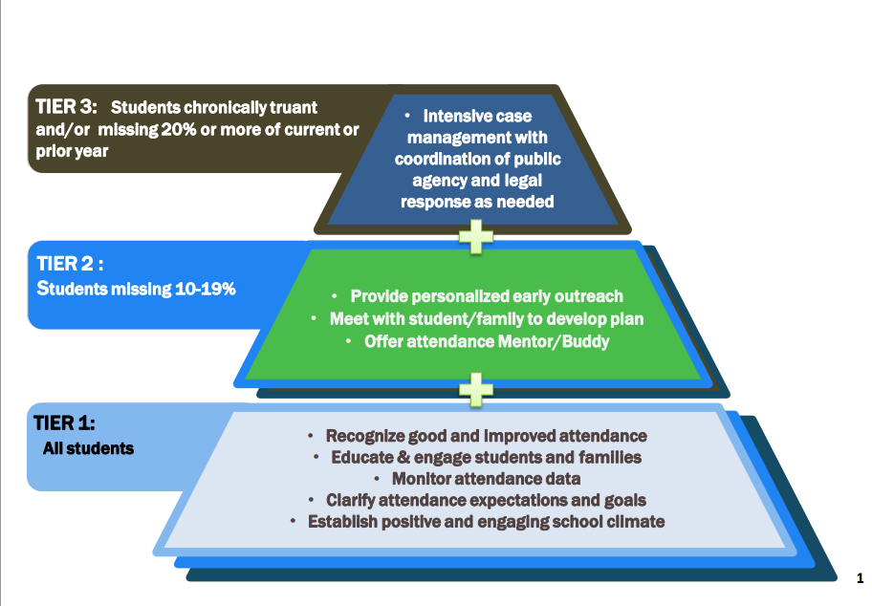

Slide 22
Determine a range of strategies to support
a culture of attendance in your school
Best practices
Welcoming students by name
Providing breakfast after the bell
Celebrating good (not great!) attendance
Calling home when a student does not make it to school
Every child has at least one adult they are connected to in the school
Build a safety net under students who struggle the most

Slide 23
Resources
Attendance Works
http://www.attendanceworks.org/tools/
Mapping the Early Attendance Gap http://www.attendanceworks.org/wordpress/wp-content/uploads/2015/07/Mapping-the-Early-Attendance-Gap-Final-4.pdf
Upstream Public Health: https://www.upstreampublichealth.org/news/upstream-releases-chronic-absenteeism-review-paper
Notes:
The Children’s Institute
All Hands Raised
Oregon Tribes
Attendance Works (Oregon Link)
ECO Northwest
Upstream Public Health
Oregon Department of Human Services
Chalkboard Project
Portland State University and Coalition of Communities of Color

Slide 24
Contact
Isabelle Barbour, MPH
Oregon Health Authority | Public Health Division
Email: isabelle.s.barbour@state.or.us
Robin Shobe, MS CCC-SLP
Oregon Department of Oregon
Robin.Shobe@State.or.us

