Slide 1

If our goal is to coordinate efforts across work groups charged with plans for improving students’ educational attainment and culturally responsive practices…
2

Slide 2
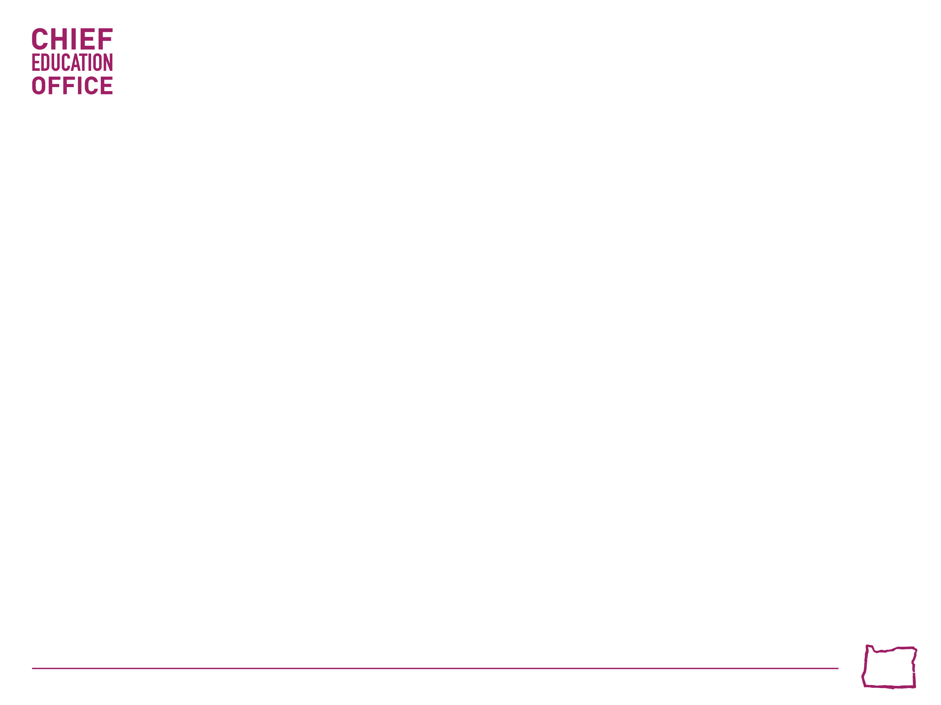
We Need to know what is already occurring…
We need to identify where overlap occurs across work groups, goals and plans…
We need to coordinate prior to 2017 session around priorities and stakeholders
3

Slide 3
Alignment of “Asks” Regarding Educators
Educator Equity Report and Recommendations
African American/Black Student Success Plan
American Indian Alaskan Native Oregon Indian Education State Plan
Oregon’s Equitable Access to Educators Plan
English Language Learners State Plan

Slide 4

Example: To what degree should the outcomes of these College and Career Readiness related legislated work groups be aligned?
3

Slide 5

Examples from the CCR work
Group | Focus
HB 2525 | Recommend standards related to transferability of credits for community colleges and public universities and Student Bill of Rights due June 1, 2016 (HECC)
HB 2681 | Recommendations on improved processes/strategies for placing students in courses at community colleges with progress report due Feb 1, 2016 (HECC)
HB 3308 | Disparities in Higher Education due 6/30/2016 (HECC)
HB 3319 | Report on Best Practices Dropout Prevention, Graduation, and Attendance due Feb 1, 2016 (ODE)
HB 5016 | Report on efforts to provide direction/ training, to school districts and ESD staff for reporting high school graduation data due March 1, 2016 (ODE)
SB 81 | Recommendations for distributing $10 M in 2016-17 via Oregon Promise to reduce student costs & increase access to community colleges (HECC)
SB 418 | Recommendations for $6.9 M in 2016-17 to improve college readiness with emphasis students who may participate in Oregon Promise (HECC)
Fifth Year | Recommendations for resolution of use of K-12 funding for Advanced Diplomas (Senator Gelser) Probably not as this is not a state agency work group
3

Slide 6

What promising practices show the greatest contribution towards key student outcomes?
3

Slide 7
Examples of promising practices that show the greatest contribution towards key student outcomes
Chronic Absenteeism Report
ODE Dropout Prevention Practices Report (HB 3319)
HECC Disparities in Higher Education Report (HB 3308)
Ninth Grade On Track
Promise Grants
Regional Achievement Collaboratives
STEM Hubs
Poverty Work Group (HB 2968)
Expanded eligibility for DACA students to financial aid, grants (SB 932)
Graduation Reporting Group
Changes in distribution of Oregon Opportunity Grants (HB 2407)
3

Slide 8

Do we know how increased resources from the 2015 session are impacting results?
3

Slide 9
Do we have a coordinated process for examining how increased resources from the 2015 session will be impacting results?
$9.6 M to HECC Oregon Promise (SB 81)
$6.9 M to HECC Student Supports (SB 418)
$3 M to CCWD Aspirations to College (HB 3063)
$2 M to CCWD for GED attainment
$700 K to CEdO Regional Collaboratives
$12 M to OSAC Additional Funding for OOG
$750 K to OSAC for FAFSA Plus
$4 M to YDD to serve additional age groups up to 24
$2.8 M to ODE for AP & IB Exams
$1.5 M to HECC Community College Advisors (HB 3072)
$2.9 M to ODE for Regional Promise Sites
$350 K to College Possible
$35 M to ODE CTE/STEM
$2.7 M to ODE for African American Education Plan
$1.5 M to ODE for Tribal Government Attendance Pilot Project
$12.5 M to ODE for English Language Learners

Slide 10
Do We Agree?
Any proposed plans must intentionally involve members of affected communities and use an Equity Lens perspective.
It’s important to compare Oregon’s data with other states and countries but we also need data that looks across regions of the state and types of schools.
Research practice partnerships with our postsecondary institutions can leverage stronger state specific research to inform practice.
School practices, beyond hiring and retention policies such as exclusionary disciplinary practices and attendance policies must be revisited.
3

Slide 11
Do We Agree?
Intentional and proven practices must be implemented to include out of school youth as well as in school youth.
Our K-12 schools and institutions of higher education will offer the best educational experience when their campus faculty, staff and students reflect this state’s growing diversity.
Developing a culturally responsive school culture starts with the culture set by the leader at the school/district and requires ongoing revisiting and focused reflection.
3

