Slide 1
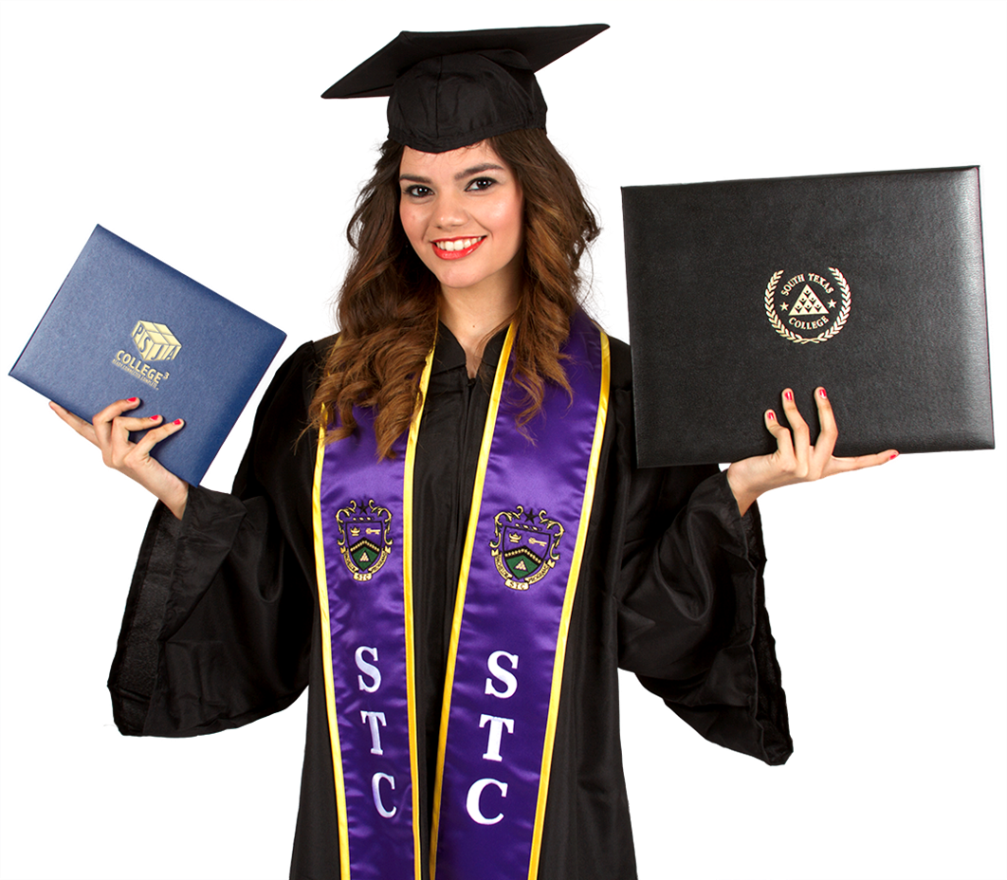
Expanding Dual Enrollment
& Early College High School
A Powerful Strategy For Increasing College Success
By Dr. Daniel P. King, Superintendent

Slide 2
THE CHALLENGE
Texas ranks low in College Completion. We want to move to the front of the pack!
Houston Endowment commissioned study shows only 1 in 5 Texas students earn a higher education credential within 11 years after entering 8th grade – or by about age 25.
Dr. Steve Murdock (Rice University) projects these statistics (and economic outcomes) will only get worse due to changing demographics – unless we do something dramatically different!

Slide 3
A POWERFUL STRATEGY
Expanding Dual Enrollment & Early College Opportunities
A number of studies (National, State and local) show the transformational power of students taking college classes while in high school.
This includes studies conducted by Jobs for the Future (Boston, MA), the American Institute for Research (Washington, DC), the Texas Higher Education Coordinating Board, and a number of Community Colleges and Universities in Texas.

Slide 4
DUAL ENROLLMENT STUDENTS HAVE BETTER EDUCATION ATTAINMENT
High School Graduation rates above State and National average
2x more likely to enroll in college after high school
2x more likely to enroll in a four year college
College persistence rates are 2x higher
50% more likely to graduate from college within 6 years after HS
75% more likely to graduate from college
Positive impact is even more dramatic for minority students, males, low income students, first generation college enrollees, and students with lower GPA’s

Slide 5
EARLY COLLEGE HS – A GAME CHANGER
30% Nationally completed an Associate’s Degree while in high school. A number of Texas Early College High Schools graduated 50-80% of students with Associate Degree
In Texas 94% of Early College High School students earn college hours in high school compared to less than 10% of all high school students nationally
Four-year high school graduation rates exceed State and National average

Slide 6
EARLY COLLEGE HS – A GAME CHANGER
Better college outcomes: Enrolling in college after high school, persistence in college, higher GPA, better college graduation rates
Positive impact for students who enter high school performing below grade level
Especially powerful for minority students, low-income youth, 1st generation college goers
Demography does not have to be destiny, we need different strategies

Slide 7

SUCCESS BY DESIGN
Sustained Systemic Transformation

Slide 8
SUCCESS BY DESIGN
Sustained Systemic Transformation
Our Goal:
To be a game changer in our community and beyond
Demographics will not be our destiny in terms of education attainment and economic potential
PSJA students will out perform state and national average in terms of college completion

Slide 9
DISTRICT DEMOGRAPHICS
Total Enrollment – 32,612
Total Number of Schools – 43
Percent | PSJA ISD | STATEWIDE
Hispanic | 98.89% | 51.34%
Economically Disadvantaged | 89.00% | 60.26%
ELL | 41.04% | 17.04%

Slide 10
A Comprehensive Approach
to the Dropout Crisis

Slide 11
Countdown to Zero

Slide 12
A COMPREHENSIVE APPROACH TO THE DROPOUT CRISIS
Total Number of Graduates
- Unique partnership with South Texas College
- Innovative alternative campus
- CC&T Academy offers its own HS Diploma
*Summer Session efforts include students from
other PSJA high schools.
*Senate Bill 975 (Hinojosa-Munoz 2011) was based
on PSJA’s CC&T Academy and gives community
colleges the authority to take the lead in
establishing similar campuses in a legislative effort
to scale up PSJA’s work.
*Senate Bill 860 (Lucio 2013) allows similar
partnerships with technical colleges.
*Jobs for the Future was given a TEA grant to
expand and strengthen a network of schools in
other districts modeled after CC&T Academy.
School Year | Dec. | May | Aug. | Total Per Year
2007-2008 | 49 | 60 | 101 | 210
2008-2009 | 72 | 87 | 77 | 236
2009-2010 | 71 | 96 | 44 | 211
2010-2011 | 56 | 56 | 41 | 153
2011-2012 | 68 | 70 | 55 | 193
2012-2013 | 67 | 84 | 35 | 186
2013-2014 | 42 | 47 | 75 | 164
2014-2015 | 51 | 42 | 14 | 107
Total |  |  |  | 1,460*
*445 over 21 years of age

Slide 13
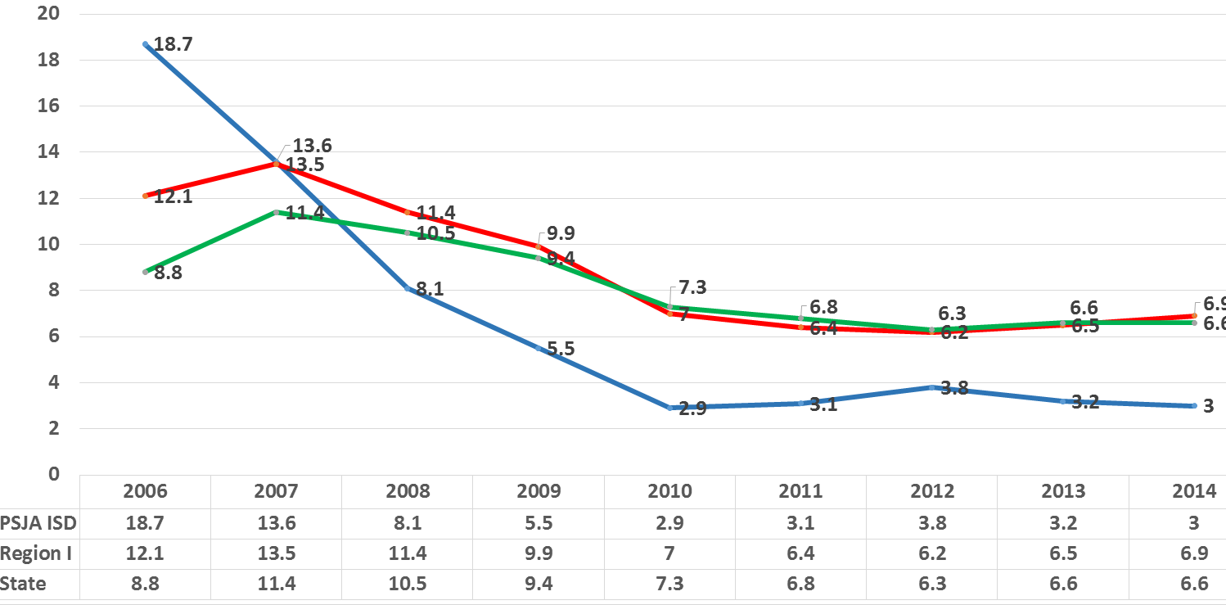
COMPARISION OF LONGITUDINAL DROPOUT RATE
2006-2014
6.9
6.6
3.0

Slide 14
Leveraging State Policy to put
Dropouts on the Path to Success
Back On Track To College

Slide 15
POLICIES THAT FACILITATE DROPOUT RECOVERY
TEXAS
Full funding (average daily attendance) is provided for enrolling young adults up to age 26 for the purpose of obtaining a high school diploma. (21 and over must be kept separate from students under age 18).
Flexible attendance accounting allows the accumulation of hours of attendance to substitute for daily attendance (at the rate of 6 hours = 1 day of funding).
Flexible Calendar Waiver allows a campus to run on a different school year calendar from the remainder of the district.
Same dual enrollment policies as all high school students.

Slide 16
SOUTH TEXAS COLLEGE
Partners with school district for dual enrollment of these young adults under same conditions as all other students.
PSJA ISD
Countdown to Zero (Annual Dropout recovery drive)
Be On Time (Focus on on-time graduation)
(Back on Track to College) Specialized campuses for different needs (18-26 year olds and 5th year seniors, teenage mothers, off-track 15-21 year olds who are far from graduation)
Ensure daycare services are provided at no charge children of district students. (Workforce and local funds).

Slide 17
DISTRICT GOAL
Connect all dropouts and off-track students
to meaningful futures while still in high school
Early College, Dual Enrollment, Connected Career Pathway
leading to Industry Certification or Associate Degrees,
workforce connections to family sustaining employment, etc.

Slide 18
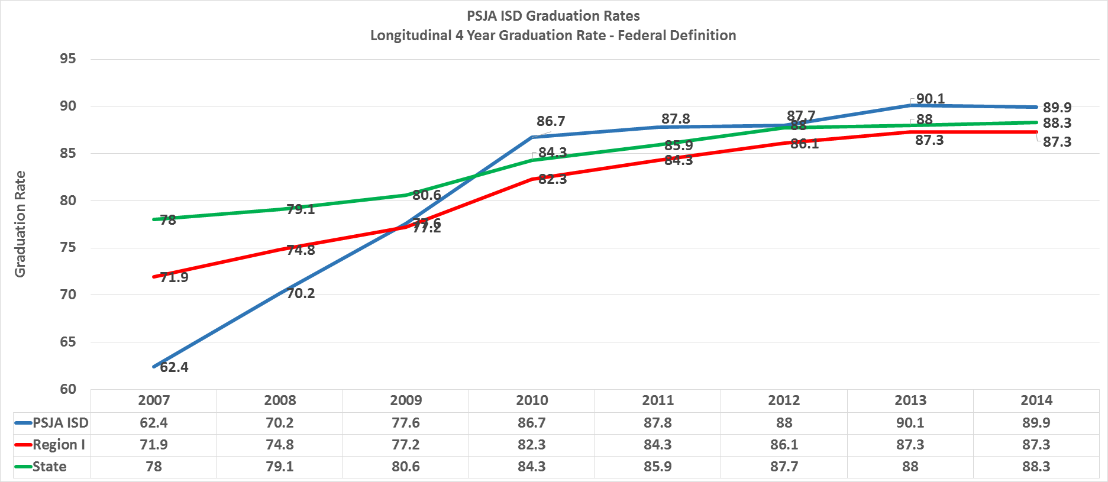
FOUR-YEAR GRADUATION RATE
2007-2014

Slide 19
DISTRICT-WIDE SCALE UP
College Ready School Designs
PSJA Demonstration Project
“College For All”

Slide 20
COLLEGE FOR ALL
Small schools offering an Associate Degree and/or up to 60 college hours for all students. These will be scaled to school wide over time.
Redesign of entire high school to install supportive pathways that allow every student a possibility to earn up to 60 college hours or an Associate Degree.
SCHOOL WITHIN A SCHOOL
EARLY COLLEGE HS
SCHOOLWIDE EARLY COLLEGE
HIGH SCHOOL
PSJA North ECHS (school-within-a-school)
PSJA Memorial ECHS (school-within-a-school)
PSJA ECHS (school-within-a-school)
PSJA T. Jefferson T-STEM ECHS
PSJA Southwest ECHS
PSJA Sonia Sotomayor ECHS*
Back-on-Track schools that adapt the early college concept for students off-track for high school graduation or have dropped out and seek to transition them to college.
College, Career & Technology Academy
PSJA Elvis J. Ballew High School
BACK ON TRACK TO COLLEGE
PSJA/STC:
DUAL TO DEGREE
District-wide redesign of the 11th & 12th grades to provide dual enrollment opportunities for all students. All students will participate in a program of study leading to a certificate or college degree.
PSJA North High School
PSJA Memorial High School
PSJA High School
SYSTEMIC TRANSFORMATION
PSJA ISD – ECHS, Dual Enrollment & College Connected Pathways for ALL
COMMON ELEMENTS
Meaningful college courses, tuition free
High schools and college partners share responsibility for secondary-postsecondary success
Untracked and developed at all high schools
Supported transition into postsecondary

Slide 21
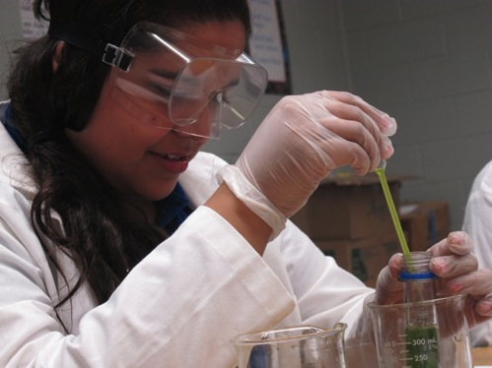
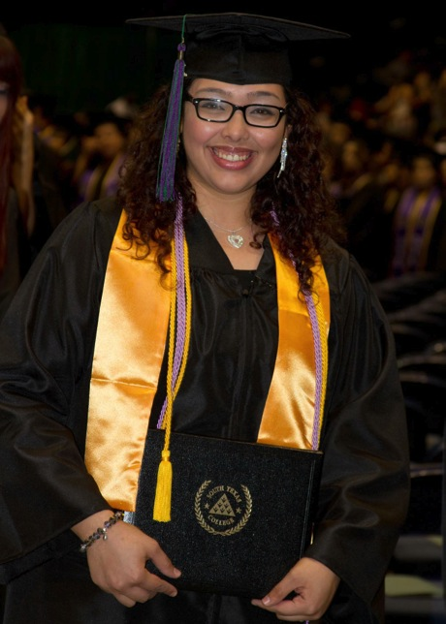
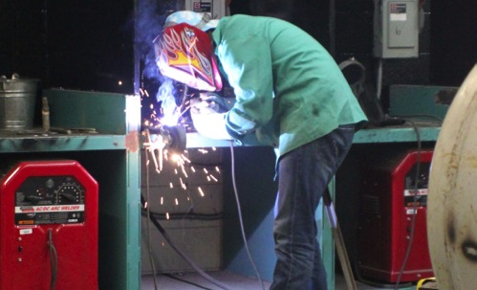
START COLLEGE NOW! COMPLETE EARLY! GO FAR!

Slide 22
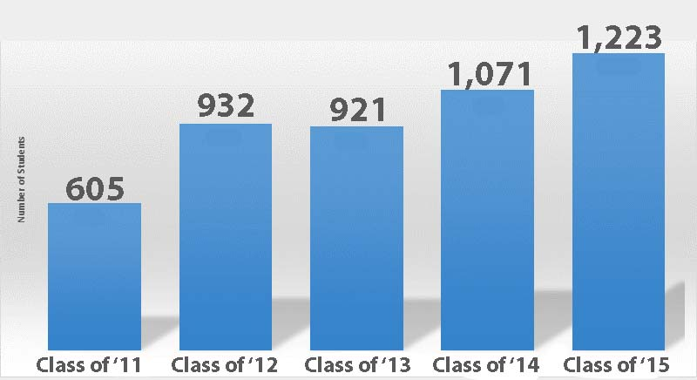
GRADUATES EARNING COLLEGE CREDIT

Slide 23
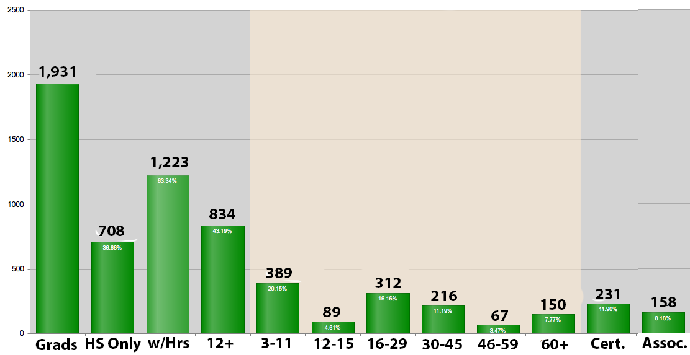
COLLEGE HOURS CLASS OF 2015

Slide 24
DISTRICT GOALS:
PERCENT OF GRADUATING CLASS WITH 12 OR MORE COLLEGE HOURS

Slide 25
DISTRICT GOALS

Slide 26
KEY POLICIES: DUAL ENROLLMENT & ECHS
TEXAS
For dual enrollment classes the school district (average daily attendance) and the college (contact hours) receive full state funding.
School districts have access to transportation funding to take students to college campus or other school campuses as needed for delivery of instruction.
ECHS students may begin taking college classes in 9th grade based on eligibility criteria and dual enrollment students may begin at the end of their sophomore year (with some exceptions for an earlier start).
Includes CTE courses and pathways in dual enrollment and ECHS programs.

Slide 27
KEY POLICIES: DUAL ENROLLMENT & ECHS
SOUTH TEXAS COLLEGE
STC waives tuition for high school students.
STC agrees to keep same textbooks for 3-4 years to keep cost down.
STC pays small stipend to high school teachers who qualify as adjunct faculty.
STC provides faculty to teach at the high schools as needed.

Slide 28
KEY POLICIES: DUAL ENROLLMENT & ECHS
PSJA ISD
District pays a stipend to teachers who teach college classes.
District pays an instructor fee when STC sends college faculty to the high school.
District buses students to the college as needed.
District purchases textbooks and maintains textbook inventory.
District provides college readiness testing at no cost to students. Every high school in the district has been approved by the Higher Education Coordinating Board as a testing site.

Slide 29
KEY POLICIES: DUAL ENROLLMENT & ECHS
STC & PSJA ISD
Have ongoing planning committees to plan, implement, evaluate progress and problem solve.
Have MOU’s in place to establish responsibilities and frame the partnership.
Have a data sharing agreement that addresses FERPA and other issues.
Take joint responsibility for student advising, degree planning, etc. for high school students and alumni.
Take joint responsibility for student and program success.
    Share facilities and equipment.

