Slide 1

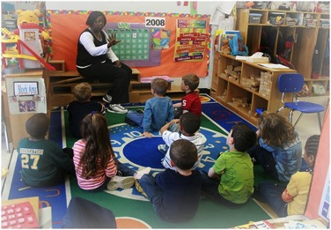
Oregon Educator Equity Advisory Group Highlights
A Presentation for the
OACOA/OASE Winter Conference—January 29, 2016
Full Report available at: http://education.oregon.gov/portfolio/2015-ed-equity-report/

Slide 2
Oregon Educator Equity Advisory Group
Guided by the OEIB Equity Lens, the group’s charge:
Assess, evaluate, and advocate for statewide educational policy and practice that prepares, recruits, and retains culturally and linguistically diverse educators in Oregon.
Meets monthly
Includes representatives from:
  Legislature, Community Organizations, School and District Administrators, Teachers, ODE, OEA, OEIB, OPTA, OSPA, Ed Prep Programs, TSPC, Chalkboard, and HR offices

Slide 3
Applying the Oregon Equity Lens
We have a moral imperative to ensure that our K-12 educator workforce is as diverse as the students and families served and that culturally and linguistically diverse educators are retained and able to advanced in their careers.

Slide 4
Applying the Oregon Equity Lens
Teacher and leader effectiveness in Oregon public schools will be strengthened if our state’s educator preparation providers prepare all teachers and leaders who are effective in teaching all students.
Ineffective and misaligned policies can negatively affect a district’s ability to hire or retain the best candidates (i.e., candidates who possess the “grit” needed to succeed in our most challenging schools).

Slide 5
Oregon Ethnically Diverse Students and Teacher Comparisons- 17 yrs.

Slide 6
2014-15 Race and Ethnicity of Students & Teachers in Oregon Public Schools

Slide 7

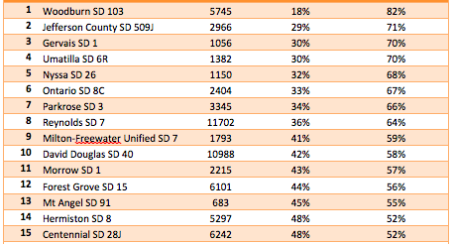
Oregon Districts with the Most Diverse Student Population
Notes:
Thirty school districts with over 40% students of color
Districts include a range in size (82 to 47,647 total enrolled students)
Districts are diverse in geographic location
Among these districts, most increased in diversity (1%) from 2013-14 to 2014-15

Slide 8
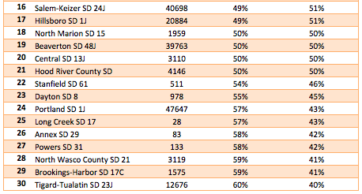
Oregon Districts with the
Most Diverse Student Population
*List was developed based on 2014-2015 ODE Student Fall membership data. All districts with greater than 40% non-white students are included.
**This column reflects the sum of all other race/ethnicity categories aside from white. These include: American Indian/Alaskan Native, Asian, Native Hawaiian/Pacific Islander, Hispanic/Latino, and Multiracial (students who identify with more than one race/ethnicity

Slide 9
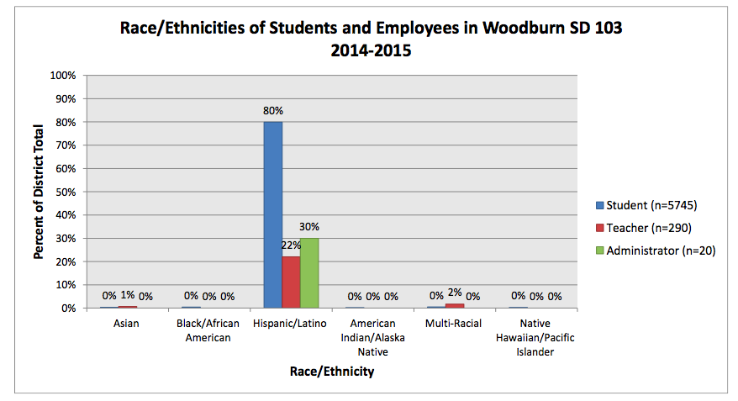
Sample Data Chart
Notes:
Hilda

Slide 10
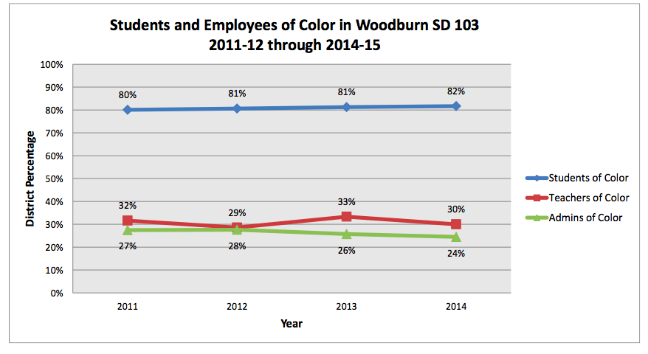
Sample Three Year Snapshot

Slide 11

“I was always given (i.e., known as "stacking or stuffing the classroom") the hardest students (behavioral problems and/or health issues). I always had far more in my rooms than the other teachers who were treated more preferentially. This didn't deter me from teaching, and my students always scored extremely well on state tests. What this DID do was wear me out.”
The school didn’t make me feel as if I was an asset. They made it seem as if they took a chance on me, that I should be lucky. I felt more like a hindrance.”
‐Survey respondent
“Make sure that you find a school that’s mission you can really buy into. If you can’t buy into a mission, then you’re just wasting your time and energy.”
- Survey respondent
“There is nothing like walking into a room full of people who look like you and have had similar experiences as you. It is simply healing."
Anibal Rivera, 1999 PTP Graduate

Slide 12
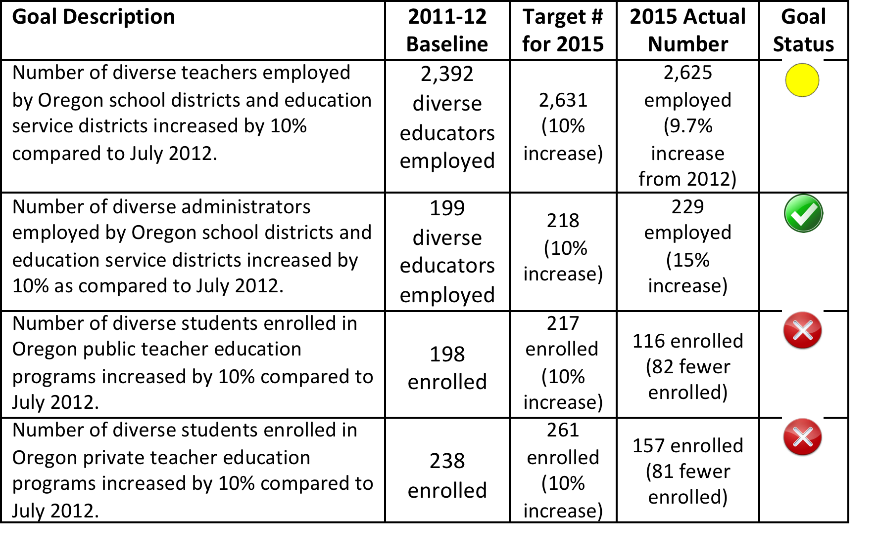
Progress towards SB 755 2015 Goals
Notes:
SB 755 assigned this work to OEIB to coordinate
Revised definition to include individuals whose first language is not English
Set goals of 10% increase over July 2012 level of:
Culturally & linguistically diverse students prepared in teacher preparation programs
Culturally & linguistically diverse educators employed in school districts
Culturally & linguistically diverse administrators employed in school districts
As of July 2015, Oregon is approximately six individuals short of being on track to meet the 2015 goal of increasing the percentage of diverse teachers employed by school districts and education service districts by 10% as compared to July 2012. The 2014-15 data reveal that the number of culturally and linguistically diverse teachers employed in Oregon public schools has increased by 233 since 2011-12 and the total is currently 9.7% higher than the 2012 number of employed diverse teachers in Oregon.
As of July 2015, Oregon has exceeded the 2015 goal of increasing the percentage of diverse administrators employed by school districts and education services districts by 10% as compared to July 2, 2012. The 2014-15 data reveal that the number of culturally and linguistically diverse administrators employed in Oregon public school has increased by 14 and the total is currently 15% higher than the 2012 number of employed diverse administrators in Oregon.
As of July 2015, federally published 2013-14 Oregon data were not yet available to fully analyze progress towards the 2015 goal of increasing the number of racially diverse teacher candidates enrolled in Oregon’s public educator preparation programs by 10% as compared to 2011- 12 data. However, the 2012-13 data show that enrollment of racially diverse candidates decreased in public educator preparation programs by 82 compared to the 2011-12 baseline. For private educator preparation programs (not required to be reported by SB 755), there were 81 fewer racially diverse candidates compared to 2011-12 data. It should be noted that total teacher enrollment for both public and private education preparation programs declined as well.

Slide 13
Proactive Steps Taken in Educator Preparation
TeachOregon projects
ODE Pipeline grants
Ed Prep faculty PD series
Basic Skills Test rule change at TSPC
Annual reports from Ed Prep on goals and progress towards diversifying the candidate pool
HECC Performance based funding-Bilingual Ed.
TeachinOregon.gov website
Notes:
Five TeachOregon projects were supported in 2013-15 (3 funded by Chalkboard and two by the state) include a focus on recruitment and preparation of a diverse educator workforce
Four Culturally and Linguistically Diverse Pipeline grants were funded in 2013-15
New statewide educator recruitment website TeachinOregon.gov launching this summer
Ed Prep faculty professional development series held this year focused on culturally responsive curriculum

Slide 14
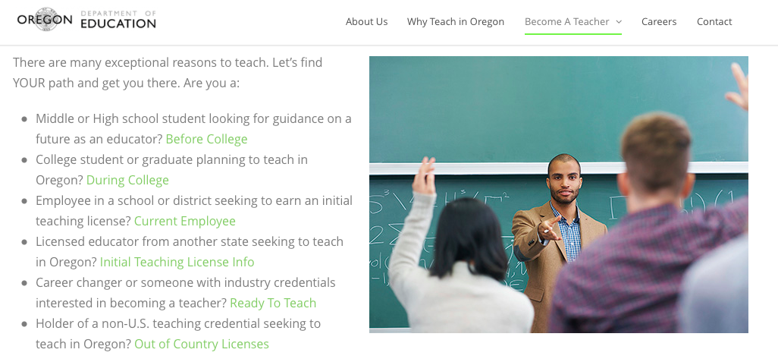
TeachInOregon.gov

Slide 15


Why Oregon's Students of Color Need You

Slide 16
HB 3375 2015 Legislation
REVISED GOAL
“As a result of this state’s commitment to equality for the diverse peoples of this state, the goal of the state is that the percentage of diverse educators employed by a school district or an education service district reflects the percentage of diverse students in the public schools of this state or the percentage of diverse students in the district. ”
Notes:
Hilda

Slide 17
Proactive Steps Taken: Hiring & Retention
ODE Retention grants
More examples from districts using Implicit Bias training for recruiting/interviewing teams
Federal State Plan to Ensure Equitable Access to Excellent Educators
Study of Voices of Licensed but now employed Teachers of Color
Changes in recruitment and hiring practices
Notes:
Three Retention grants sponsored by ODE in 2013-15
Federal State Plan submitted to begin addressing gaps in access to excellent educators
Study conducted with currently licensed educators of color who are not working in Oregon public schools (revisions in Fall 15)
District efforts to change recruitment and hiring practices and to embed hiring and retention goals
Ex: Parkrose School District, Springfield, Portland Public, etc.

Slide 18
Oregon Educator Equity
Advisory Group 2015-16 Goals
Develop and share annual state report on progress
Develop and implement a state plan for recruiting, retaining, and supporting professional career pathways for culturally and linguistically diverse educators
Advocate for needed policies and sustainable funding to implement plan

Slide 19

Never doubt that a small group of thoughtful, committed citizens can change the world; indeed, it's the only thing that ever has.
Margaret Mead

