Slide 1
Measuring College Readiness
Jim Soland, Ph.D.
Research Scientist

Slide 2
5 Key Takeaways in 5 Pictures
Predictions academic readiness can be used to broaden horizons
Attitudes and understanding important
Teachers underrated source of data
Academics, attitudes, understanding can be combined
Students set postsecondary path, not schools or policymakers

Slide 3
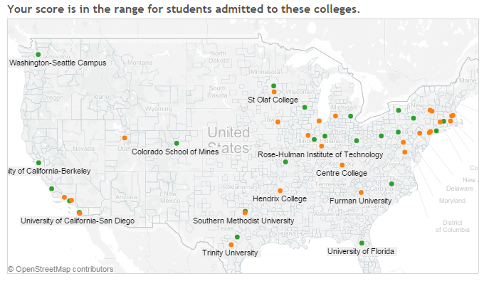
Picture 1: Predictions academic readiness can be used to broaden horizons
Notes:
https://public.tableau.com/profile/john.cronin.nwea#!/vizhome/NextgenerationcollegetableauOctober12/Dashboard1

Slide 4
College readiness benchmark study published
Provides predictions for students to achieve ACT benchmarks in grades 5-9 for both
    ACT = 24 Major State Universities
    ACT = 22 College Readiness Benchmark
410 schools with over 83,000 students

Slide 5
College readiness benchmark study published
Study makes applied & methods contributions:
  Predicts benchmarks when don’t know whether a student will take the ACT or not
  Quite accurate
    5th grade fall math – 63% True: 15% False Predictions
    9th grade spring math– 70% True: 10% False Predictions
Technical study is on NWEA.org (search on College)

Slide 6
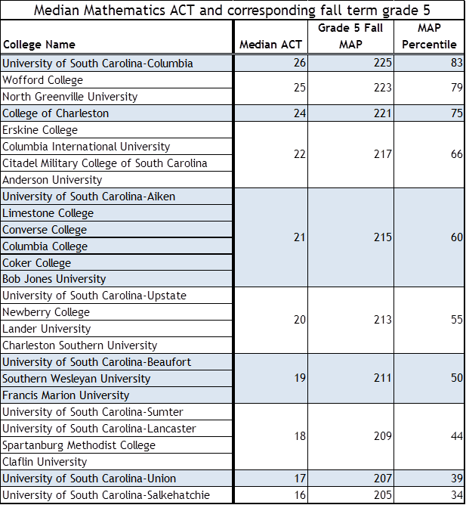
Combine median ACT scores for specific colleges with…

Slide 7
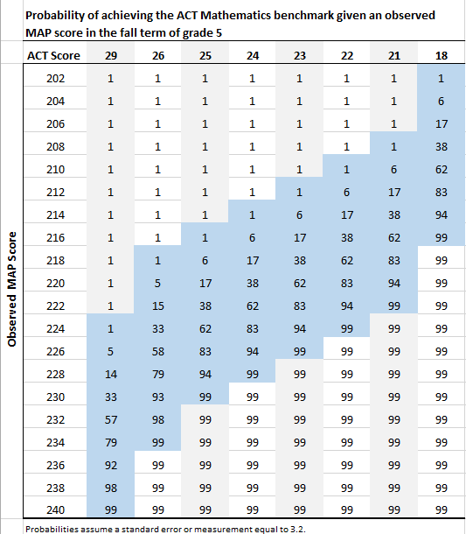
…probability of obtaining an ACT score by RIT score

Slide 8
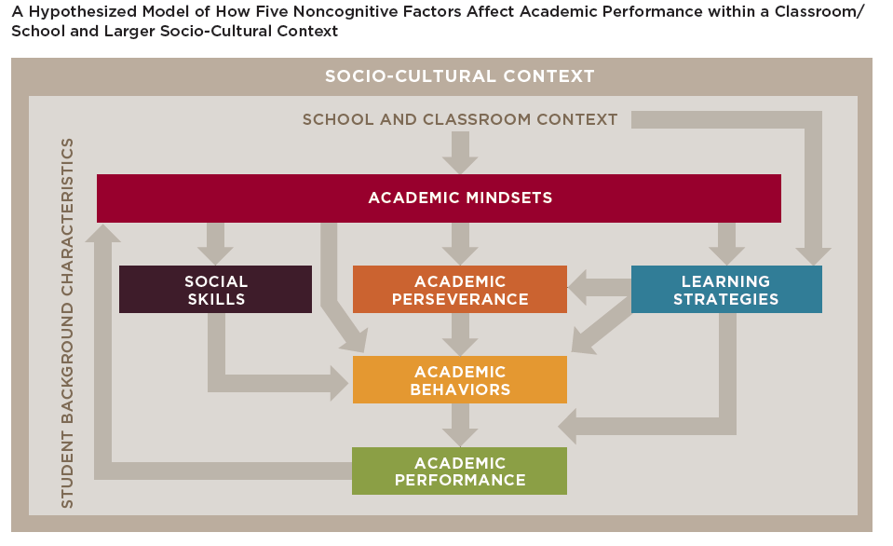
Picture 2. Attitudes and understanding important

Slide 9
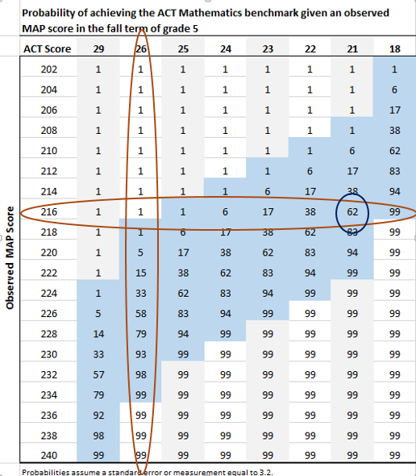

Slide 10
Results can help put college on the radar

Slide 11
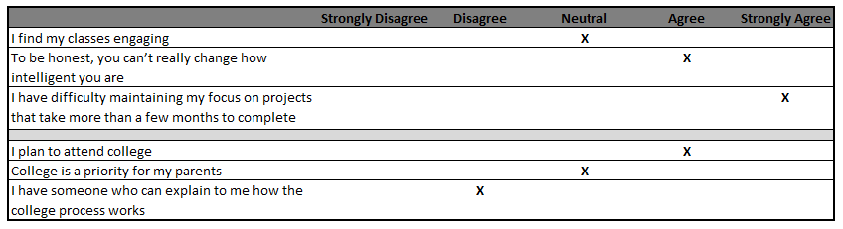
Now here are student’s survey responses…
Notes:
Mention problem with self-report measures (don’t usually get this kind if spread in responses)

Slide 12
College knowledge could be most actionable information
Bettinger, Eric P., et al. The role of simplification and information in college decisions: Results from the H&R Block FAFSA experiment. No. w15361. National Bureau of Economic Research, 2009.

Slide 13
Some schools beginning to fold both domains into the curriculum
Benefits measuring attitudes & understanding:
  Being more intentional
  Building a common vocabulary
  Tying skills to outcomes of interest
  Making curriculum more engaging
  Making students feel more valued
Challenges include:
  Measurement difficulties
  Managing ambiguity
  Avoiding labels
Soland, J., Hamilton, L. S., & Stecher, B. M. (2013). Measuring 21st Century Competencies: Guidance for Educators. Santa Monica, CA: The RAND Corporation.

Slide 14
Picture 3. Teachers underrated source of data
Soland, 2013. Journal of Education for Students Placed at Risk

Slide 15
Teachers good at measuring these outcomes
Outcome | Teacher | Model
Dropout
% Correct | 82 | 88
% Incorrect | 11 | 12
% Unsure | 7 | 0
College Readiness
% Correct | 62 | 82
% Incorrect | 22 | 18
% Unsure | 16 | 0
Notes:
Takeaways
-teachers can be quite accurate (especially when remove unsure category, look at same group of students)
-accurate in part because they base judgment on AT information
-models can help in gray areas

Slide 16
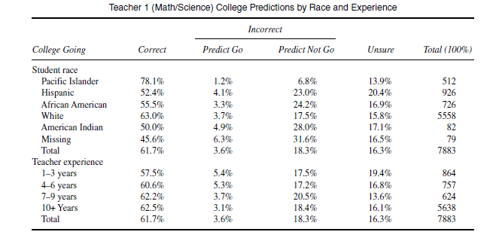
Biggest risk relying on teacher judgment is bias

Slide 17
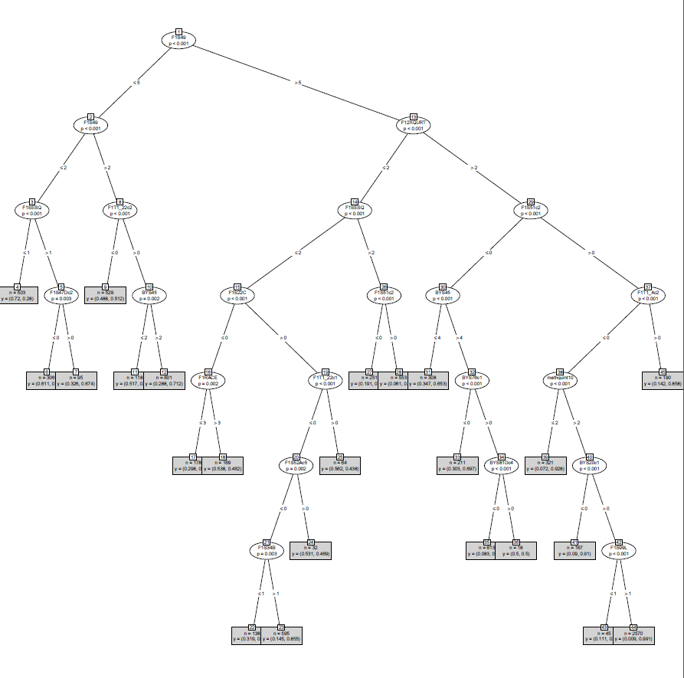
Picture 4. Academics, attitudes, understanding can be combined

Slide 18
Most “important” predictors include SES, aspirations, test scores

Slide 19
Predictions accurate, balanced

Slide 20
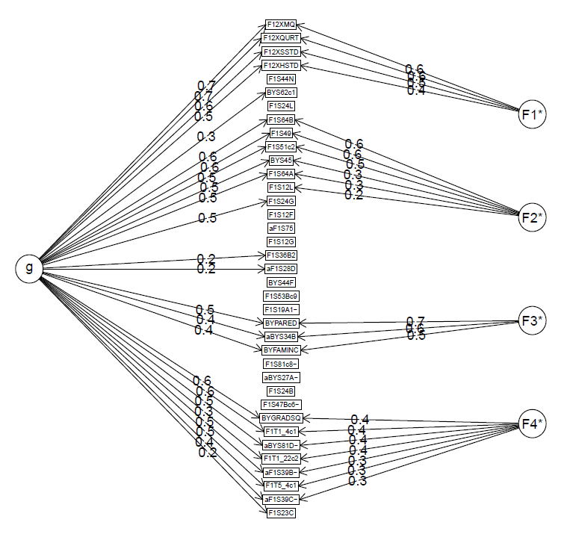
Picture 4b. Predictive variables measure four constructs
Test scores
College aspirations & expectations
SES
Teacher perceptions of student readiness

Slide 21
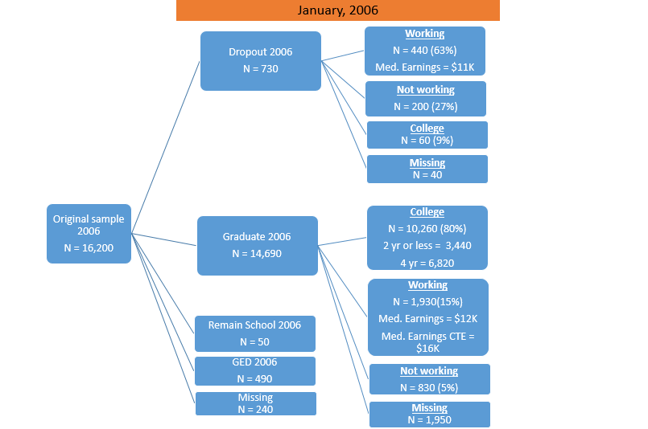
Picture 5. Students set postsecondary path, not schools or policymakers

Slide 22
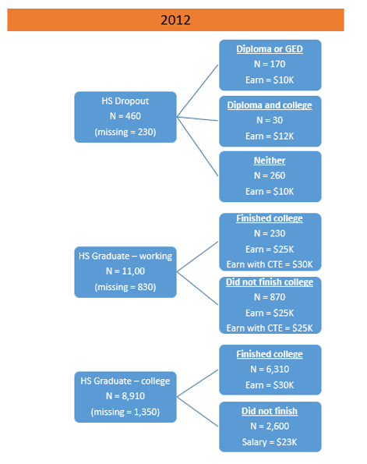
Most working students do not go back to school

Slide 23
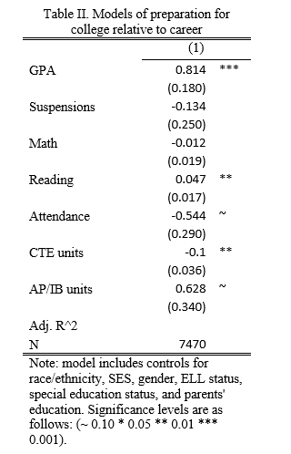
College grads and workers with high salaries similar

Slide 24
IN CONCLUSION…

Slide 28
Test scores
College aspirations & expectations
SES
Teacher perceptions of student readiness

Slide 30
Thanks for your time!
Jim Soland jim.soland@nwea.org

