Slide 1


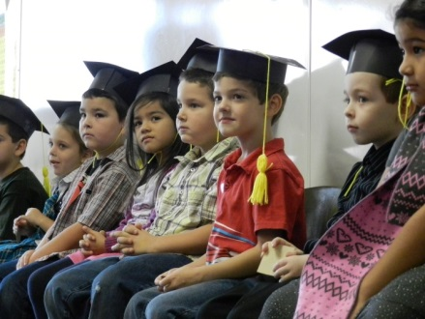

Early Learning & Kindergarten
Standards Alignment:
A clear path to success through aligned standards
August 18, 2015

Slide 2
Outcomes
After today’s session, the group will:
Understand the importance of PreK-3rd Alignment
Be aware of the state’s current effort to align Prekindergarten and Kindergarten Standards

Slide 3
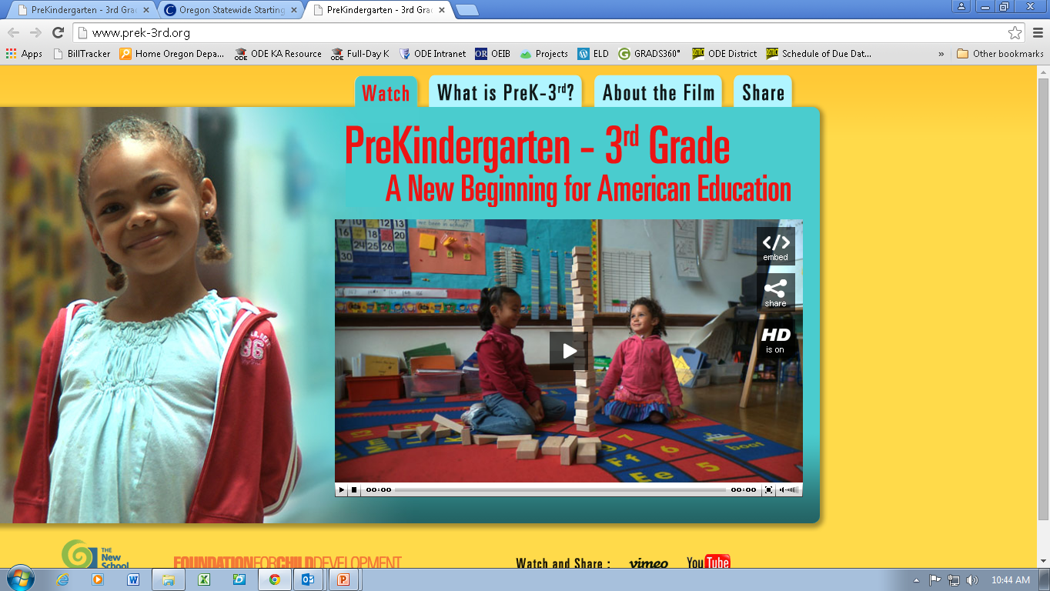
Why P-3 Alignment?
PreKindergarten-3rd Grade: A New Beginning for American Education

Slide 4
5 Core Components of a PreK-3rd Approach
Five components are core to a PreK-3rd approach to education:
Alignment
School organization
Qualified teachers
Classrooms as learning environments
Accountability to parents and communities

Slide 5
Alignment
Standards, curricula, instruction, assessment, and professional development are strongly connected within and across grades from PreK through Third Grade
Standards, curriculum, instruction, assessment, and professional development focus on both social competence and self-discipline as well as academic skills

Slide 6
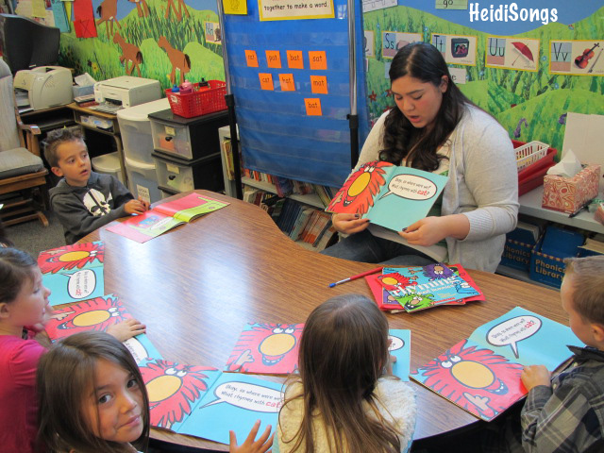
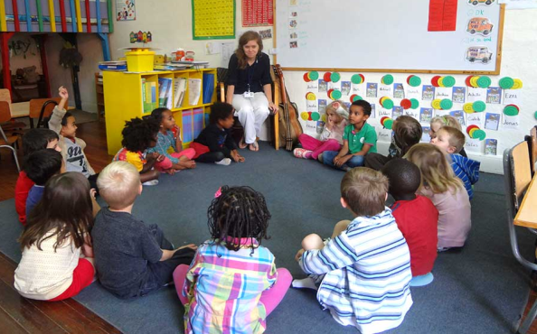
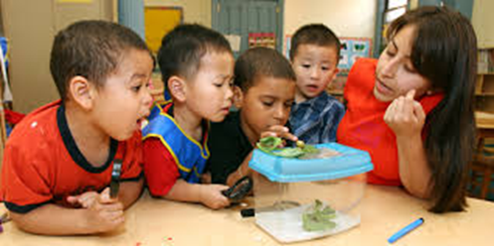
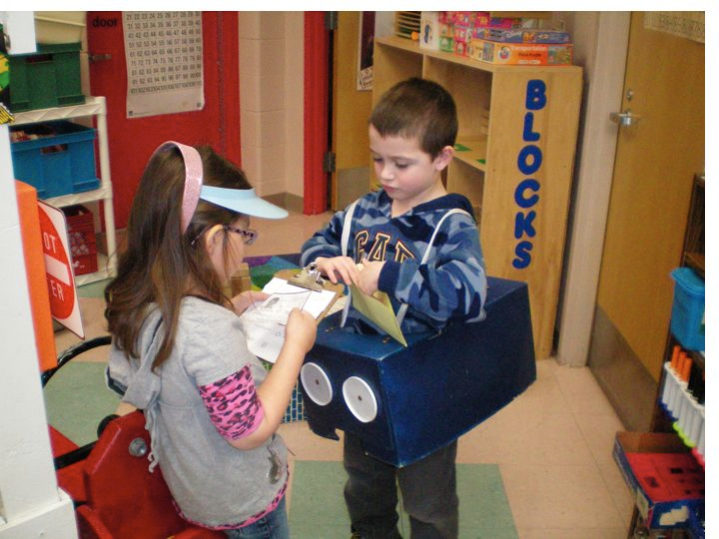
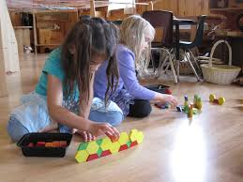
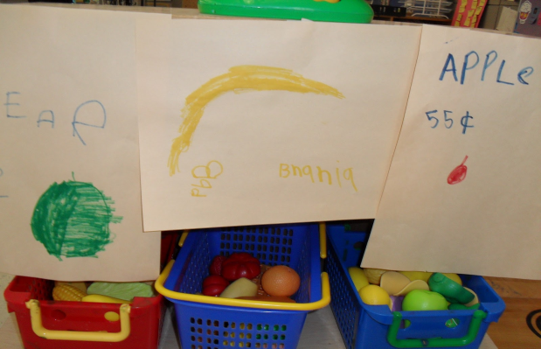
How do Academic and Developmental Standards Fit with DAP?
“Academic rigor meets developmental science”
Academic content is the “what”
Developmentally appropriate practice is the “how”

Slide 7
Oregon’s Early Learning and Kindergarten Standards Alignment Project Goals
Clearly articulate how the domains of Oregon’s early learning and development standards align with Oregon’s academic standards for kindergarten
Develop a set of tools and resources to support the implementation of aligned standards across the P-3 continuum
Ensure that the products are culturally responsive and help close access and opportunity gaps

Slide 8



Oregon’s Early Learning and Kindergarten Standards
Kindergarten Transition
Aligned Standards for Children Ages 3 to Kindergarten

Slide 9
Domains Included in Alignment
Approaches to Learning
  HS Framework + New Standards for K
Social and Emotional
  HS Framework + New standards for K
Language and Communication
  HS Framework + CCSS ELA-K
Literacy
  HS Framework + CCSS ELA-K
Mathematics
  HS Framework + CCSS Math-K

Slide 10
Alignment Workgroup’s Guiding Values
Embrace equity
  Equity of voice
  Culturally responsive practice
  Closing access & opportunity gaps
Learn from others
  Local standards alignment efforts
  Other states
Respect different funds of knowledge, experience, and perspectives
Balance ‘developmentally appropriate’ and ‘academic vigor’
Isolate standards from curriculum, instruction, and assessment (for now)

Slide 11
Project Recap To Date
March 2015: Project launched in March with a 35+ member work group consisting of experts from early learning, K-12, and the research community.
April-June 2015: Four small work groups drafted aligned standards language for the domains of language, literacy, math, and social-emotional development/approaches to learning.
June 23-24, 2015: In-person, work group decided to:
  Use new Head Start Learning Outcomes Framework as the foundation for aligned standards
  Include domain-level introductory narrative
  Include age level progressions
July 2015: Initial working draft language was shared with the work group via webinar. Key areas for feedback included:
  How inclusive is draft language of multiple settings?
  How culturally responsive is the draft language?
  How effectively does draft language address accommodations/differentiation for children who receive special education services?

Slide 12
Project Recap to Date, cont.
August 18, 2015: Workgroup convened for one day in-person session. Broke into five small groups focusing on:
  Learning Progressions
  Equity Lens
  Supports for Children With Disabilities
  What Adults Can Do
  Domain Narrative & Document Introduction

Slide 13
Review of Alignment Documents
This group will have the opportunity to look at the structure and format of the draft documents.

Slide 14
Next Steps
Staff will compile revised domain and narrative language into a single document
Phase II of the project
  Stakeholder engagement
  Resource development
  Design
  Launch

Slide 15
Feedback from the Group
If you were in charge of rolling out the standards alignment, what would you do?
What kinds of tools/resources would you like to see to accompany it?
With your experience in education, what are some examples of highly effective resources? What made them highly effective?

