Slide 1
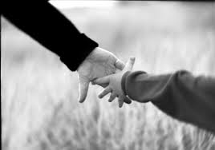
Concepts and Tools for Improved Engagement
Kenan Ginsberg, MSW, Attendance Specialist
Kenan_Ginsberg@ddouglas.k12.or.us
503.953.9660

Slide 2

Don’t forget your warm ups…
Expectations
Real is Better than Perfect
Take Chances
Introductions
“Think of a client…”

Slide 3

Seat Belts ON!
We’re about to go FAST
Get the concepts, let the words slide by

Slide 4
What is Assertive Engagement?
AE is an approach to working with people.
AE keeps the client centered and respected as the expert on their family and their situation.
AE guides the worker in how to develop a healthy and trusting relationship.
AE focuses our work on drawing out and exploring the client’s wishes, desires, challenges and abilities.
Rather than focusing on fixing the client’s problems for them, AE allows the client to be the agent of their own change and their own success.

Slide 5
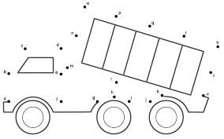
What we’ll do
Guiding Concepts
How we may Hurt
How we may help
Tools, Activities, Practice

Slide 6

Who we are in charge of…
Focus on our own actions and how they affect our clients.
Learn some real steps to take to decrease reactivity and other negative responses.
See every interaction as an opportunity.

Slide 7
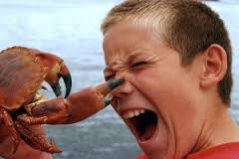
How we may Hurt
The Case for Caution
Damaging Relationship
Judgment
The “Righting Reflex”
Arguing one side of Ambivalence

Slide 8

The Case for Caution
The Ravine
Hierarchy
Tunneling

Slide 9

How to Avoid the Ravine
Coming Alongside
Ask-Offer-Ask
Listening
Empathy

Slide 10

We focus on Relationship
Many of the worlds cultures have an important emphasis on relationship.
There is also a heightened emphasis on relationship for people living in poverty.
Life Crises, Mental Health, Dependency: Ditto.
Our ideas, information, or solutions cannot come before we have established a solid relationship.
Therefore, relationship building is one of our primary avenues to helping our clients.

Slide 11

Skill #1 - Listening
Why Listen? (AKA The Power of Listening)
Activity

Slide 12

Skill #2 - How to give information
ASK - OFFER - ASK
Ask what they already know
Ask permission to provide new information
Offer the information
Ask what they think
Notes:
Since the rule on information in AE is to ask permission before giving it, I thought we should open with this. We ask what they already know about AE. Get the main points written up on chart paper or white board. Then Ask permission to provide new information….. And launch in from there.
This becomes a great starting discussion and demonstrates one of the biggest skills and principles right off the bat

Slide 13
What Works?
Research has shown that only 15% of client success is attributable to the model used.
85% percent of factors identified for successful treatment come from client factors, hope & the relationship between the provider and client
Notes:
Seth
Activity to lead with: Ask group to raise their hands if they have ever been to a training to discuss a specific model. Do they use a specific model at their work?Now raise your hand if you have ever been to a training to discuss Hope and having Healthy Relationships with your clients. Explore the (presumed) disparity.
Then discuss this research. – Seth
3.6.14 Additions:
11
You did this one, not me, we can change the name above. I’m fine with it…

Slide 14


Non-Judgment
The Flatscreen TV
The Doctor who Drinks
Where else do we struggle
with Judgment?

Slide 15
The “Righting Reflex”
Definition: A circumstance where our desire to solve a problem takes precedence over the client’s right to be seen as the expert in their life. Often results in damage to relationship.
Reminder: Focusing on Relationship, Strengths, Hope, etc. will allow your clients to be their own expert, their own agents of change, progress, or growth.
Protection: Ask-Offer-Ask

Slide 16

Ambivalence
Ambivalence means feeling 2 ways about the same idea, concept, or decision.
It is normal and it is healthy.
It is an Opportunity for us.
What happens if you upset the balance?

Slide 17


Change Talk In order for things to get better something is going to have to change…
Change Talk has to come out of the Right Mouth…
Skill #3: “Sharp Eyes” for: Ambivalence/Change Talk
Sharp Eyes Activity
For

Slide 18

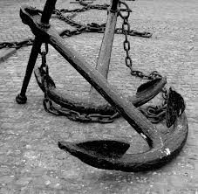
We also have Sharp Eyes for…
Change Talk
Hope
Strengths (They anchor us, ground us)
For
&

Slide 19


Take these Tools for your Tool belt…
Ask-Offer-Ask
Listening
Non-judgment
Sharp Eyes
Relationship
…And remember these Cautions
The Ravine
Hierarchy
Judgment
The Righting Reflex
Information before Relation
Closing and Takeaways

