Slide 1
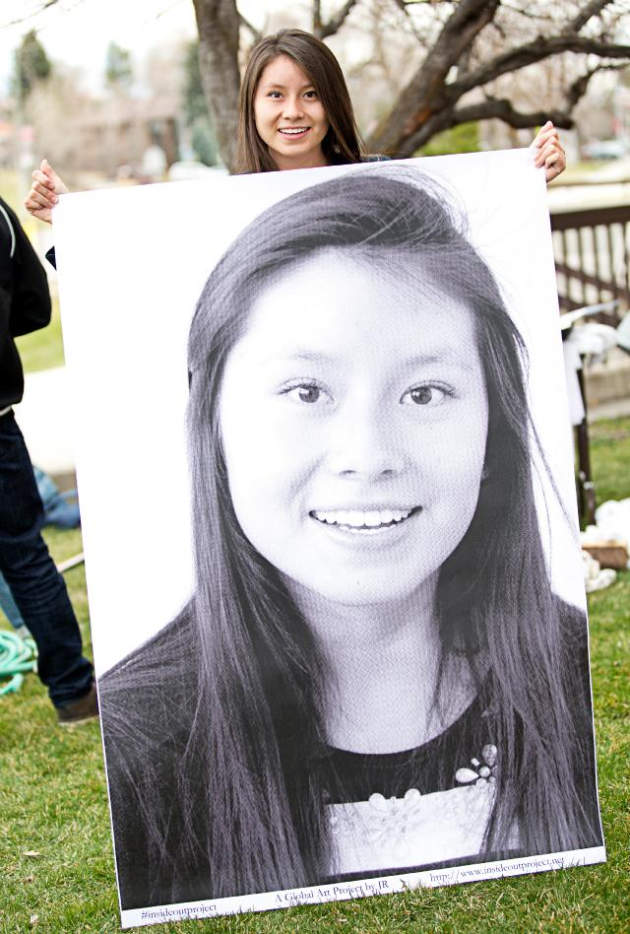

AVID
Leading College & Career Readiness Districtwide - Transforming Student Outcomes
AVID's mission is to close the achievement gap by preparing all students for college readiness and success in a global society.

Slide 2
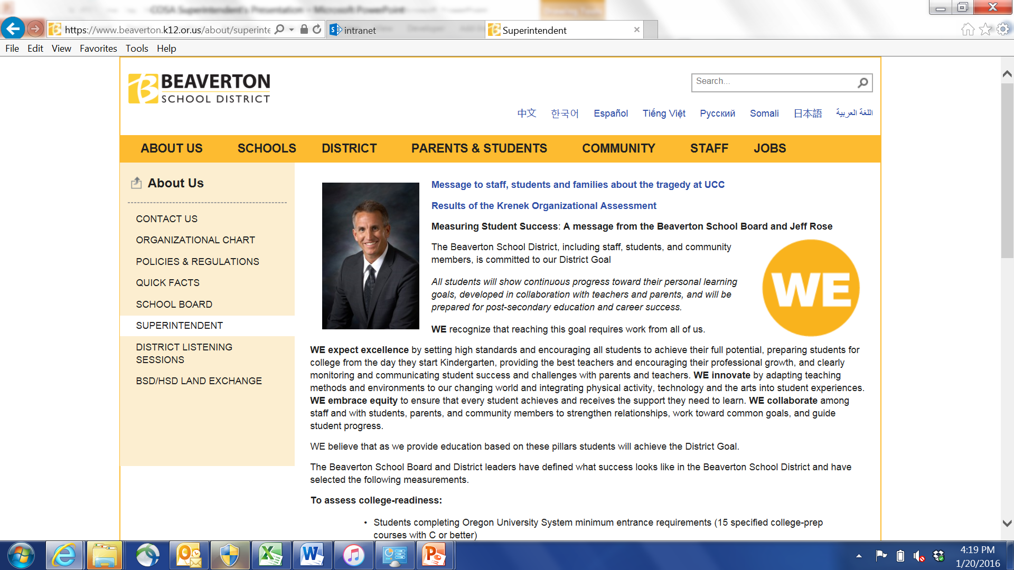
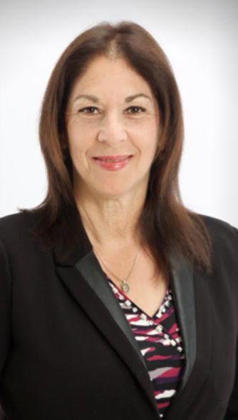
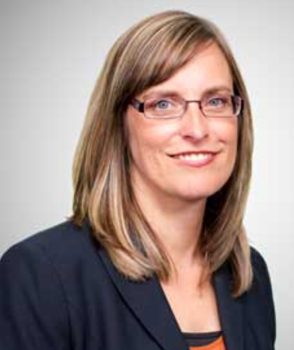
Superintendent Panel
Beaverton SD: Dr. Jeff Rose
Parkrose SD: Dr. Karen Fischer Gray
Salem-Keizer SD: Christy Perry

Slide 3
AVID in Oregon School Districts
Describe the impact AVID has had on your district in terms of preparing all students for success in college, career and life?
What piece of advice would you have for superintendents who are just beginning their AVID journey?

Slide 4
Presented by
Denise Wren
Director Leadership & Professional Learning
dwren@avid.org
Melissa Cole
AVID State Director, Oregon
mcole@avid.org

Slide 5
Learning Objectives
Participants will…
Explore “Why” AVID?
Analyze current district-level systems pertaining to college readiness
Gain a better understanding of how AVID can support the vision of college & career readiness
Articulate a 3-year or 5-year plan to support college readiness districtwide

Slide 6

Student Voices

Slide 7
Our Mission
AVID’s mission is to close the achievement gap by preparing all students for college readiness and success in a global society.

Slide 8

Making a Connection
In your table group:
Introduce yourself.
Identify your school & district.
Identify your role.
Make a connection with one word or statement from AVID’s mission that resonates with you & your district mission.
Notes:
Ice breaker activity – Purpose: establishes a safe table group environment. promotes networking, and makes a direct connection to AVID’s mission.

Slide 9
Elevator Speech
What is your “Why” for
College Readiness for all students?

Slide 10
Lines of Communication
Round 1:
Share elevator speech
Round 2:
Share how you have communicated your “Why” or how you plan to communicate your “Why.”

Slide 11
AVID Secondary 11 Essentials
Set Up AVID
1. Student Selection
2. Voluntary Participation
3. AVID Elective During School Day
4. Rigorous Curriculum
Deliver AVID
5. Organization
6. Reading and Writing
7. Inquiry and Collaboration
8. Trained Tutors
Support AVID
9. Data Collection and Analysis
10. Resource Commitment
11. Active Interdisciplinary Site Team

Slide 12
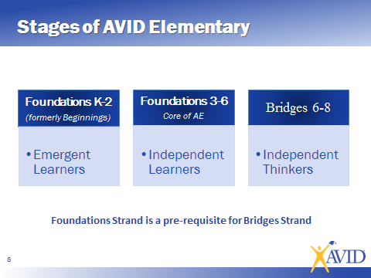
Stages of AVID Elementary

Slide 13
AVID Elementary 4 Essentials
Essential 1
Instruction
Writing to learn, Inquiry, Collaboration, Organization, and Reading to learn (WICOR) are the foundations for instruction in AVID elementary classrooms
Essential 2
Culture
AVID Elementary sites incorporate rigorous, relevant, differentiated opportunities for all students in an environment that promotes college readiness.
Essential 3
Leadership
AVID Elementary leaders support, guide, and facilitate AVID Elementary implementation for all students.
Essential 4
Systems
AVID Elementary sites align their systems through accountability, articulation, assessment, and calibration to ensure the quality of AVID Elementary implementation.

Slide 14

AVID Is Schoolwide When…
…A strong AVID system transforms the Instruction, Systems, Leadership, and Culture of a school, ensuring college readiness for all AVID Elective students and improved academic performance for all students based on increased opportunities.

Slide 15

Stand, Share, and Sit
How does learning around AVID Secondary, AVID Elementary, and AVID Schoolwide compare to what you know about AVID and/or what you have seen in your District?

Slide 16
Focusing on a College Ready Vision
In table groups:
Draw a 3- Column Chart on Chart Paper.
On the far right column, identify characteristics you want to see in a “College Ready Student”.
Then, go back, in the first column identify characteristics of students in your schools today.

Slide 17
What is your vision for your district?
Current descriptor of a Student
Vision of a College Ready Student
Some students are able to critically think and persevere to solve problems.
Able to critically think and persevere to solve problems.

Slide 18

District Strategic Plan
District Leadership
Strategic Plan
AVID District Director
DD Plan
School Administrators
SIP
AVID Site Team
Site Team Plan
Reduced Variability in Student Experiences

Slide 19
Districtwide AVID
Districtwide AVID is aligning District resources and planning to support the quality and sustainable schoolwide implementation of the AVID system at schools K-12.
Districtwide AVID alignment reduces the variability experienced by all students in K-12 system resulting in graduates who have had access to rigorous instructional opportunities and are college ready.

Slide 20
Districtwide AVID
Districtwide AVID is aligning District resources and planning to support the quality and sustainable schoolwide implementation of the AVID system at schools K-12.
Districtwide AVID alignment reduces the variability experienced by all students in K-12 system resulting in graduates who have had access to rigorous instructional opportunities and are college ready.

Slide 21
Superintendent and BOE establish the foundational belief system and support the culture that all students can be successful
District leadership sets vision for Districtwide AVID
-District leadership commitment
AVID college readiness culture becomes an integral part of the
District Strategic Plan
Leadership Commitment and Accountability
Establish District Infrastructure and Systems
Ongoing Evaluation Systems
K-12 Instructional and Accountability to Support Sites

Slide 22
ACTIVITY
Take a few minutes and reflect on the Culture arrow of the Districtwide graphic tool with the following question:
How does this align with your current Strategic Plan?

Slide 23
Leadership Commitment and Accountability
•Site Principal is an active member of the leadership team and is committed to fidelity
•Site Leadership team is committed to implementation and sustainability with fidelity

Slide 24
ACTIVITY
Take a few minutes and reflect on the Leadership part of the Districtwide graphic tool with the following question:
How does this align with your current Strategic Plan?

Slide 25
Establish District Infrastructure and Systems
• DD selection
• District level Visioning team-sustainability plan
• Community Partnerships
• Resource Allocation

Slide 26
Ongoing Evaluation Systems
•Defined data points to support AVID’s integration into the District’s continuous improvement cycle
•Number of AVID sites and successful Certification

Slide 27
ACTIVITY
Take a few minutes and reflect on the System parts of the Districtwide graphic tool with the following question:
How does this align with your current Strategic Plan?

Slide 28
K-12 Instructional and Accountability to Support Sites
• Integrate AVID with District Adult Professional Learning Plan
• WICOR language
• Leverage strategies
• WICOR integration with other academic priorities

Slide 29
ACTIVITY
Take a few minutes and reflect on the Instructional part of the Districtwide graphic tool with the following question:
How does this align with your current Strategic Plan?
Notes:
Brief report out to bring finality to conversations

Slide 30
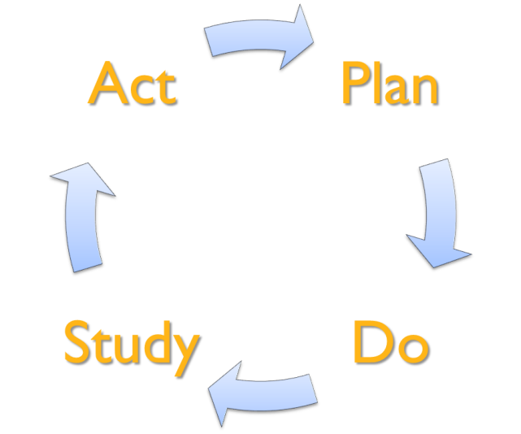
Developing a 3 or 5 – Year Plan
Step 1 – Plan & Prepare
Organize the process, Gather Input, Review Data
Step 2 – Establish Priorities
Develop priorities, including resources needed
Step 3 – Support Priorities
Determine Funding sources
Step 4 – Implement Plan
Step 5 - Monitor & Adjust

Slide 31
Superintendent and BOE establish the foundational belief system and support the culture that all students can be successful
District leadership sets vision for Districtwide AVID
-District leadership commitment
AVID college readiness culture becomes an integral part of the
District Strategic Plan
Leadership Commitment and Accountability
Establish District Infrastructure and Systems
Ongoing Evaluation Systems
K-12 Instructional and Accountability to Support Sites

Slide 32
Planning for Success
Leadership
Commitment and
Accountability
Establish District
Infrastructure
and Systems
Ongoing Evaluation
System
K-12 Instructional & Accountability to Support Sites

Slide 33
Backwards Planning Brainstorm
In table groups:
You’ve already identify where you want your schools to be in terms of Districtwide AVID or College & Career Readiness.
Describe how you’ll know if your schools will reach it.
Moving into Planning:
Move to Year 3 or 5– based on your brainstorm identify your priority, develop a goal & work through the SMART planning document.
Build backwards.

Slide 34
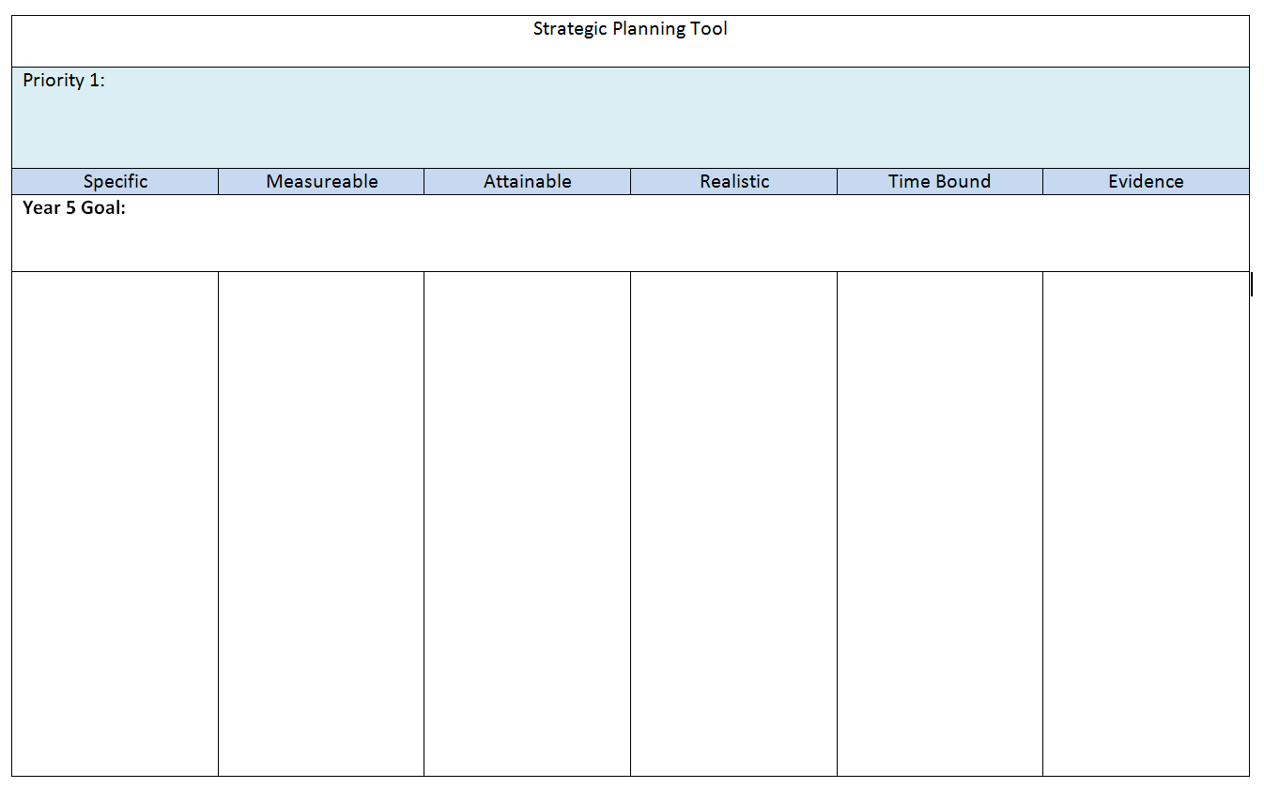
Strategic Planning
Determine Priority (consistent from Year 1 – 5)
Determine Goal

Slide 35

Thank you!

