Slide 1

Supporting Transition from ECSE to Kindergarten
Portland Public Schools Special Education
Robert D. Cantwell
Academic Programs Administrator
Maria Gianotti
Early Childhood Transition Specialist
Beth Raisman
Kindergarten Teacher
Notes:
Intro selves and explain roles

Slide 2

Why are you here?
Who’s in the audience?

Slide 3
Learning Objectives for Today
Provide an overview of the PPS model and share the challenges and successes of this past year
Learn ideas for increasing and improving family engagement, i.e. Family Info sessions
Learn the importance of stakeholders (district early childhood staff, contracted ECSE providers, K teachers, building administrators, Special Ed administrators, families, etc.) working collaboratively to ensure a successful transition
Learn about resources needed to support K transition in this model
Learn strategies for ensuring the transition process is culturally responsive

Slide 4
District Overview
Portland Public Schools, founded in 1851, is an urban school district in Portland, Oregon. With more than 48,500 students in 78 schools, it is the largest school district in the Pacific Northwest.
At Portland Public Schools, this is our goal: By the end of elementary, middle and high school, every student by name will meet or exceed academic standards and will be fully prepared to make productive life decisions.
PPS students also attend the Head Start Early Childhood Education program.
Animate each bullet

Slide 5
PPS Facts and Figures
Schools
Elementary schools | 28
K-8 schools | 29
Middle schools | 10
High schools | 10
K-12 schools | 1

Slide 6
http://www.pps.k12.or.us/about-us/index.htm

Slide 7
Page 2 of the Fairfax handout
As one HS mother shared with us, “I don’t think there is a very good transition of parents...it is a huge shock for parents who were in this warm, welcoming, all-encompassing coverage of a Head Start program...then you go to the public school system and it’s like culture shock.”

Slide 8
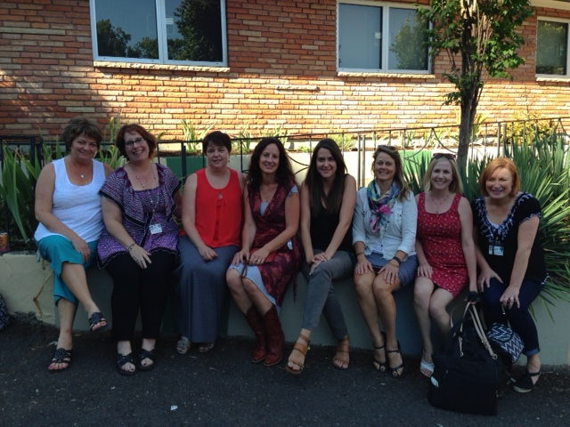
PPS Early Childhood Transition Team

Slide 9
Early Childhood Transition Team
Provides children and families with an internal point of contact and support to ensure a successful transition from early childhood special education services to kindergarten.
Provides additional support to K teachers and school teams.

Slide 10
Early Childhood Transition Team
8 Staff = 7.6 FTE
3 Teachers
3 Speech Language Pathologists
1 Occupational Therapist
.6 School Psychologist
Partial support and supervision from sped administrator as well as two classified staff; temporary one-day/week support from a classified records clerk

Slide 11
Background
Not a brand new model
Brought back in Fall 2014 to relieve workload issues
Partnership with DDMECP; they provide services; we do all assessments for children residing in our district; we support K transition
We supported 480+ transitioning children this year
Transitioning children need to have a school age categorical eligibility; can’t go with DD in Oregon
3D Process in PPS; way to frontload supports and fade over time

Slide 12
Successes
Using a lens of cultural/linguistic diversity in our approach.
Making a personal connection with families.
Having one familiar face (transition coordinator) all through the process.
Principals attending transition IEP meetings to meet families and learn about the students’ strengths and needs
More kids starting in inclusive learning environments?
Families visiting learning environment options that were being considered.
Strengths-based and Person-Centered Approach. Sharing pictures of child at meeting.
Having ECSE service providers at meetings.
ANIMATE THESE

Slide 13
Successes (cont’d)
Observations completed by transition coordinators
Use Google Apps during meetings to take notes on children
K tchrs appreciate the scheduling in advance; ECTT coordinated scheduling with parents
IEPs were written by staff who have a knowledge of school-based services
First-hand knowledge from in-district team member who had observed the child
Balance out last two slides with equal number of bullets

Slide 14
Challenges
Starting transition evals too late
Sometimes families chooses other school options and the school team must still meet to complete transition IEP. Feels like lost time and energy.
K has become more academic. The pressures of CCSS. Children’s pre-K experience is critical.
Within the early childhood context, social emotional readiness is K readiness.
K Teachers report that 3-4 IEPs in one day makes for a long day; intense
Some staff feel that CD has become a “gateway” to special education
School teams still feel more adult support is better; 1:1s
Capacity building of school staff; resource mapping
Funding

Slide 15
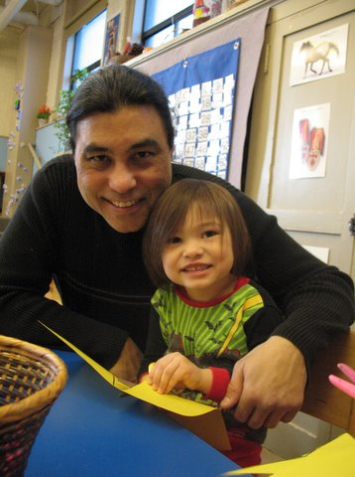
Family Engagement
Family Info Sessions
How many and where
Turnout
What we learned; provide child care and food; decrease handout materials

Slide 16
Culturally Responsive Practices
How we meet families where they’re at. Home visits.
Considering a family’s cultural and linguistic background
Asking families to define their cultural background

Slide 17
Role of Transition Coordinators
Manages the “Cycle”
Record Review as a team
Evaluating all DD, expiring, or complex students
Attend IFSP meetings to meet the family and get to know the student
Permission to complete observations
Meet with neighborhood school special ed team to block out days to discuss incoming Kinders
Work with service provider to complete Early Childhood K checklist
Gather info from family as part of IEP development
Write IEP

Slide 18
The Cycle
Fall: in classroom presence, visibility and support
Coaching/Consultation
START of NEW CYCLE
Mid-October: Record Reviews of next year’s group of children
Invitations from MECP to IFSP meetings; typically our initial meeting of the family
Nov/Dec: Start scheduling transition evaluations
Before Spring Break: Schedule Transition IEP meetings with School Teams
Completion of Transition IEP meetings through summer
Fall: in classroom presence, visibility, and support

Slide 19
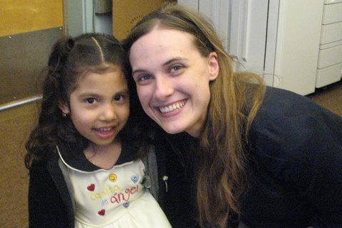
Collaboration with K Teachers
Children who look complex on paper
Student transitioning this fall has mobility issues; first time in 7 years this school has had a child with mobility issues
CD+ kids; social emotional needs
Connect teachers with resources, i.e. websites for pre-made visuals, etc.
The value of dually endorsed teachers - Gen Ed/Sped

Slide 20
Miscellaneous Resources
EKT

Slide 21
Questions?

