Slide 1

Oregon Engagement Summit
November 18, 2015
Oregon ASCD in partnership with COSA

Slide 2

Oregon ASCD
Empowering those committed to enhancing education

Slide 3
Oregon ASCD Board
Colin Cameron, Executive Director
Cate Hill, Bend-La Pine
Chris Gutierrez, OALA
Erin Whitlock, OEA Center for Great Schools
Greg Borgerding, Eugene
Gwen Soderberg-Chase, Grants Pass
Inge Aldersebaes, OEA Choice Trust
Jacquie Jaquette, Central Point
John George, Gresham-Barlow
Lynn Scott, Central Point
Michael Ralls, North Clackamas
Rachael George, Oregon Trail
Samantha Steele, Central Point
Scot Stockwell, St. Helens
Aeylin Summers, North Clackamas

Slide 4
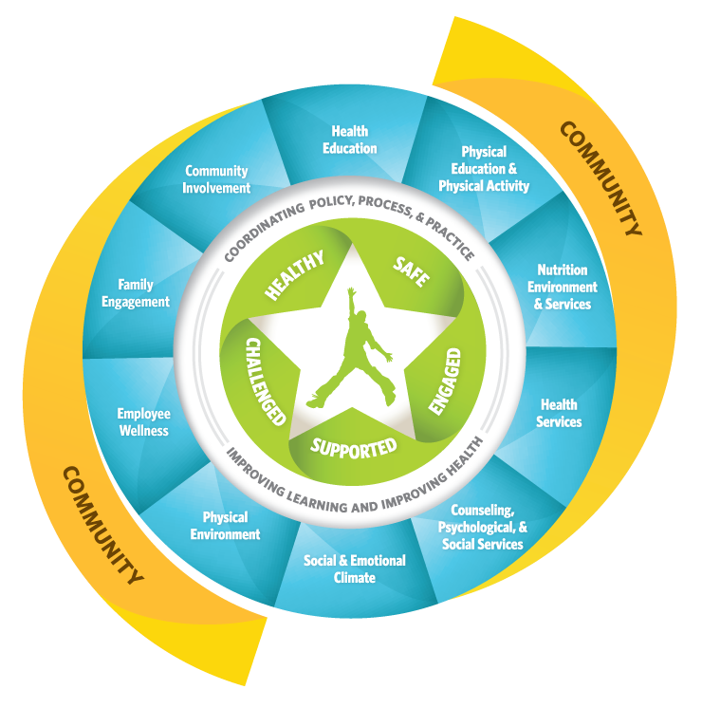
Whole School,
Whole Community, Whole Child

Slide 5
Whole School,
Whole Community, Whole Child
Every student
has the right
to be

Slide 6




HEALTHY
SAFE
ENGAGED
SUPPORTED
CHALLENGED

Slide 7
Oregon Posts Nation's Worst Graduation Rate for Class of 2013
By Betsy Hammond | The Oregonian/OregonLive
January 26, 2015, updated January 27, 2015
Oregon's 69 percent on-time graduation rate for the class of 2013 is the worst of any state in the nation, according to new data posted by the U.S. Department of Education.
Oregon ranks No. 49 in the nation with just one state, Idaho, unable to report its high school graduation rate, the federal report says.
For the class of 2012, Oregon ranked No. 46 in the nation, with Nevada ranking worse and three states unable to accurately calculate their graduation rates in the manner now required by the federal government.

Slide 8
Oregon Fails to Improve
Dismal Graduation Rate
By Betsy Hammond | The Oregonian/OregonLive
on January 29, 2015 at 12:01 AM, updated January 29, 2015 at 11:50 AM
Oregon's on-time graduation rate reached a historic high of 72 percent for the high school class of 2014, the state reported Thursday.
But all of the improvement from the previous year stems from change in the state's definition of a high school graduate, not an uptick in Oregon students earning diplomas.
Had the definition stayed the same, the statewide rate would have fallen almost 1 percentage point, to 68 percent.

Slide 9


Slide 10
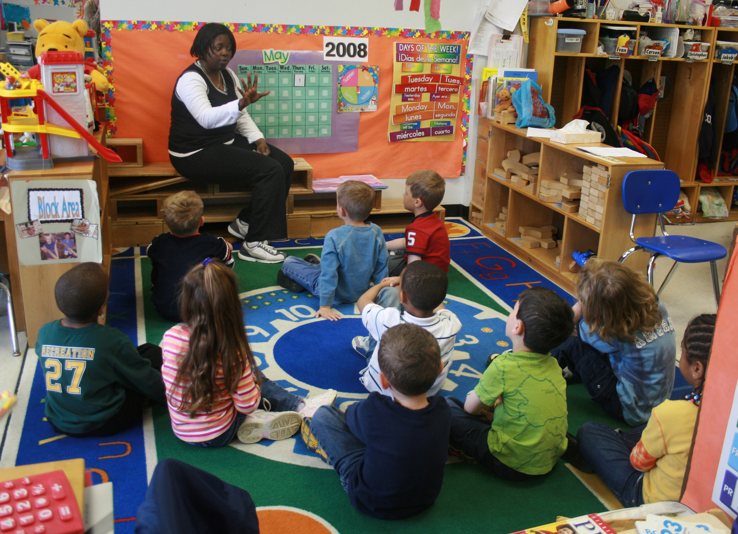

Slide 11
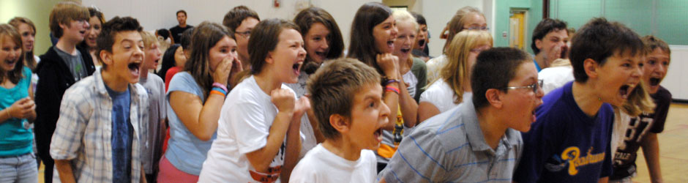

Slide 12
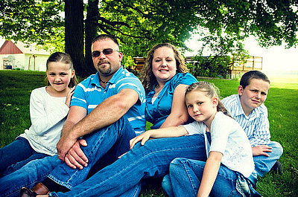

Slide 13
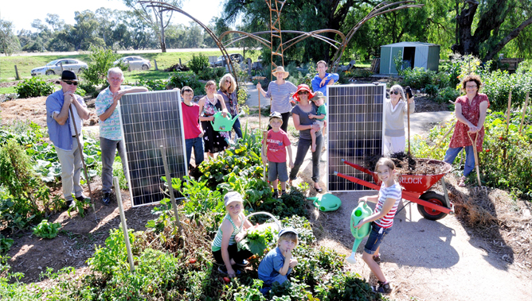

Slide 14
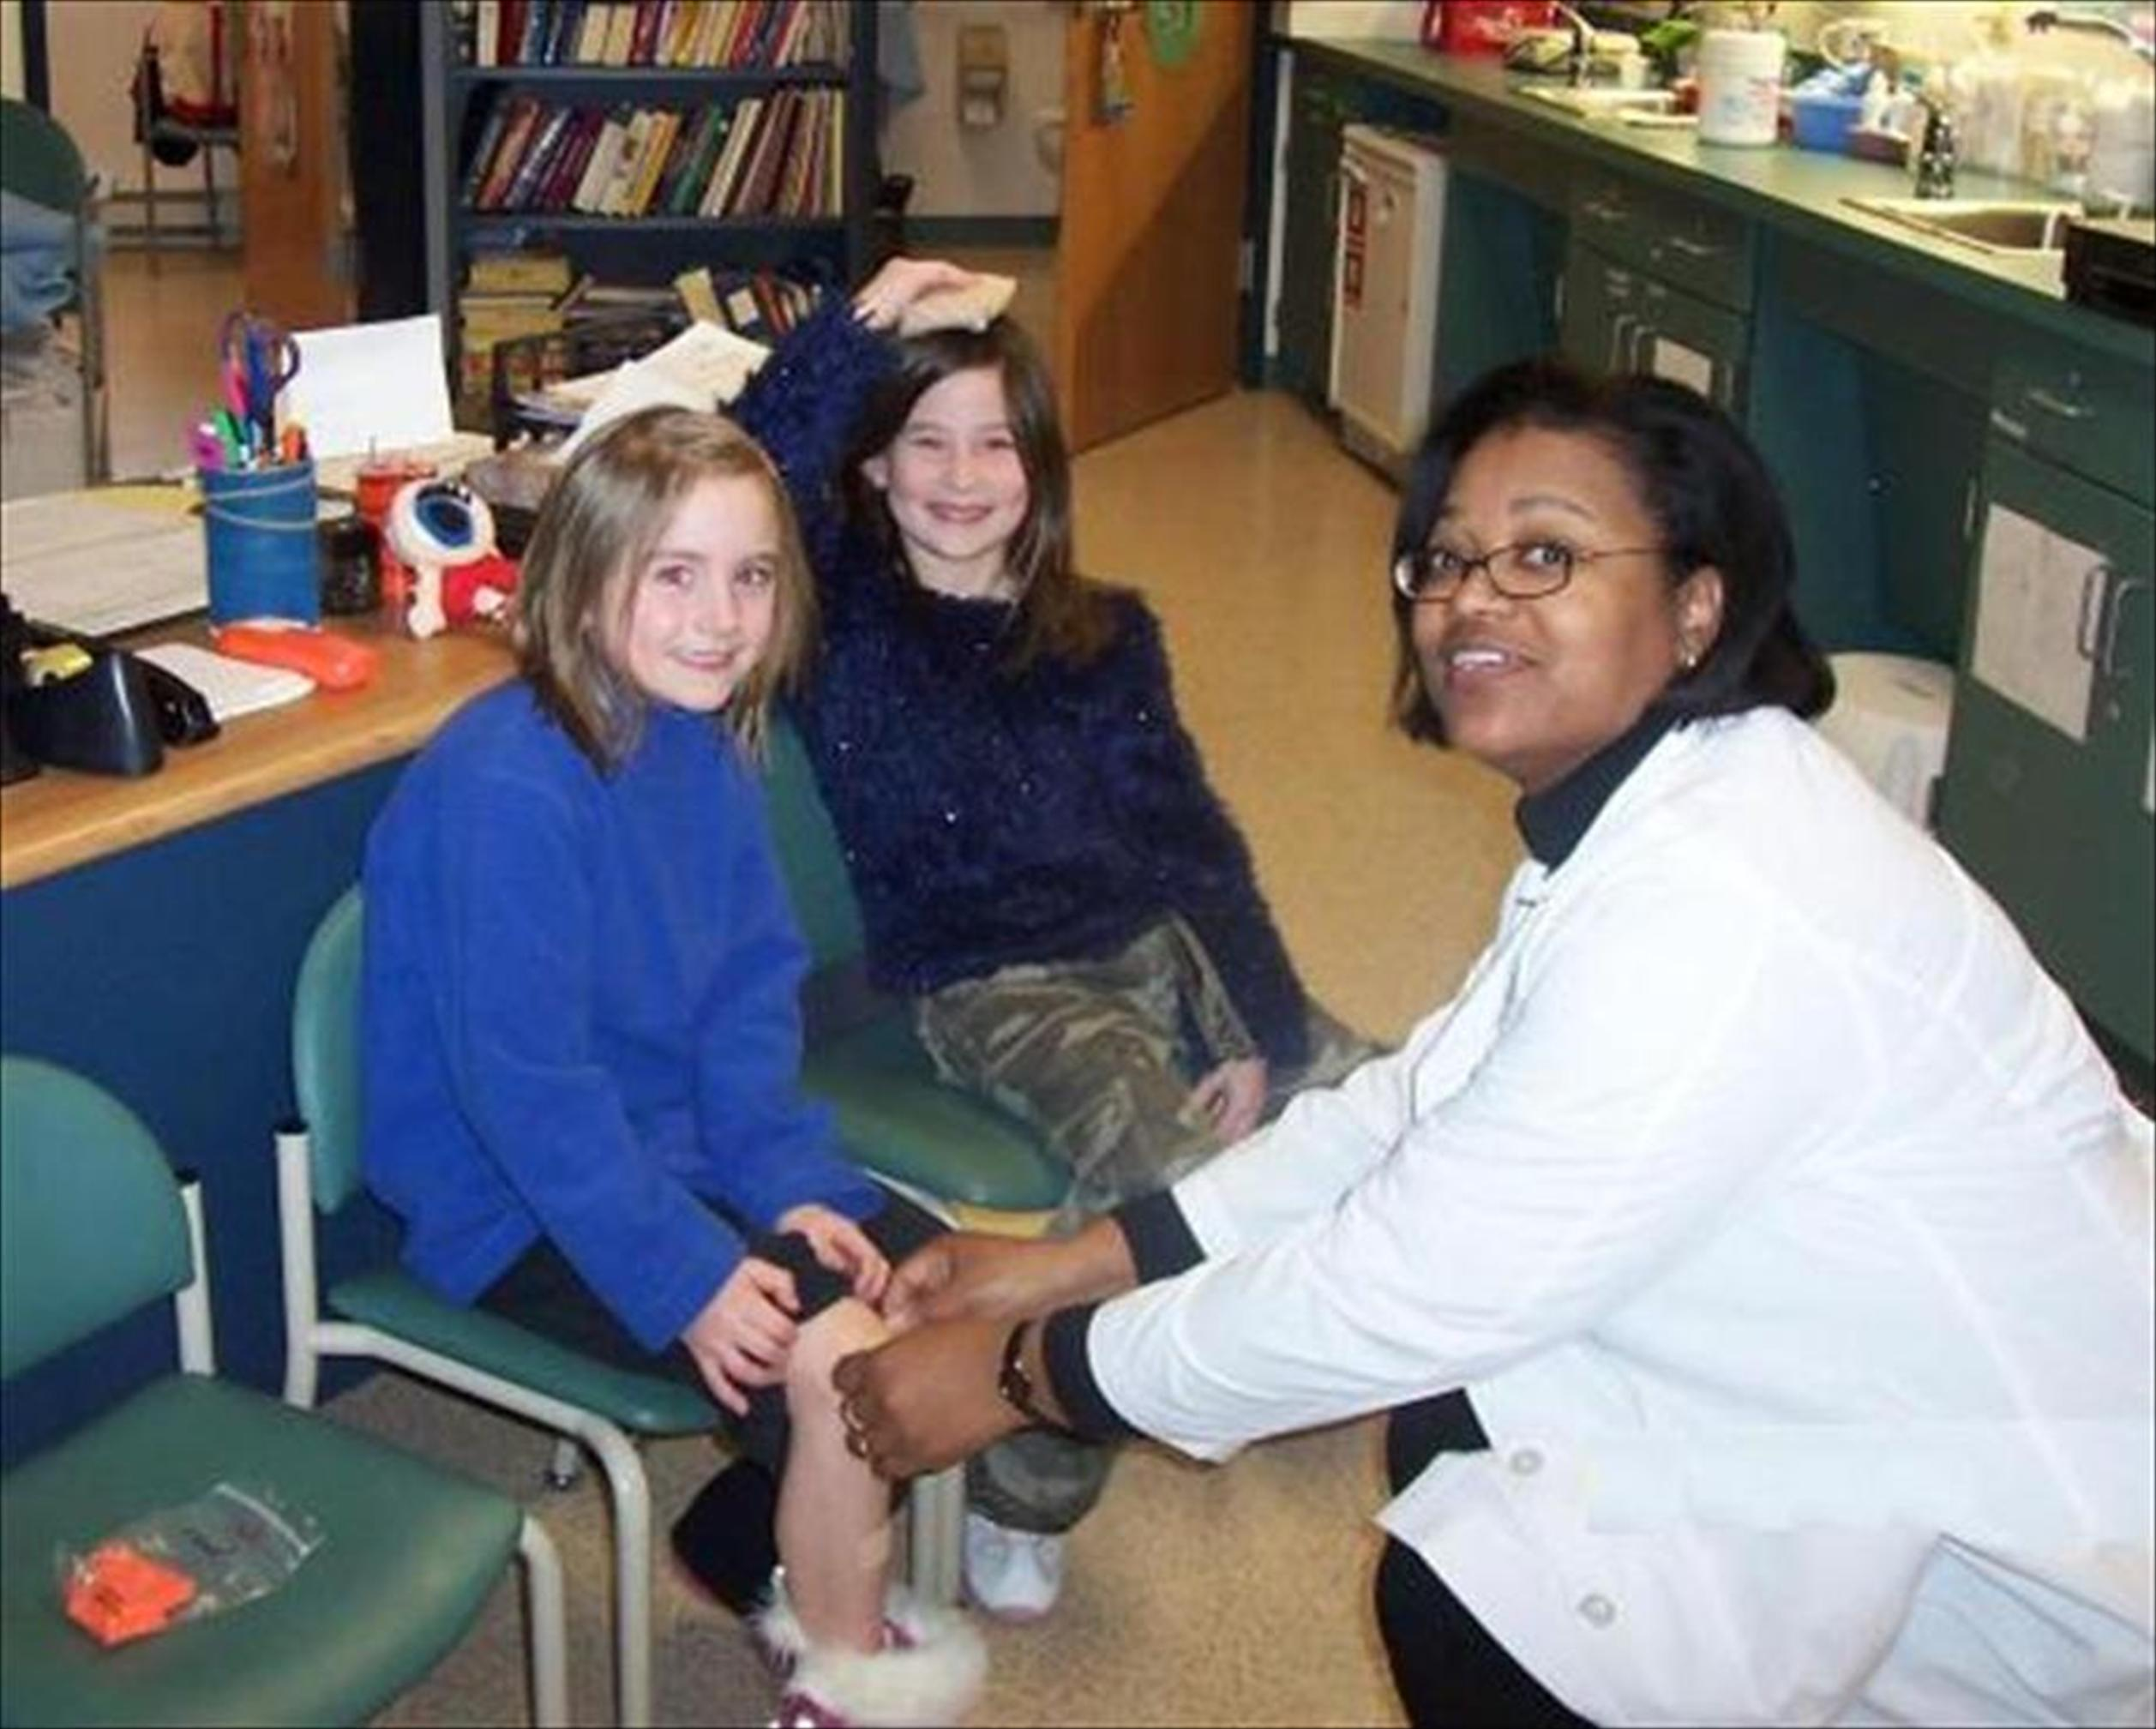

Slide 15

Convene Oregon’s Talent

Slide 16

Convene Oregon’s Talent

Slide 17

Convene Oregon’s Talent

Slide 18
HEALTHY
SAFE
ENGAGED
SUPPORTED
CHALLENGED

