Slide 1
Data Study Strategies
Shawna Moran – School Improvement
Jon Potter – Oregon RTIi
August 5th, 2015

Slide 2

The Problem Solving Process
How is it working?
1. Problem Identification
What is the problem?
Improved Student Achievement
4. Plan Implementation & Evaluation
2. Problem Analysis
What are we going to do about the problem?
Why is the problem occurring?
3. Plan Development

Slide 3


1. Problem Identification
There is a difference between where we are and where we want to be
Where we are
Where we want to be

Slide 4
District/School
Where we want to be
Grade Level
Intervention Group
Where we are
Individual Student

Slide 5
1. Problem Identification
Do your teachers “trust the data?
How clearly are you currently defining “problems” in your district? Do you primarily rely on the data?
“I think…”
“I feel like…”
“I believe…”
“Our data/evidence indicates…”
VS.

Slide 6

2. Problem Analysis: Why is the problem happening?
Focus on “the water”-
__________
__________
__________
E
I
C
Notes:
THE WATER ANALOGY COMES FROM OUR DEAR FRIENDS IN PASCO COUNTY FLORIDA. AMELIA HAS EMBEDDED IN HER TRAINING THE VISUAL OF CLEAR/HEALTHY WATER THAT ALLOW “FISH” TO GROW… THE BALANCES WITHIN THE WATER MUST REMAIN JUST RIGHT, FOR THE FISH TO HAVE A HEALTHY “ENVIRONMENT”… CHILDREN ARE THE SAME WAY… INSTEAD OR WORRYING ABOUT THE INDIVIDUAL “FISH” , ONE SHOULD FIRST START WITH THE “WATER” TO MAKE SURE IT IS BALANCED AND CONTAINS EVERYTHING IT SHOULD! :) IN MY OPINION, THE IOWA CORE CURRICULUM IS GOING TO HELP US CONCENTRATE ON THE WATER! :)

Slide 7
ICEL
Instruction: | Curriculum:
Environment: | Learner:
How you teach
What you teach
Where you teach
Who you teach
Notes:
When analyzing problems, we focus on the ICE

Slide 8
What impacts student achievement?
Effective teaching variables | Effect size | Other variables | Effect size
Formative Evaluation | +0.90 | Socioeconomic Status | +0.57
Comprehensive interventions for students with LD | +0.77 | Parental Involvement | +0.51
Teacher Clarity | +0.75 | Computer based instruction | +0.37
Reciprocal Teaching | +0.74 | School Finances | +0.23
Feedback | +0.73 | Family Structure | +0.17
Teacher-Student Relationships | +0.72 | Whole Language | +0.06
Direct Instruction | +0.59 | Retention | -0.16
John Hattie, Visible Learning, 2009
Notes:
*Effect of computer based instruction not any higher as technology has increased
*There is no research support for ATI’s. Kids benefits from instruction that uses multiple modalities
Talk time – With a partner, talk about one variable that makes sense, and one variable that is a surprise.

Slide 9
District/School
Curriculum needs?
Grade Level
Curriculum & Instruction?
Intervention Group
Instruction & Environment?
Individual Student
Instruction, Environment, & Learner?

Slide 10

3. Plan Development
What action steps are needed to address the problem?
What can we do about the problem?

Slide 11
District/School
Supplement curriculum?
Grade Level
Train on Instructional Strategies?
Intervention Group
Increase explicitness & add behavior management?
Individual Student
Highly individualized plan including instruction, behavior plan, and additional supports?

Slide 12
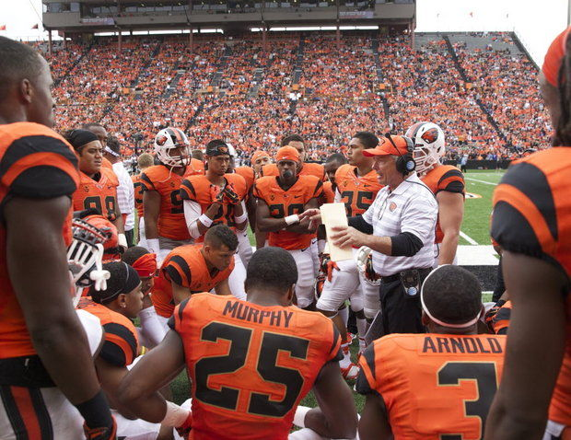
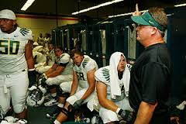
4. Plan Implementation & Evaluation
Implement the plan & evaluate frequently

Slide 13
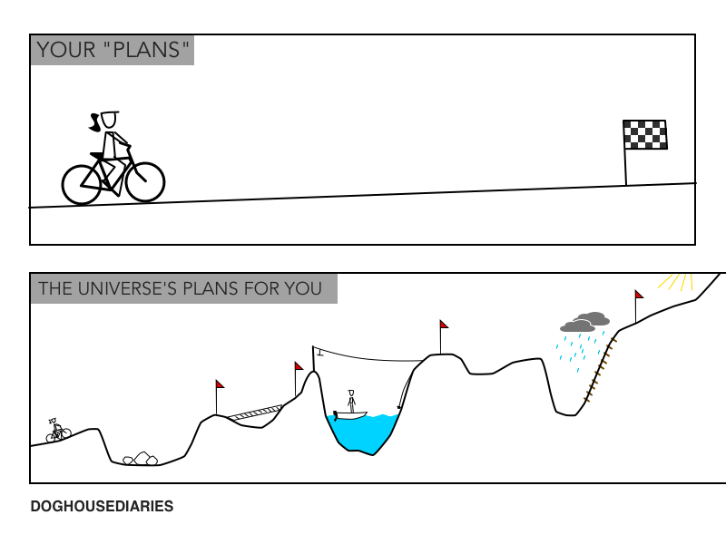

Slide 14
Looking at Benchmarking/Screening Data
100% Meetings

Slide 15
The Problem Solving Process
How is it working?
1. Problem Identification
What is the problem?
Improved Student Achievement
4. Plan Implementation & Evaluation
2. Problem Analysis
What are we going to do about the problem?
Why is the problem occurring?
3. Plan Development

Slide 16
The water….
Focus on “the water”-
Instruction
Curriculum
Environment
E
I
C
Notes:
THE WATER ANALOGY COMES FROM OUR DEAR FRIENDS IN PASCO COUNTY FLORIDA. AMELIA HAS EMBEDDED IN HER TRAINING THE VISUAL OF CLEAR/HEALTHY WATER THAT ALLOW “FISH” TO GROW… THE BALANCES WITHIN THE WATER MUST REMAIN JUST RIGHT, FOR THE FISH TO HAVE A HEALTHY “ENVIRONMENT”… CHILDREN ARE THE SAME WAY… INSTEAD OR WORRYING ABOUT THE INDIVIDUAL “FISH” , ONE SHOULD FIRST START WITH THE “WATER” TO MAKE SURE IT IS BALANCED AND CONTAINS EVERYTHING IT SHOULD! :) IN MY OPINION, THE IOWA CORE CURRICULUM IS GOING TO HELP US CONCENTRATE ON THE WATER! :)

Slide 17
Purpose: 100% Data Meetings
Determine if the grade level is benefiting from core instruction
AND
Refine core instruction to better meet the needs of ALL students at the grade level.
Notes:
Don’t talk about individual students

Slide 18
Why do we look at whole grade level core instruction for 100% meetings?
5%
25%
10%
25%
vs
85%
50%
Is this a whole grade level need or a some students need?
Notes:
Should we use slide 5 or 6 I like this slide better. I wasn’t sure about which picture to use.

Slide 19
General Features
When: | 2-3 times per year (following collection of your schoolwide screening data)
Who: | Principal, Literacy Specialist/Title I, Grade level team Could include SPED, ELL, School Psychologist/Counselor, Paraprofessionals
What: | Use schoolwide screening data to answer questions about core instruction
Outcomes: | Identify the skills/strategies (curriculum) that need additional focus AND Develop a common plan (with a goal) for improving grade level achievement (Instruction, Curriculum, & Environment)

Slide 20
1. Problem Identification: Is the grade level where we want them to be?
15%
25%
60%
5%
15%
At least 80%
-20% difference
Is it a most kids need or a some kids need?
Where we are
Where we want to be
Notes:
Not sure how to fit the questions…. How do we answer this question for 100% meetings on this slide?

Slide 21
2. Problem Analysis: Focus on the ICE
Instruction: | Curriculum:
Environment: | Learner:
How you teach
What you teach
Where you teach
Who you teach

Slide 22
What skills are your students currently lacking?
Reading Comprehension
Reading Comprehension
Vocabulary
Foundational Skills
Fluency
(Accuracy, Prosody & Rate)
Phonics and Word
Recognition
Phonemic Awareness
Print Concepts
Notes:
If we can fill in the gaps, we can decrease the gap between our current performance and our expected or hoped for performance

Slide 23
3. Plan Development: Focus on the ICE
Instruction: | Curriculum:
Environment: | Learner:
How you teach
What you teach
Where you teach
Who you teach

Slide 24
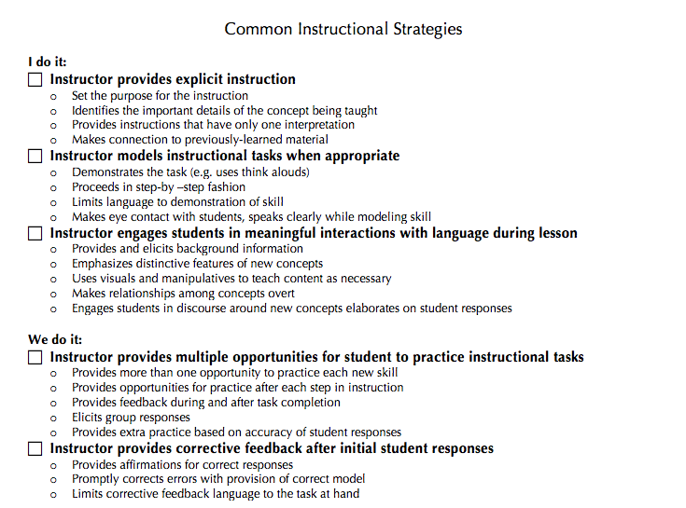
Instruction

Slide 25
    Importance of Active Engagement
How many times it takes to learn something new
Above Average Learner
Average
Truly disabled student
Jo Robinson (2008)
4-14 times
14-250 times
250-350 times
Notes:
How we keep students involved
Oral Responses
Written Responses
Action Responses

Slide 26
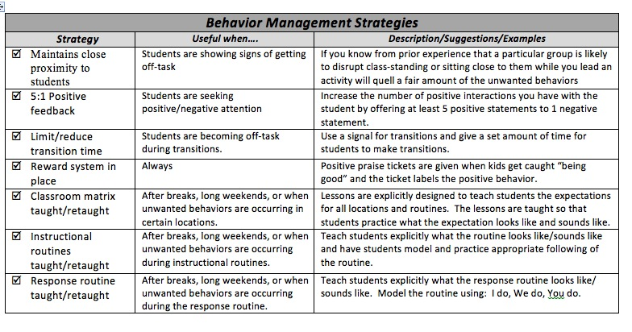
Common Environmental Supports

Slide 27
4: Plan Implementation & Evaluation
At the next benchmarking we ask…
Did we improve?

Slide 28
Was our plan implemented?
How do we ensure that we implement our plan?
  Make it public
  Revisit the agreements at regular PLC/PLT times
  Principal Walkthroughs

Slide 29
4: Plan Evaluation
Next Benchmarking Period
34%
17%
49%
12%
18%
70%
Where we were
Where we are now

Slide 30
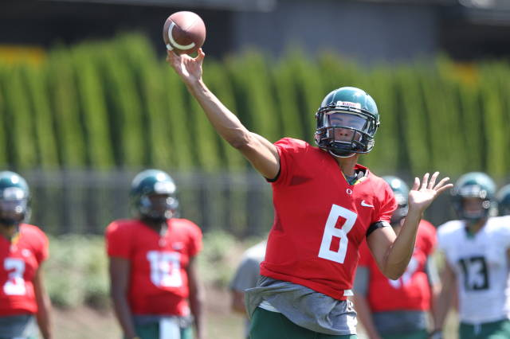

Progress Monitoring:
What information does it give you?
The ultimate goal is not for student’s to be successful inside your classroom.
The ultimate goal is for them to be successful outside your classroom.
progress monitoring
(In-curriculum assessments)
Progress Monitoring
(General Outcome Measures)

Slide 31
What is an intervention?
Scientifically, research-based instructional intervention
An intervention matched to student need that has been demonstrated through scientific research and practice to produce high learning rates for most students (NASDSE, 2008)
Notes:
It’s about odds
Research-based programs have a high probability of success

Slide 32
30-60 minutes of isolated intervention is necessary but not sufficient.
Our most at-risk learners need the most coordinated instruction and support in generalizing skills across their day.
Writing
Specials
ELD
Core Reading
Open
Lunch & Recess
Social Studies/Science
Math
4 hours
15 min
Intervention
45 min
1 hour

Slide 33
Using Progress Monitoring Data
20% or Group Intervention Review Meetings

Slide 34
What are Group Intervention Review Meetings?
Grade level teachers and specialists meet on a regular schedule (e.g., every 6-8 weeks) to use data (e.g., progress monitoring, diagnostic, classroom) and standardized decision rules to determine if interventions are working or need to be modified.

Slide 35

Why do we meet every 6 to 8 weeks?
Research-based interventions do not always work immediately.
In 6-8 weeks, we do not necessarily expect that the intervention has worked, but we expect that the intervention is “working”.

Slide 36
Who sits at the table?
Literacy “Guru”/
Title I
Grade Level Teacher
Grade Level Teacher
Grade Level Teacher
Principal
SPED
Teacher
May also include:
ELL Teacher
School Psych/Counselor
Parapro’s

Slide 37
How often and When do we meet?
How often:
  Every 6-8 weeks, depending on…
    Your decision rules
    Your weekly schedule
When:
  After school?
  Before school?
  During school?

Slide 38
Sample Meeting Schedule:
6 Week Cycle
Sunday | Monday | Tuesday | Wednesday | Thursday | Friday | Saturday
Week 1 |  | Kinder |  |  | 1st Grade Data due
Week 2 |  | 1st Grade | Professional Development |  | 2nd Grade Data due
Week 3 |  | 2nd Grade | Staff Meeting |  | 3rd Grade Data due
Week 4 |  | 3rd Grade | PBIS Meeting |  | 4th Grade Data due
Week 5 |  | 4th Grade |  |  | 5th Grade Data due
Week 6 |  | 5th Grade |  |  | Kinder Data due

Slide 39
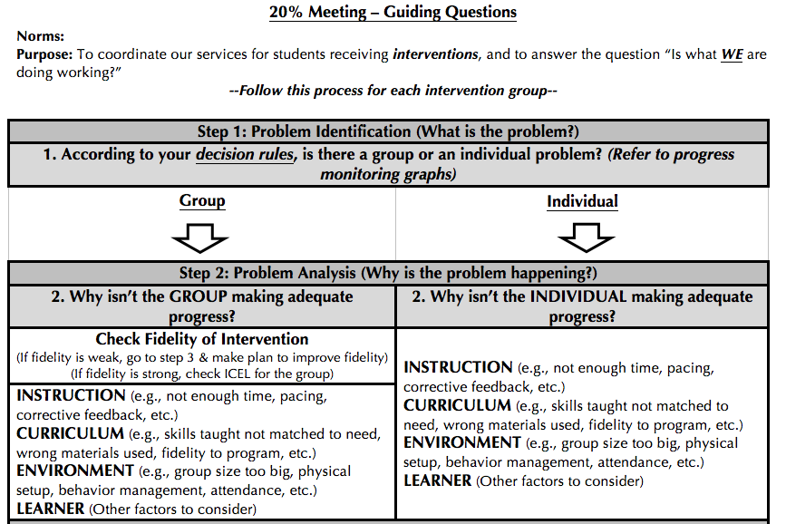
Have an Agenda or Guiding Questions

Slide 40
Group Intervention Review process
Use Decision Rules
1. Problem Identification
What’s the problem

Slide 41
Data-Based Decision Rules
Decision rules guide how we decide if what WE are doing is working
  Use your progress monitoring data
Your decision rules create consistency across grade levels and schools
Determine how to intensify and individualize interventions
Decision rules won’t make the decision for you, but they will tell you when you need to make a decision

Slide 42
Key features of decision rules
Set the grade levels for the decision rules (K, 1-6)
Define success
  Number of points below/above the aimline
  What if the data is highly variable
    Trendline analysis
Balance the duration of intervention & the frequency of monitoring (Length of time in between meetings (6 to 8 weeks)

Slide 43
Example from North Clackamas
Modify interventions when:
Progress monitoring indicates three or more data points below the aimline after 20+ instructional sessions
If data is highly variable, maintain the current intervention for another month to establish a trendline
  Progress is monitored weekly or biweekly.

Slide 44
Exit Rules: Example from TTSD
Consider Exiting students from interventions when:
The student has met the DIBELS Next grade level goal at the next benchmark three times consecutively.
Core reading assessments and intervention assessments indicate grade-level proficiency.
Student has met the benchmark goal on OAKS (for students in grades 3 to 5).

Slide 45
Group Intervention Review process
Use Decision Rules
Group or Individual problem?
1. Problem Identification
What’s the problem

Slide 46
Group or Individual Problem?
6
0
5
0
4
0
Isaiah
Mary
Aimline
3
0
Amy
2
0
1
0
Chase
D
e
c
.
J
a
n
.
F
e
b
.
M
a
r
c
h
A
p
r
i
l
M
a
y
J
u
n
e
S
c
o
r
e
s
S
c
o
r
e
s
S
c
o
r
e
s
S
c
o
r
e
s
S
c
o
r
e
s
S
c
o
r
e
s
S
c
o
r
e
s

Slide 47
Group or Individual Problem?
6
0
5
0
4
0
Aimline
3
0
2
0
Amy
Isaiah
1
0
Chase
Mary
D
e
c
.
J
a
n
.
F
e
b
.
M
a
r
c
h
A
p
r
i
l
M
a
y
J
u
n
e
S
c
o
r
e
s
S
c
o
r
e
s
S
c
o
r
e
s
S
c
o
r
e
s
S
c
o
r
e
s
S
c
o
r
e
s
S
c
o
r
e
s

Slide 48
Starting with intervention groups helps to…
Increases your efficiency
  Can discuss more kids in less time
Identify a group vs. individual problem
  Requires different solutions
Keep the focus on what we are doing

Slide 49
Group Intervention Review process
Use Decision Rules
Group or Individual problem?
1. Problem Identification
What’s the problem
GROUP
INDIVIDUAL
2. Problem Analysis
Why is the problem occurring?
Check ICEL
for group
Start with FIDELITY
3. Plan Development
What are we going to do about the problem?
4. Plan Implementation & Evaluation
How it it working?

Slide 50
Why might the problem be occurring?
The Group
Instruction: | Curriculum:
Environment: | Learner:
Not explicit enough?
Not enough student opportunities to respond?
Not enough instructional time?
Not enough corrective feedback?
Wrong lesson placement?
Wrong focus skill?
FIDELITY
Distracting setting?
Group size too large?
Behavior management needs?
Other things to consider?
Notes:
Jon

Slide 51
Group Intervention Review process
Use Decision Rules
Group or Individual problem?
1. Problem Identification
What’s the problem
GROUP
INDIVIDUAL
2. Problem Analysis
Why is the problem occurring?
Check ICEL
for GROUP
Start with FIDELITY
Check ICEL
for Individual
3. Plan Development
What are we going to do about the problem?
4. Plan Implementation & Evaluation
How it it working?

Slide 52
Why might the problem be occurring?
The Individual
Instruction: | Curriculum:
Environment: | Learner:
Not explicit enough?
Not individual student opportunities to respond?
Not enough instructional time?
Not enough corrective feedback?
Wrong lesson placement?
Wrong focus skill?
More explicit curriculum?
FIDELITY
Distracting setting?
Group size too large?
Individual behavior plan needed?
Other things to consider?
Notes:
What additional data do you need to answer these questions?

Slide 53
Group Intervention Review process
Use Decision Rules
Group or Individual problem?
1. Problem Identification
What’s the problem
GROUP
INDIVIDUAL
2. Problem Analysis
Why is the problem occurring?
Check ICEL
for GROUP
Start with FIDELITY
Check ICEL
for INDIVIDUAL
3. Plan Development
What are we going to do about the problem?
Decision Rules
Make a change for the GROUP
Make a change for the INDIVIDUAL
4. Plan Implementation & Evaluation
How it it working?

Slide 54
What can we change?
Instruction: | Curriculum:
Environment: | Learner:
More instructional time
Refine instructional delivery (with assistance from a reading “expert”)
Change lesson #
Change curriculum
Add curriculum
FIDELITY
Reduce group size
Add behavior plan
Other things to consider
Notes:
Jon

Slide 55
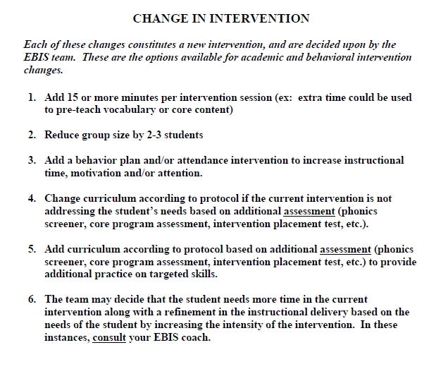
Example from TTSD: What do we change?
INSTRUCTION
ENVIRONMENT
CURRICULUM
INSTRUCTION

Slide 56
A change of intervention does not necessarily mean a change of intervention curriculum.
It means a change in intensity matched to need.

Slide 57
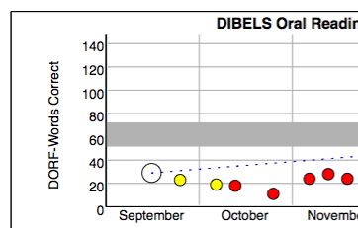
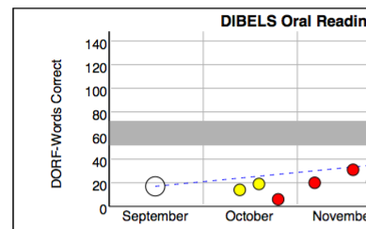
Match the intensity of the change to the intensity of the need
29
24
31
17

Slide 58
Group Intervention Review process
Use Decision Rules
Group or Individual problem?
1. Problem Identification
What’s the problem
GROUP
INDIVIDUAL
2. Problem Analysis
Why is the problem occurring?
Check ICEL
for GROUP
Start with FIDELITY
Check ICEL
for INDIVIDUAL
3. Plan Development
What are we going to do about the problem?
Make a change for the GROUP
Make a change for the INDIVIDUAL
4. Plan Implementation & Evaluation
How it it working?
Implement for 6-8 weeks

