Slide 1
Oregon Math Network Launch
Annual Principals & Teacher Leaders Conference
October 26th, 2015
Mark Freed Dev Sinha
Oregon Department of Education University of Oregon

Slide 2
Vision
Skilled, knowledgeable, well-supported teachers in K-20 math classrooms across the state engaging in, continually learning, and sharing best practices.

Slide 3
Beliefs and Values
All Learners and Teachers are capable of learning math
Working Network – we learn by working together to solve problems
Discerning Community – honor the variety of perspectives while also recognizing quality
Locally Responsive, Robust Systems – activities are driven by teachers locally and support systematically statewide
Notes:
So much to learn here to realize this promise – necessity of sustained PD; growth mindsets for students/ teachers (2x)/ parents&society.

Slide 4
Part 1: Do the math

Slide 5
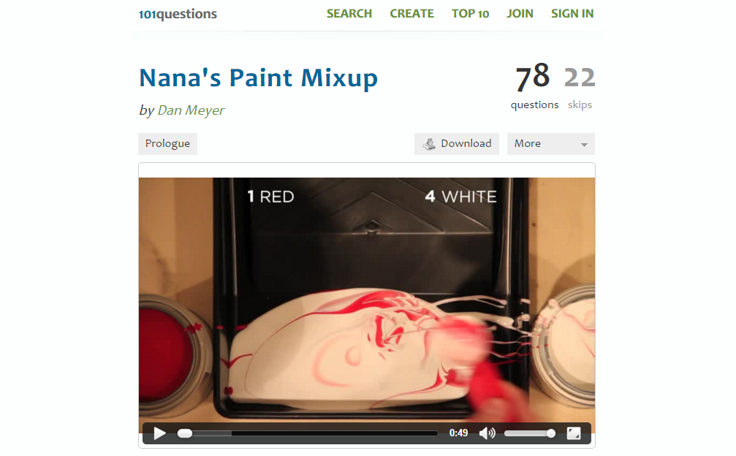
Nana’s Paint Mix Up http://www.101qs.com/2841-nanas-paint-mixup

Slide 6
Do the work
We can't do 5 red to 1 white because we already have 5 white in the pan. Is there another equivalent ratio we CAN do?
How many other ways to fix the mix up can you find?

Slide 7
Solution
http://www.101qs.com/2841-nanas-paint-mixup

Slide 8
Part 2:
What are students doing in a high quality math classroom?
& how do we get there…

Slide 9
Questions
As a result of students attending math class:
  What you like students to be able know and do?
    What would employers like to see students know & do?
    What would universities like to see students know & do?
    What would students like to do?

Slide 10
What are the standards asking students to do?
Standards for Mathematical Content
Standards for Mathematical Practice
  MP1: Make sense of problems and persevere in solving them.
  MP2: Reason abstractly and quantitatively.
  MP3: Construct viable arguments and critique the reasoning of others.
  MP4: Model with mathematics.
  MP5: Use appropriate tools strategically.
  MP6: Attend to precision.
  MP7: Look for and make use of structure.
  MP8: Look for and express regularity in repeated reasoning.

Slide 11
What are employers and universities asking of our students?
Employers
Oregon College Professors
Common skills for job success for new entrants at all education levels
  Professionalism,
  Communications (oral & written),
  Teamwork, and
  Critical Thinking
Source: Are They Really Ready To Work? Employers’ Perspectives on the Basic Knowledge and Applied Skills of New Entrants to the 21st Century U.S. Workforce Contents
HIGHEST Content Needed
Calculations
  Number & Operations
  Estimation
Algebra
  Relationships (Proportional reasoning)
  Linear Relations
LOWEST Content identified
  Geometry
    Analysis of figures
  Algebra 2
    Polynomials, Matrices, Logs, Factoring
Source: What Math Do Students Need to Succeed at a Public Oregon University? A Survey of OUS Faculty Teaching Entry Level Classes that Require Mathematics

Slide 12
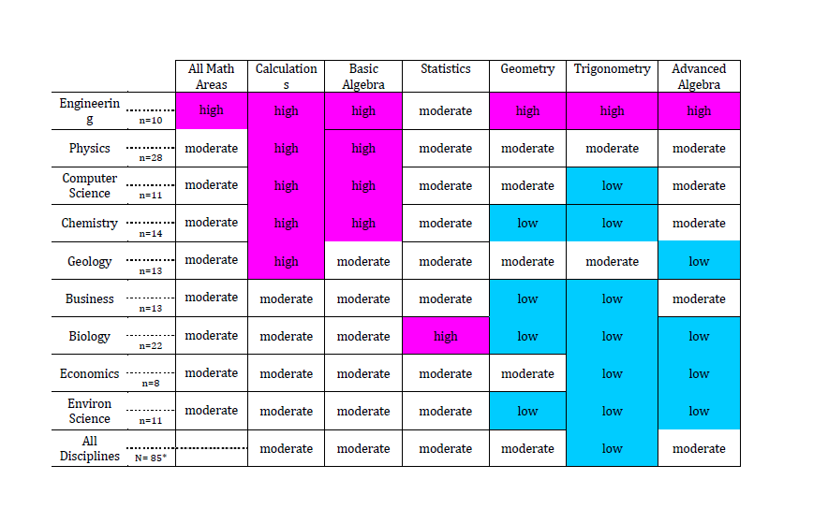
Oregon University System

Slide 13
What would students like to do?
Students are naturally curious – this curiosity arises when they see both:
  (a) a knowledge gap relevant to them, together with
  (b) the means by which it can be closed.
Students are intrigued by gaps, but are discouraged by chasms
Students Value:
  Fairness, dignity, and individual respect
Source: Hattie, J. & Yates, G. (2014). Visible Learning and the Science of How We Learn. New York Routledge.

Slide 14
Optimal Learning
Students need a trusting, fair, and safe environment to acknowledge that we “do not know” and will make errors in learning
Learning is optimized when teachers see learning through the eyes of the learner, and when learners see themselves as their own teachers
Source: Hattie, J. & Yates, G. (2014). Visible Learning and the Science of How We Learn. New York Routledge.

Slide 15
Oregon Math Network:
Sharing quality resources
Standards Support
  Math Progressions
    Turn on CC Math
  Illustrative Mathematics
  Inside Mathematics
  Achieve the Core
  The Teaching Channel
Lesson Plans
  Dan Meyer Three-Acts
  Robert Kaplinsky
  Mathalicious
  NCTM Illuminations
  OER Commons
  Math Assessment Project
  Others…
    http://tinyurl.com/OMNCOSA15

Slide 16
Oregon Math Network:
Sharing quality resources
Experience mathematics through the eyes of a learner
  Regional Math Learning Communities
    STEM Innovation Grants (Nov/Dec 2015)
  Lesson Study Model
    Do math together
      collectively plan & anticipate student responses
    Carry out the task in your classroom
    Collectively reflect & debrief learning experience

Slide 17
Part 3: How do we support teachers?
Some suggestions, including how the Oregon Math Network can help

Slide 18
Anticipating difficulties
A key ingredient to good teaching is the ability to anticipate student difficulties and choose tools to address those. This ability is hard-won through experience and professional learning.
Notes:
Mark

Slide 19
Anticipating difficulties
There is now experience in our state which allows us to anticipate difficulties teachers have in shifting their teaching to promote students’ understanding, explaining, applying, reporting, modeling, persevering, calculating fluently, etc.
Notes:
Mark

Slide 20
Examples of Classroom Practice
Challenge: Many teachers need to see examples of classrooms working productively towards these goals.
Resources: There are many videos out there, but not all show great quality instruction.
There are many teachers throughout the state (TOSAs, OCTM PD Cadre, consultants) who can give model lessons etc.
Notes:
Mark

Slide 21
Examples of Classroom Practice
The Oregon Math Network will be collecting links to exemplar videos (through Oregon Educator Network site, at least),
and through regional professional learning communities also help connect classroom teachers with experienced colleagues.
Notes:
Mark

Slide 22
Experience as Learners
Challenge: it is difficult to lead students in these practices when one’s own math learning experience was so focused on procedure alone.
Resources: Math Teachers Circles are a national PD model which addresses this lack of experience, and can be embedded in other models.
Notes:
Dev
So much to learn here to realize this promise – necessity of sustained PD; growth mindsets for students/ teachers (2x)/ parents&society.

Slide 23
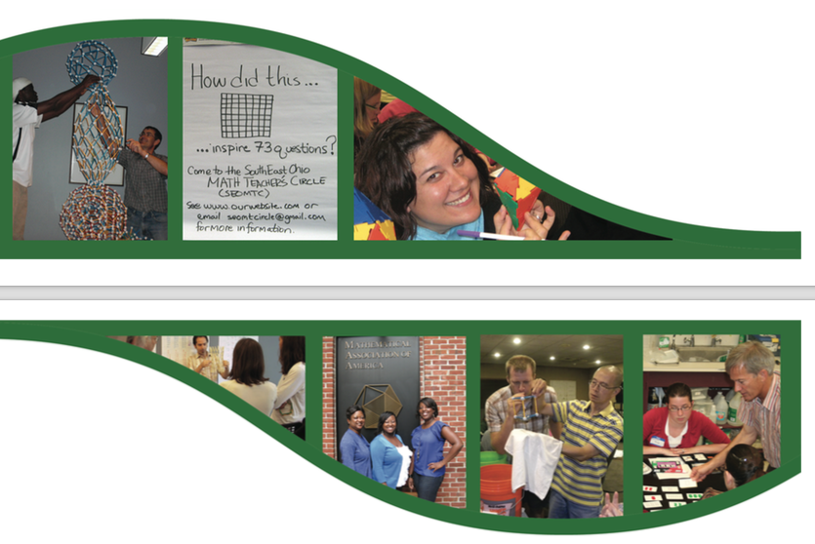
Experience as Learners
.
FUN!
MTCs
Fun
Fellowship
Food and Drink
Math!
Notes:
FUN!!

Slide 24
Experience as Learners
The Oregon Math Network is working with the Oregon Council of Teachers of Mathematics (OCTM) and has obtained funds from the American Institute for Mathematics to start Math Teachers Circles throughout the state.
Regional partnerships with higher educators can provide such experiences within existing PD frameworks.

Slide 25
Curricular Materials
Challenge: Teachers have a range of needs for resources, and may not have had success with some initial choices.
Resources: Curriculum Caravan – coming to you!
Many open resources available, but quality and the demands they place on teachers not clear.
Notes:
Dev

Slide 26
Curricular Materials
The Oregon Math Network can help collect and evaluate resources continually (informally), and share perspective as well as PD resources.
Can also disseminate experience, such as which may be good “first try” resources (e.g. Mathalicious) and strategies for professional growth (e.g. implement one project lesson each month).
Notes:
Dev

Slide 27
Curricular Materials
The Oregon Math Network will be starting Task Talks, monthly, on-line (and thus accessible statewide) discussions of Illustrative Math activities. Teachers will take away:
- Understanding of strongly aligned grade-level (possibly adjacent) activity.
- Perspective on the learning progression that activity fits into.
Notes:
Dev

Slide 28
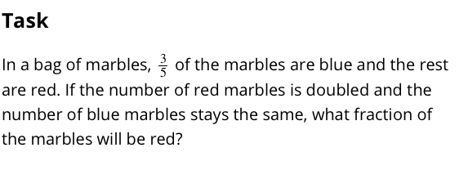
Curricular Materials
Notes:
Dev

Slide 29
Focus
Challenge: Teachers do not see enough classroom time to address all of these facets of learning mathematics, especially at high-school.
Resources: Many (such as from Student Achievement Partners) which elaborate
Focus/ Priority vs. Supporting vs. Additional standards.
Notes:
Dev

Slide 30
Focus
Especially around HS, the Oregon Math Network has initiated conversations about sequencing among leaders around the state.
Observation: postsecondary education in Oregon does not remediate in geometry. Other research also shows geometry not as important as simple algebra, data, numeracy.
Notes:
Dev

Slide 31
Focus
Proposal: second year of HS split between geometry and data/modeling/numeracy (e.g. the new Math 98).
Further proposal: more applied options for the third credit of math (but still rigorous, at certificate/ college ready level).
Statewide discussions “across silos” are needed!
Notes:
Dev

Slide 32
Feedback
Challenge: teachers see a disconnect between feedback mechanisms designed around previous learning targets and current needs. (e.g. a quiet classroom isn’t necessarily the goal!)
Resources: Many walk-through and other resources. Overlap between strong teaching across disciplines should be leveraged.
Notes:
Dev

Slide 33
Community Engagement
Challenge: push-back from parents and possibly school boards or other stakeholders.
Resources: publications aimed at parents produced by UO; websites such as from Howard County MD; sharing experts across districts and different levels.

Slide 34
Community Engagement
The Oregon Math Network can collect best resources, facilitate the sharing of experts across the state, and also help share experience.

Slide 35
Part 4: What are other states doing?

Slide 36

What our neighbors are doing.
‘
Idaho recently started a program, through legislation, to provide PD to teachers statewide through centers based at colleges and universities.

Slide 37


What our neighbors are doing.
‘
Washington started a program to promote PD through formalizing roles for teacher leaders in the Washington State Fellows Network.
Notes:
Mark

Slide 38

What our neighbors are doing.
‘
California has been running the California Math Project, housed in its colleges and universities, for over thirty years.
Notes:
Mark

Slide 39
California Math Project
The CMP was created in 1982 by legislative act SB 424 (Carpenter) to "seek to solve the mathematics skills problem of students in California through cooperatively planned and funded efforts.” At that time nine sites were funded. The University of California was vested with authority to manage and control the projects. The California Postsecondary Education Commission (CPEC) was to evaluate the projects. In 1986, it was decided that there needed to be a full-time statewide Executive Director to oversee the CMP.
Notes:
Mark

Slide 40
California Math Project
Following this report, in 1989 the California legislature created a professional development program expanding the structure of the California Writing Project (CWP) and CMP to embrace nine subject areas called the California Subject Matter Projects (CSMP).
"The CMP model is one of long-term, sustained professional development, in contrast to a conference or a "one-shot" workshop. Experienced and interested teacher leaders often assume leadership roles at the project site.”
Notes:
Mark

Slide 41
California Math Project
Section 99200.5 of the California Education Code:
The statewide subject matter projects shall accomplish all of the following goals:
  (a) Create opportunities for researchers, higher education faculty, and elementary and secondary school faculty to work together to accomplish all of the following:
  Identify exemplary teaching practices.
  Examine and develop research on learning, knowledge, and education materials.
  Provide support to teachers, including career technical education teachers, to develop and enhance the content knowledge and skills necessary to implement the State Standards
Notes:
Mark

Slide 42
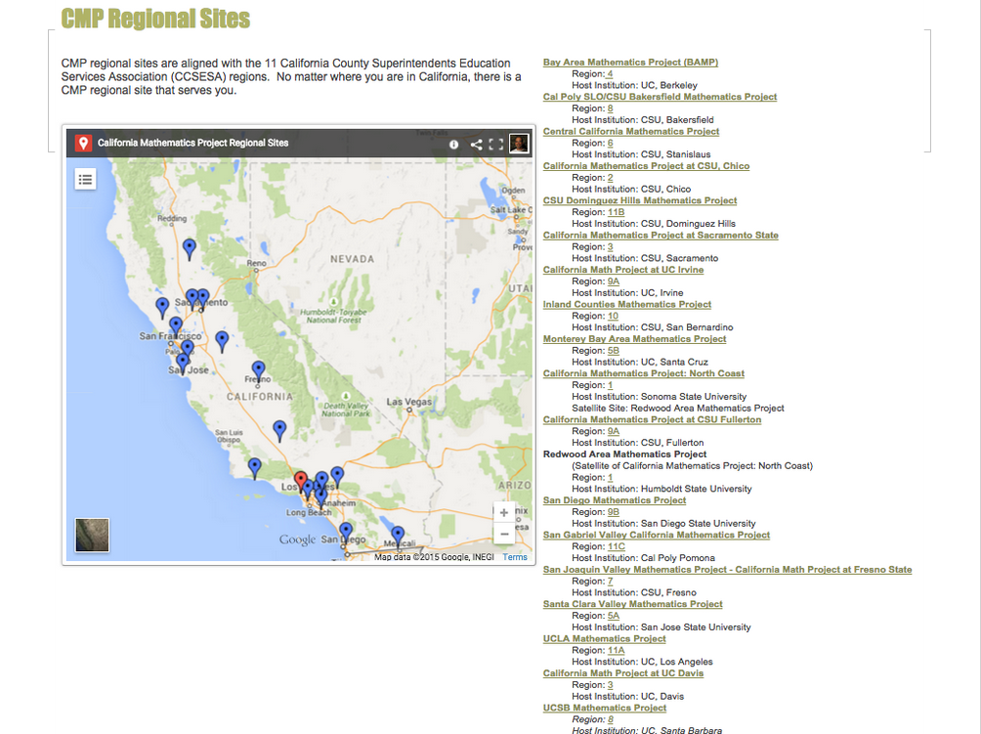
Notes:
Mark

Slide 43
Oregon Math Network
The Oregon Math Network will be tailored to meet our state’s needs.
Looking for flexible, regionally based models.
Will partner bringing different expertise to the table, especially K-12/ postsecondary.

Slide 44
Oregon Math Network
More? Launch event; Lane work; network of networks, Yadda yadda yadda.

Slide 45
Part 5: Wrap up

Slide 46
Oregon Math Network
We saw when we discussed challenges that the OMN aims to:
Collect and post high-quality resources.
Promote proven PD models, some of which can have great reach (Math Teachers’ Circles, Task Talks).
Increase communication – on-line and in person – between communities.

Slide 47
Oregon Math Network
Questions:
Would you be interested in regular (like monthly) web meetings where say one district shares successes/ challenges and then all districts can ask questions of experts?
Would you be interested in trainings aimed at admin teams?

Slide 48
Questions?
Mark Freed
mark.freed@state.or.us
Dev Sinha
dps@uoregon.edu

