Slide 1
New Assessment & Accountability Directors and District Test Coordinators
How to get started in your new role

Slide 2
Presenters
Bill Stewart – Gladstone SD
ODE Assessment & Accountability Advisories
Region One Assessment Consortium
16 years experience in Assessment
  503-805-8680
  stewartw@gladstone.k12.or.us
Brian Bain – Tigard-Tualatin SD
ODE Assessment Advisory
Region One Assessment Consortium
13 years experience in Assessment
  503-431-4120
  bbain@ttsd.k12.or.us

Slide 3
What is a District Test Coordinator?
A district designee who:
Coordinates training and delivery of state assessments
  Smarter Balanced - ELA and Math for 3-8 and 11th grades
    And 12th grade opportunities for Essential Skills
  Extended Assessment (Oregon’s Alternative Assessment)
  ELPA21 - K-12 English Language Learner Students
  OAKS
    Science and Social Science for 5, 8 and 11th grades
  Kindergarten Assessment
  PSAT - 10th grade assessment
  NAEP – if selected
Validates accountability reports
  School & District Report Cards
  Essential Skills & Graduation
Other duties related to “tests” or “scores”

Slide 4
Are you really the District Test Coordinator?
Make sure to have your Superintendent complete the “District Test Coordinator Designation” form and submit it to ODE:
  http://www.ode.state.or.us/search/page/?id=499
Have an ‘information only’ contact designated and trained too, in case you are not reachable.

Slide 5
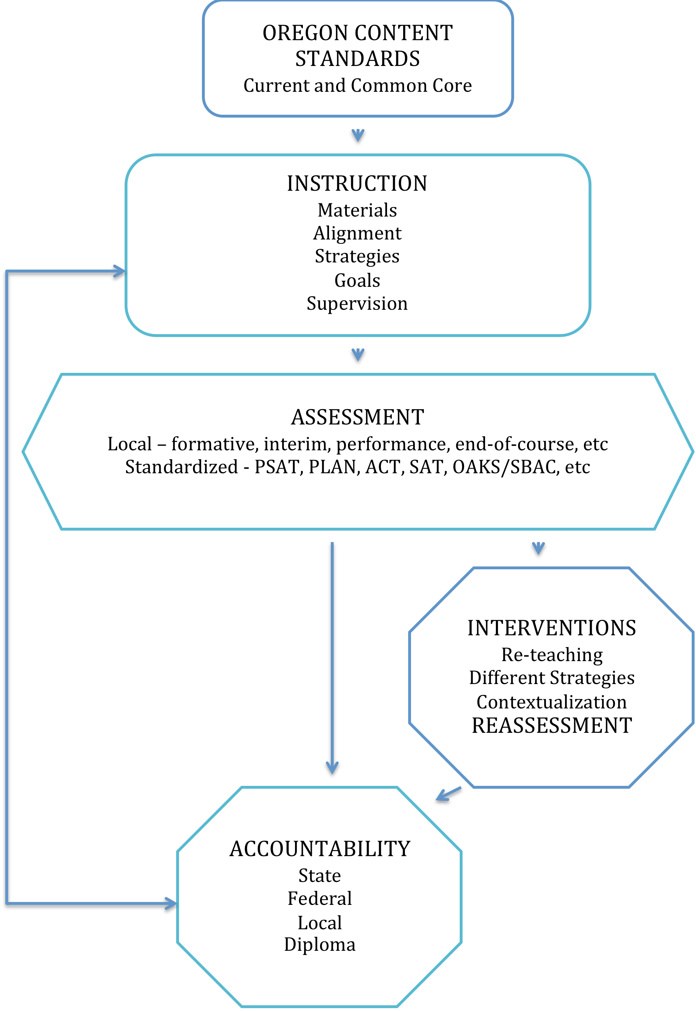

Slide 6
Your 1st quiz -
1) Why does your district need a DTC?
2) How can a DTC support instruction and learning?
3) What will YOU do to support teachers and help students learn more?
What do you envision you will be doing this year?

Slide 7
A Primer on Assessment and Accountability
Generate and manage data for purposes such as -
Achievement Compacts
School and District Report Cards
Federal ESEA Accountability
Public Reporting
Board presentations
Media contact
Essential Skills Graduation Requirements
Educator Effectiveness / SB 290
Local evaluation of programs
Place students into academic programs
Grant Applications and funding
Staff recognition and awards

Slide 8
Summer Break?
Over the Summer….
  Validate OAKS/Smarter Balanced Scores and other Accountability data
  Plan for the Kindergarten Assessment trainings and administration
  Plan for Smarter Balanced trainings and administration
  Provide data for district needs
  Make sure your high school(s) is prepared for PSAT
  Review the TAM (Test Administration Manual)
  Review the Assessment and Accountability Checklist
  Learn about assessment through various conferences, seminars, and opportunities.
  Communicate Results of last year’s Smarter Balanced

Slide 9
Get in the Loop!
Where to find information and get help

Slide 10
Assessment Resources
Statewide Assessment Reference
  http://www.ode.state.or.us/search/results/?id=169
Assessment and Accountability Checklist (What to do and when to do it!)
  http://www.ode.state.or.us/wma/teachlearn/testing/admin/asmtacctbltychecklist1415.pdf
Assessment Guidance
  http://www.ode.state.or.us/wma/teachlearn/testing/resources/oregon_asssessment_guidance.pdf
OAKS Portal
  http://oaksportal.org

Slide 11
ODE Communications
DTC Webpage
  http://www.ode.state.or.us/search/page/?id=499
Assessment & Accountability Checklist
  http://www.ode.state.or.us/wma/teachlearn/testing/admin/asmtacctbltychecklist1415.pdf
Assessment and Accountability Updates
  http://listsmart.osl.state.or.us/mailman/listinfo/ayprcupdates
DTC Webinars
Webinars related to specific topics:
  Kindergarten Assessment Training
  OAKS Training
  Smarter Balanced Training
  Informal Updates

Slide 12
Get on the List
Assessment DTC
  You should be added automatically when you submit the designation form
  http://listsmart.osl.state.or.us/mailman/listinfo/assessmentdtc
Data Collections
  Information about data submission to ODE
  http://listsmart.osl.state.or.us/mailman/listinfo/datacollection
Super
  Information for Superintendents about EVERYTHING
  http://listsmart.osl.state.or.us/mailman/listinfo/super
Region One Assessment Consortium
  DTCs from Newport to The Dalles everywhere in between
  http://mailman.mesd.k12.or.us/mailman/listinfo/roac

Slide 13
Region One Assessment Consortium
A resource for connecting with experienced DTCs.
Mailing list for problem solving, guidance, important announcements, etc…
  http://mailman.mesd.k12.or.us/mailman/listinfo/roac
Monthly meetings in the Portland area which are broadcast via webinar.
  Information sharing
  Collaboration
  Guidance
At the Assessment Institute:
  Informal Meeting - Thursday 4-5pm – Hilton Studio A
2015-16 Chair: Leigh Anne Scherer
  schererl@nclack.k12.or.us

Slide 14
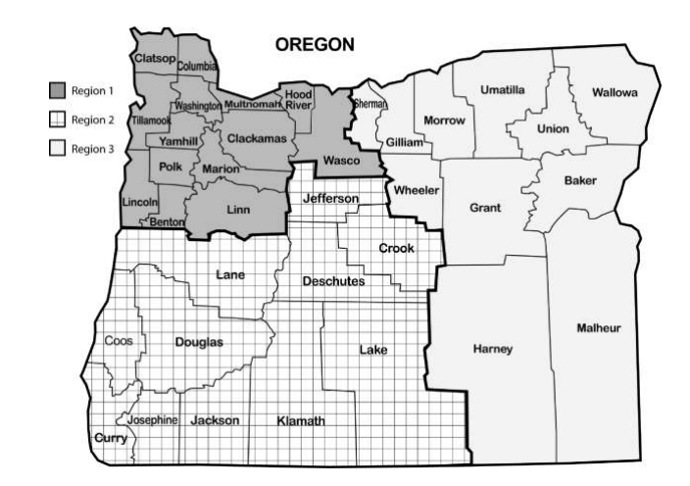
Your Regional ESD Partners
Amy Rockwell
1-800-970-8372
Connie Lobato
1-800-706-4447
Connie Lobato
1-800-706-4447

Slide 15
Wrapping up 2014-15

Slide 16
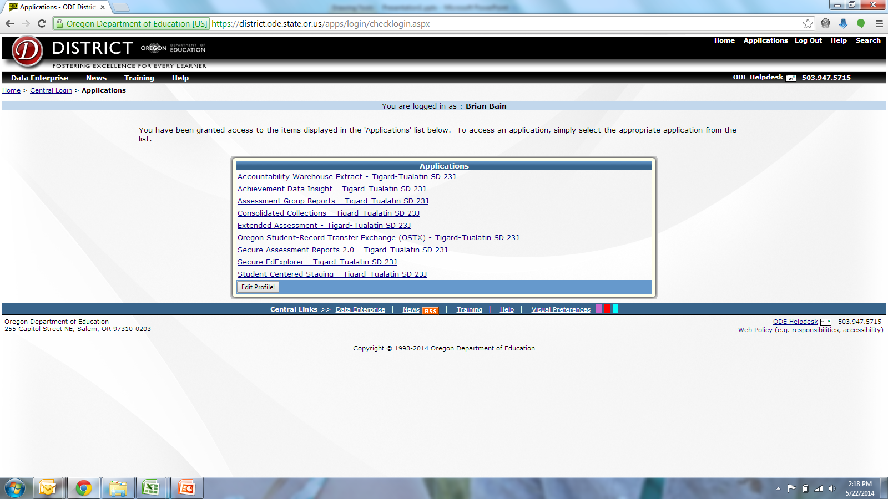
district.ode.state.or.us
Contact your District Security Administrator (IT?)
Student Centered Staging (OAKS - editable)
Consolidated Collections (Enrollment, Programs, etc… - editable)
  ADM
  SSID
  Title III LEP Collection
Achievement Data Insight (preview of outcomes)
  Grad Rates
  OAKS Results
  AMAOs
  Report Cards

Slide 17
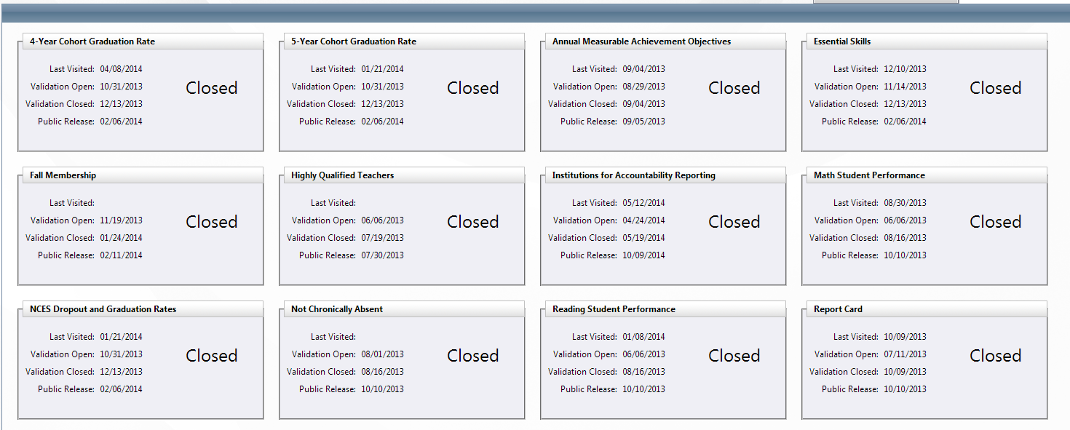
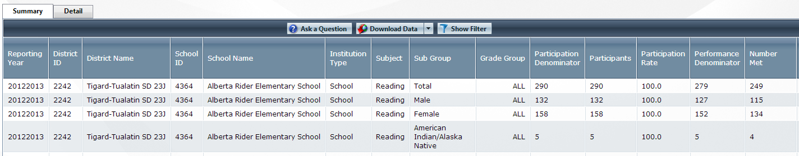
Achievement Data Insight
(district.ode.state.or.us)

Slide 18
Summer Validation
Achievement Data Insight application
  Participation (Why did these students not participate?)
  Populations (Were these students enrolled on May 1st, and for ½ the school year? Are they in the right programs? Are the SPED kids, really SPED?)
  Graduation Rates (Why did these students not graduate?)

Slide 19
Special Note -
TALK to your specialists, early and often!!
TAG
SpEd / 504
ELL
Homeless / Econ Dis staff
Pre-K providers
Private / Alternative / Charter Schools
Other local interests

Slide 20
Planning for Instruction and Assessment

Slide 21
School Report Cards….besides data validation
The New Oregon Report Card, includes
  A letter from the principal
  Descriptions of programs
Coordinate the submission of these pieces, to ODE for each school and the district.
Start soon, it takes longer than you’d expect
Supplemental Data Collection in ADI closes: September 25th
Public Release: October 9th
May 11th webex (Video Training)- https://district.ode.state.or.us/search/page/?id=407

Slide 22
Preparing for 2015-16

Slide 23
Kindergarten Assessment
Did your district order materials?
ODE Training Webex – August 18th
  Materials: http://www.ode.state.or.us/go/ka
  Register with Regional ESD partner
You’ll train your test administrators (Kindergarten staff/other)
Test given ‘first 6 weeks’ of the school year [8/10 – 10/22]
Academic Measures (Reading, Math)
  Directly administered to students
  10-15 minutes per a student
  Early in the test window
  Spanish Literacy required for all ELL ( 2 minutes)
  Field Test this year for selected schools (Are you selected?)
Approaches to Learning
  Survey completed by teacher
  Late in the test window, after observing students in classroom

Slide 24
Smarter Balanced!
Register for the DTC training Webex November 3rd, 4th, or 5th
  Register with your Regional ESD Partner
Review Test Scheduling Needs
  Elementary and Middle: 66% of the school year
  High: 80% of the school year*
Plan for Staff Trainings
Review Smarter Balanced Tech Requirements
Install Smarter Balanced Browsers (IT?)
http://oaskportal.org

Slide 25
Some Example Smarter Balanced Schedules
 | Teacher | Monday | Tuesday | Wednesday | Thursday | Friday | Monday
Lab 1 | Smith | Multiple Choice | Multiple Choice | Classroom Activity | Performance Task | Performance Task | Performance Task
Lab 2 | Jones | Multiple Choice | Multiple Choice | Classroom Activity | Performance Task | Performance Task | Performance Task
3 to 4 weeks total |  | 1.5 hours |  | .5 hours (15 minutes open) | 2.25 hours
 | Monday | Tuesday | Wednesday | Thursday | Friday | Monday
Lab 1 | Stewart A-Multiple Choice | Stewart B -Multiple Choice | Stewart A -Classroom Activity(30 min)/ Performance Task (60 min) | Stewart B -Classroom Activity/Performance Task | Stewart A - Performance Task | Stewart B -Performance Task
Lab 2 | Bain A -Multiple Choice | Bain B -Multiple Choice | Bain A -Classroom Activity(30 min)/ Performance Task (60 min) | Bain B -Classroom Activity/Performance Task | Bain A - Performance Task | Bain B -Performance Task
Short ½ hour for MC, Over by ½ hour for PT. 3 to 4 weeks total.

Slide 26
Other Examples where an entire grade was tested simultaneously….
Monday | Tuesday | Wednesday | Thursday
ELA CAT | ELA PT | Math CAT | Math PT
ELA CAT | ELA PT | Math CAT | Math PT
Extended Lunch | Extended Lunch | Extended Lunch | Extended Lunch
ELA CAT | ELA PT | Math CAT | Math PT
ELA CAT | ELA PT | Math CAT | Math PT
Late Start Bell Schedule….
Testing Session
Period 1
Period 2
Period 3
Period 4
Period 5
Period 6

Slide 27
But Wait, There’s more…
Don’t forget about Math!
High Schools only get 6 weeks to get through both
  Which likely include Non-School Days!
  And College Admissions Testing
  And AP and IB testing
  And Finals

Slide 28
Ensuring the Fidelity of your SBAC Training by your Trained Trainers
How will you be certain that the details of the TAM and the ODE SBAC training are effectively and consistently implemented in all schools / grades / classrooms?
If it’s not specifically allowed in the TAM, don’t do it!
There’s no such thing as ‘over-training’ or ‘too prepared’.
The system WILL go down, do you have a ‘plan B’ ready to roll?

Slide 29
Other “Tests”
PSAT
  10th grade students state-wide are provided the PSAT with funding from the state
  Your district needs to
    Register
    Plan accommodations
NAEP (National Assessment of Educational Progress)
  Randomly selected (and schools/DTC notified)
  ODE Contact: Beth LaDuca
Local Assessments
  TAG ID test
  Formative, Interim Academic Measures
  CBMs for RTI Processes
  End of Course Assessments / Finals
  AP & IB Assessments
  ACT and SAT

Slide 30
Other Items To Do

Slide 31
Essential Skills
What’s Required?
Options for completion?
Impact on graduation?
How does Smarter Balanced factor in?
http://www.ode.state.or.us/wma/teachlearn/testing/resources/es_assessment-options_all.pdf

Slide 32
Homework for August –
Can you find these?
OAKS Percentiles
Like School Comparisons
TAM
Report Cards
Group Reports
Assessment and Accountability Technical Manuals
Essential Skills Transition
Test Blue Prints
Smarter Balanced information
Assessment Training dates and materials
https://goo.gl/1T8lbu (cheat sheet)

Slide 33
Data – Friend or Foe?
Is it -
Accurate?
Reliable?
Valid?
Relevant?
Do you understand SEM and how it impacts the usefulness of data?
Are you a ‘data dork’ or just a dork who tries to use data?
Is Excel your favorite software program?

Slide 34
Some ideas to consider -
Just because you ‘can’ doesn’t mean you ‘should’
Stand the high ground – academically, intellectually, educationally and politically.
  Illegitimi non carborundum
Be thoughtful about your work, make every move count for something….now or in the future.
Don’t waste an opportunity to help someone….
What’s your favorite?

Slide 35
To Do
Validate Report Cards
Send Principal Letters for Report Cards
Plan for Kindergarten Assessment
Plan for PSAT
Plan for Smarter Balanced
Plan for NAEP

Slide 36
THANKS for your attendance!
Feel free to contact us, any time!
Bill Stewart – Gladstone SD
ODE Assessment & Accountability Advisories
Region One Assessment Consortium
  503-805-8680
  stewartw@gladstone.k12.or.us
Brian Bain – Tigard-Tualatin SD
ODE Assessment Advisory
Region One Assessment Consortium
  503-431-4120
  bbain@ttsd.k12.or.us
GOOD LUCK in 2015-16 and beyond

