Slide 1

Student Learning and Growth Goals:
Collaborative Writing Practice
August 2015
DO NOW On chart paper on the wall, please share:
A challenge from last year that you would like to avoid this year OR
An effective practice you used last year that you would like to share with others
This will inform ODE’s continued planning

Slide 2
Essential Question
How can I support teachers writing Student Learning and Growth (SLG) Goals?
Outcome
Learn the steps of writing an SLG Goal to be able to support teachers
Agenda in Handout p.1
Definition in Handout p.2

Slide 3
Working Agreements
Recognize the work as a journey
Be fully present
Share the air
Be open-minded

Slide 4
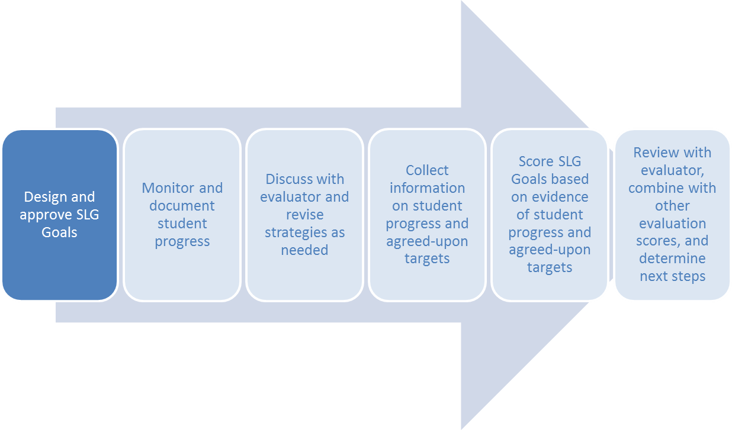
Focus of the Session
Handout p.3
Breakout of first step in Handout p.4

Slide 5
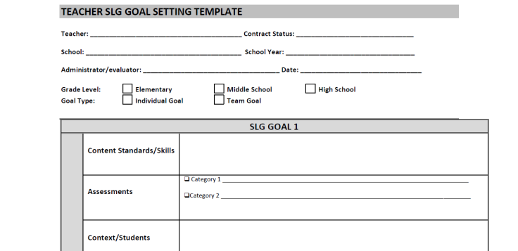
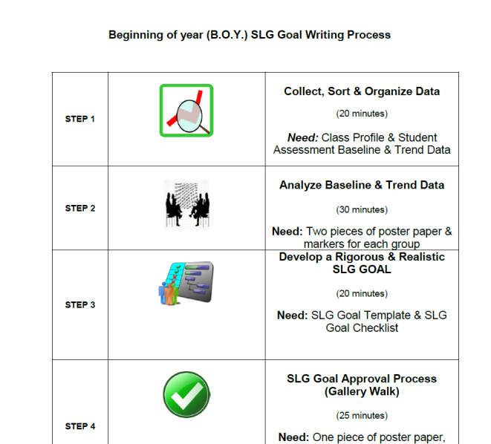
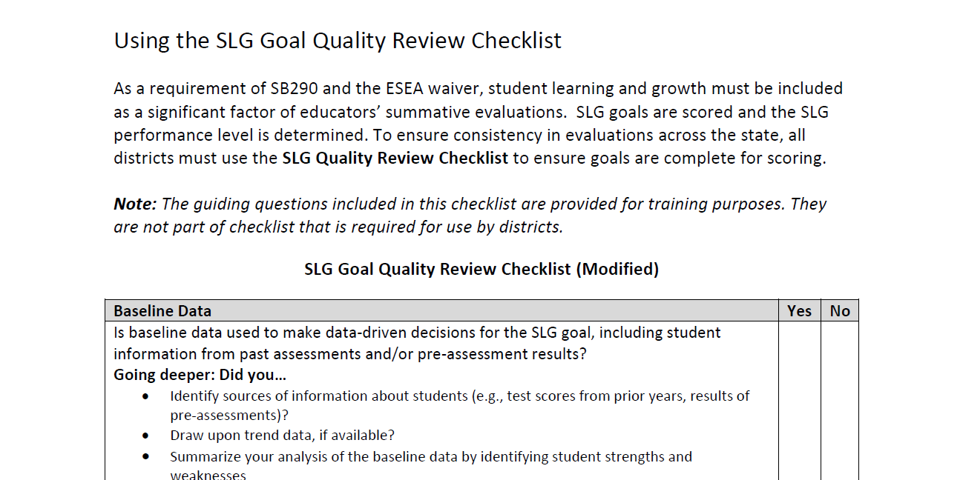
Materials – Instructions and Forms
Protocol
SLG Goal Template
Handout pp.12-14
SLG Goal Checklist
Handout pp.5-11
Handout p.15

Slide 6
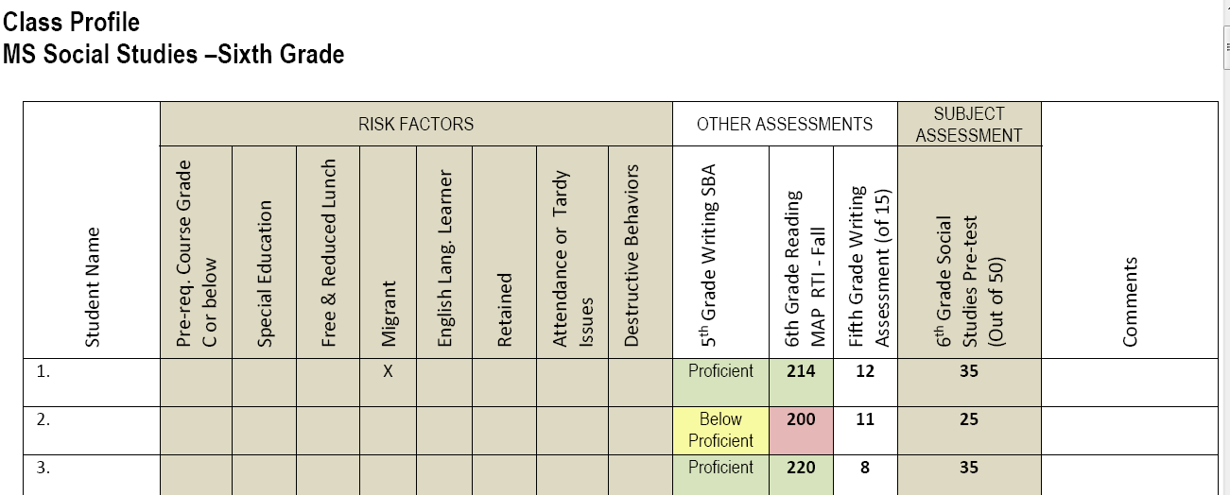
Materials - Data
Pick a grade level and join others who make the same choice:
Class Profile
Subject Assessment
  Beginning of the Year Data
  Trend Data
  Standards
Additional Information
In Handout, grades:
4 ➔ pp.16-24
6 ➔ pp.25-29
10-12 ➔ pp.30-34

Slide 7
Roles
Handout p.6
Role 1 | Recorder | Takes notes during the protocol.
Role 2 | Facilitator | Guides group through the protocol.
Role 3 | Creative Director | Facilitates creation of the group poster.
Role 4 | Time Keeper | Manages time for each step of the protocol.
Role 5 | Group Members | Support and remind each other of the norms of the group and of looking at data and talking about students.

Slide 8




Time Keeper Information
 | Collect, Sort & Organize Data | 10 minutes
 | Analyze Baseline Data | 20 minutes
 | Develop a Rigorous & Realistic SLG Goal | 15 minutes
 | SLG Goal Approval Process (Gallery Walk) | 15 minutes

Slide 9


Collect, Sort, and Organize Data
Handout
p.7
p.8 Step 1
STEP
Individually
10 minutes
• Review data
• Make OBSERVATIONS – Facts Only…

Slide 10

Analyze Baseline Data
Handout
p.8 Step 2 and p.9
STEP
4 Rounds @ 5 minutes each
Round 1 Talk about what the data told them about their student’s areas of strength and weakness? For example,… | Round 2 What are the implications of this data on annual goal setting, for both teaching and student learning growth target(s)? For example . . . | Round 3 What help or support might you need to enact these goals? For example … | Round 4 What insight(s) and aha(s) did you gain from this discussion? For example …
“Based on this data, I/we believe the students our focus should be on, should be… because…” RECORDER: Record main points from this round on the poster paper provided. | “What initial goal(s) could be set to support student growth?” RECORDER: Record main points from this round on the poster paper provided. | “I would love to get professional development or support for…” RECORDER: Record main points from this round on the poster paper provided. | “Based on all of this, I think that I might…” RECORDER: Record main points from this round on the poster paper provided.

Slide 11

Develop a Rigorous and Realistic SLG Goal
Handout
p.10 Step 3
STEP
15 minutes
 Based on the group’s discussion complete these portions of the Teacher SLG Goal Setting Template:
  Content Standards/Skills
  Assessments
  Context/Students
  Baseline Data
  Student Growth Goal (Targets)

Slide 12

SLG Goal Approval Process
Gallery Walk
Handout
p.10 Step 4
STEP
POST YOUR SLG Goal
PROVIDE FEEDBACK TO YOUR COLLEAGUES
Choose one aspect of the SLG Goal Checklist and and Provide SPECIFIC and ACTIONABLE FEEDBACK
15 minutes

Slide 13
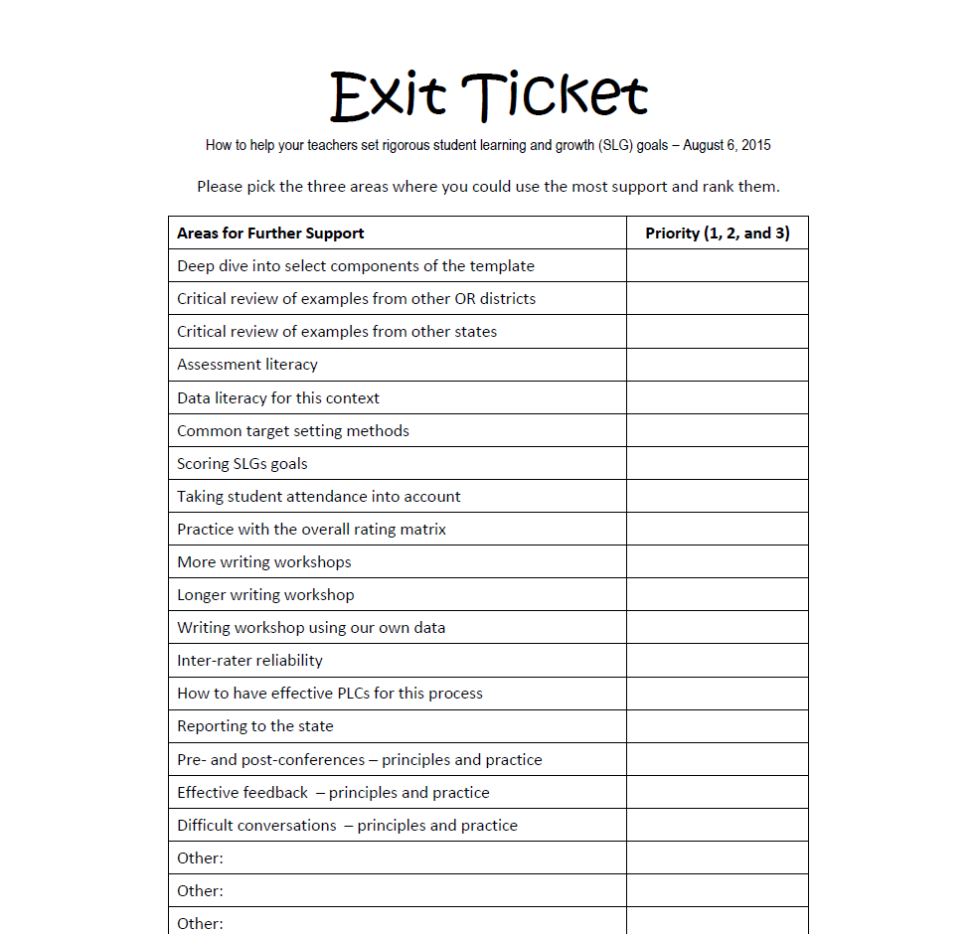
Exit Ticket
Please rip it off, fill it in, and leave it on the table

Slide 14
Contact
Oregon Department of Education
Brian Putnam
Education Specialist
Office 503.947.5806 brian.putnam@state.or.us
Sarah Martin
Educator Effectiveness Education Specialist, Instructional Resources
Office 503.947.5668 sarah.martin@state.or.us
Sarah Phillips
Educator Effectiveness Education Specialist
Office 503.947.5783 sarah.phillips@state.or.us
Education Northwest
Mark Endsley
Senior Advisor
Education Northwest
Office 503.275.9643
mark.endsley@educationnorthwest.org
Hella Bel Hadj Amor, Ph.D.
Practice Expert: Education Policy and Research
Education Northwest
Office 503.275.9587
hella.belhadjamor@educationnorthwest.org
Notes:
Need Mark’s title

