Slide 1


TELL Survey: Tips for the 2016 Implementation
Provided by the Chief Education Office on behalf of the TELL Partners

Slide 2

What is the tell surVey?

Slide 3

What is the TELL* Survey?
A 20-30 minute survey of licensed school-based educators to assess teaching conditions at the school, district and state level.
The TELL survey is completely voluntary, confidential, and anonymous!
Respondents include teachers, principals, assistant principals, school counselors, social workers, and school psychologists.
* The acronym “TELL” stands for Teaching, Empowering, Leading, and Learning.

Slide 4

Purpose of the TELL
The purpose of TELL Oregon is to document and analyze how teachers and other educators view the teaching and learning conditions at their school. By taking the survey, educators have provided data to help identify supports needed to strengthen student learning and to ensure student success.
Notes:
Goals of the TELL Oregon Results
1. Determine whether educators in schools and districts across the state have the resources and supports necessary to provide the most effective teaching and learning environment for students.
2. Use the data to inform continuous improvement in schools and districts and advocate for resources and supports at the local and state policy level.
The following are recommendations to consider before using the TELL survey results:
1. Teaching conditions are an area for school improvement, not accountability.
2. Teaching conditions are not about any one individual and it will take a community effort to improve.
3. Perceptual data are real data.
4. Conversations need to be structured and safe.
5. Identify and celebrate positives as well as considering areas for improvement.
6. Create a common understanding of what defines and shapes teaching and learning conditions.
7. Focus on what you can solve.
8. Solutions can be complex and long term.

Slide 5
What does the TELL survey assess?
TIME
SCHOOL LEADERSHIP
TEACHER LEADERSHIP
FACILITES & RESOURCES
PROFESSIONAL DEVELOPMENT
COMMUNITY ENGAGEMENT & SUPPORT
INSTRUCTIONAL PRACTICES & SUPPORT
MANAGING STUDENT CONDUCT
NEW TEACHER SUPPORT
Set of Core Questions which are research-based and externally validated.
The unit of analysis is the school-not any individual.
Survey can be customized to address teaching conditions specific to client.
Notes:
Time—Available time to plan, collaborate, provide instruction, and eliminate barriers in order to maximize instructional time during the school day
Facilities and Resources—Availability of instructional, technology, office, communication, and school resources to teachers
Community Support and Involvement—Community and parent/guardian communication and influence in the school
Managing Student Conduct—Policies and practices to address student conduct issues and ensure a safe school environment
Teacher Leadership—Teacher involvement in decisions that impact classroom and school practices School Leadership—The Ability of school leadership to create trusting, supportive environments and
Professional Development—Availability and quality of learning opportunities for educators to enhance their teaching
Instructional Practices and Support—Data and support available to teachers to improve instruction and student learning

Slide 6

History of TELL in Oregon
In 2014, 19,373 OR Educators (59.4 percent) responded!
17,418 Teachers
588 Principals
236 Assistant Principals
1,131 other education professionals (school counselors, school psychologists, social workers, etc.)
In 2014, 784 of 1,265 schools (62 percent) met or exceeded the 50 percent participation threshold!

Slide 7
Why do we need a survey?
We all care deeply about the teaching conditions in our schools: we hear anecdotally where things are good and bad- but we need to know systemically and involve all of the stakeholders in the state in improving our schools.

Slide 8
Why do we need a survey?
From a state perspective we want to accurately assess perceptions about teaching conditions and work with state leaders on ways to improve our schools.
We believe some answers can only come from those that deal with our children everyday- our educators in schools.

Slide 9
Why another survey?
One snapshot is not sufficient.
The 2014 survey provided a timely baseline of results for our schools, districts, and states.
A number of improvements have been put into place and the 2016 survey will offer teacher and school leaders the chance to monitor change in perceptions that can continue to inform practice.

Slide 10
Who created the TELL?
The TELL survey was developed in 2002 by the New Teacher Center.
The New Teacher Center (NTC) is a nonpartisan group with a mission to support the development of an effective, dedicated and inspired teaching force.
They have experience with administering the survey in a dozen states including: North Carolina, Delaware, Tennessee, Kentucky, Colorado, Ohio, Vermont, Maryland, New Mexico, and Massachusetts.

Slide 11
What is NTC’s Role?
Design a Teaching and Learning Conditions Survey and communications plan that best reflects the needs of the state or district.
Administer an anonymous, online Teaching and Learning Conditions Survey.
Produce, publish and help communicate Teaching and Learning Conditions Survey results
Analyze Teaching Conditions Survey results and explore connections
Design training materials that facilitate use of the data

Slide 12
What were the results in 2014?

Slide 13
A Few 2014 Statewide Findings
Nearly nine of 10 educators (87 percent) agree that students understand behavioral expectations and that administrators support teachers’ effort to maintain discipline.
About seven of 10 educators agree that there is a shared vision (71 percent) and an atmosphere of trust in the school (70 percent), and that teachers are comfortable raising issues (69 percent).
Fewer than seven of 10 educators (67 percent) surveyed believe their school improvement team provides effective leadership.

Slide 14
How can I learn more about the 2014 results?

Slide 15
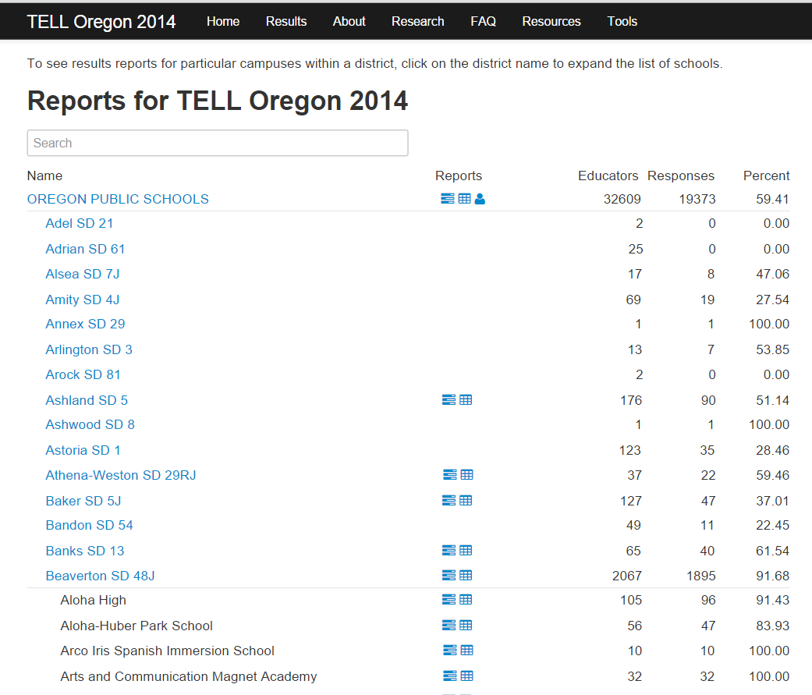
http://www.telloregon.org/results
DETAILED STATE REPORT
PRINCIPAL’S STATE RESULTS
SUMMARY STATE REPORT

Slide 16
DETAILED DISTRICT REPORT
SUMMARY DISTRICT REPORT
DETAILED SCHOOL REPORT
SUMMARY SCHOOL REPORT

Slide 17
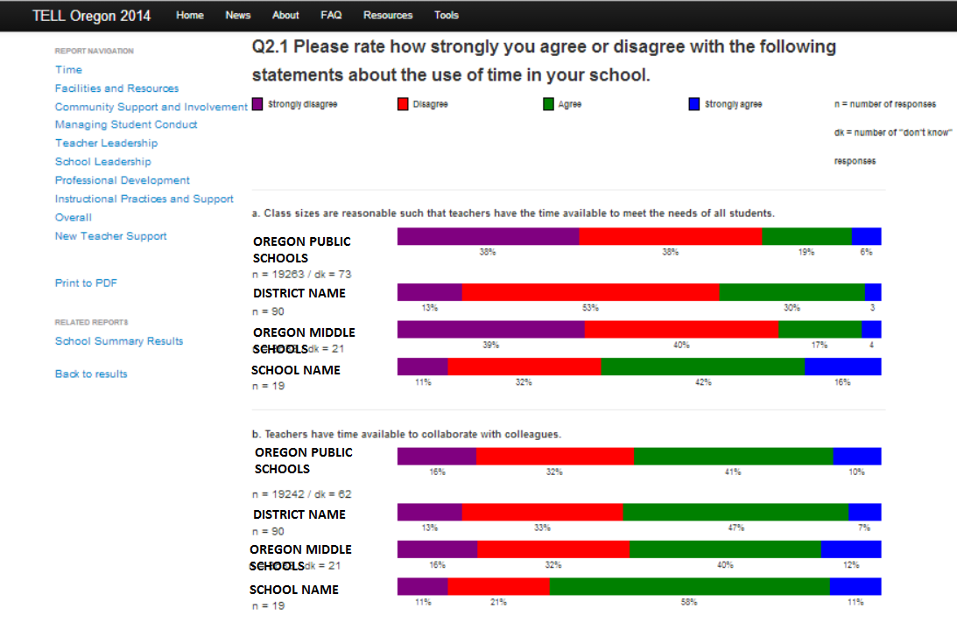
How to View & Download School
DETAILED Results
download
district
like type
school

Slide 18
HOW were the results FROM 2014 used?

Slide 19
How were the results used?
ODE analyzed educator perceptions regarding the educator effectiveness model, needs related to Common Core and to track progress on ODE’s Strategic Plan Goal 2.
OEIB and ODE compared results from 1st and 2nd year teachers regarding mentoring supports.
Beaverton School District administrators and teachers used the TELL Survey results to collaboratively engage in conversations about best practices and work together in finding solutions to common challenges.

Slide 20
How were the results used?
Chalkboard compared perceptions of educators in CLASS districts with non-CLASS districts:
  Leadership in schools. Teachers in CLASS districts were significantly more satisfied with the leadership in their districts than those in non-CLASS districts.
  Professional development. Teachers in CLASS districts were more in agreement and satisfied with professional development endeavors.
  Teacher concerns. Teachers in CLASS districts were more likely to agree that school leaders make a sustained effort to address teacher concerns.

Slide 21
What is my role?

Slide 22
If you are a principal…
You will receive a packet with letters for each certified educator in your building
This letter contains the anonymous access code, unique to every teacher, which is required to access the survey.
<<District Name>>
<<School Name>> Your Confidential Access Code # <<access code>>
Using your confidential access code, you may complete the survey from any Internet location from February 1-February 29, 2016 at www.telloregon.org

Slide 23

Prior to January - Set up a meeting with your designated local education association leader(s) in the school to plan staff meeting.
Before meeting, go to www.telloregon.org and print the FAQs; review and bring a copy of them to the meeting. (You can also check on your school’s participation level in 2014!)
AT YOUR STAFF MEETING PRIOR TO SURVEY LAUNCH (Late Jan)
Don’t ask educators in your building to sign in that they attended the meeting, Try to remember who wasn’t there and meet with them afterwards.
During the meeting, share information about the upcoming survey.
Hand out the letters to the certified educators at the meeting and indicate where the anonymous access code is located.
Ask them to switch papers with anyone they wish.
Encourage them to complete the survey ASAP, from ANY Internet location!
Communicate reminders throughout the month of January and let folks know participation levels of your school.
Consider incentives for reaching a predetermined level of participation.

Slide 24
What Support will I receive?

Slide 25


February 1 –29, 2016
The survey will be available online for one month allowing educators time to select when they take the survey.

Slide 26
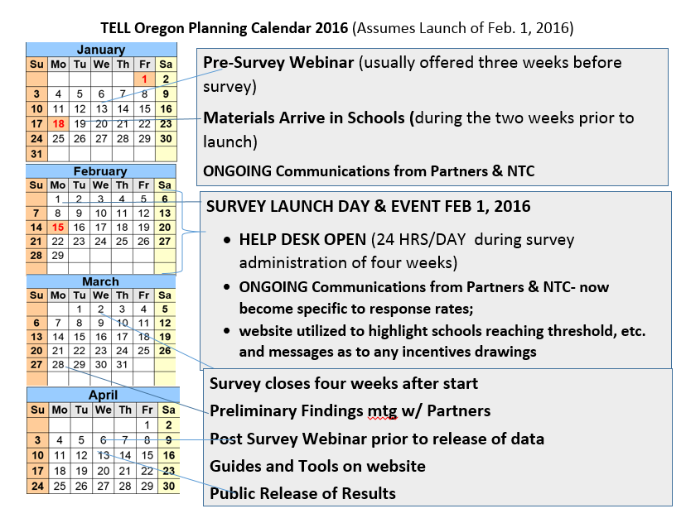
TELL Oregon Survey Planning Calendar

Slide 27
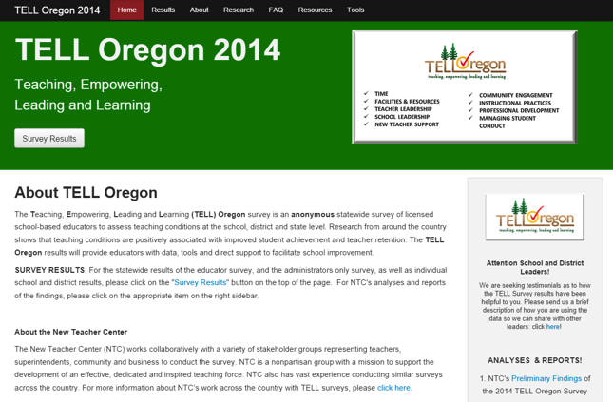
TELL Oregon Website 2016
A one-stop-website for all information related to TELL Oregon
Updated regularly
News and events
Access to take the survey
Access to the previous results as well as 2016 results
FAQs
Research
Tools and Guides
Timely updates during the survey window on schools & districts that are leading in response rates

Slide 28

Help Desk 2016
Purpose: to provide help to teachers and administrators during the survey window
Toll-free Help Desk available 7:30 AM-4:30 PM Pacific time zone Monday through Friday during the survey window. (1- 800-310-2964)
Help Desk can also be accessed at any time through Email (helpdesk@telloregon.org or by accessing the website (www.telloregon.org).
The help desk can generate new access codes for any that have been lost or misplaced

Slide 29





TELL Oregon Partners
We’re here to help you!

Slide 30
How CAN I use the results?

Slide 31

Reminder: Response Threshold
Individual school results will be available and posted online if at least 50% of licensed personnel and at least five respondents in the building participate in the survey.
The data generated will be provided to each Oregon school that receives a sufficient response rate for use in improvement planning processes.

Slide 32



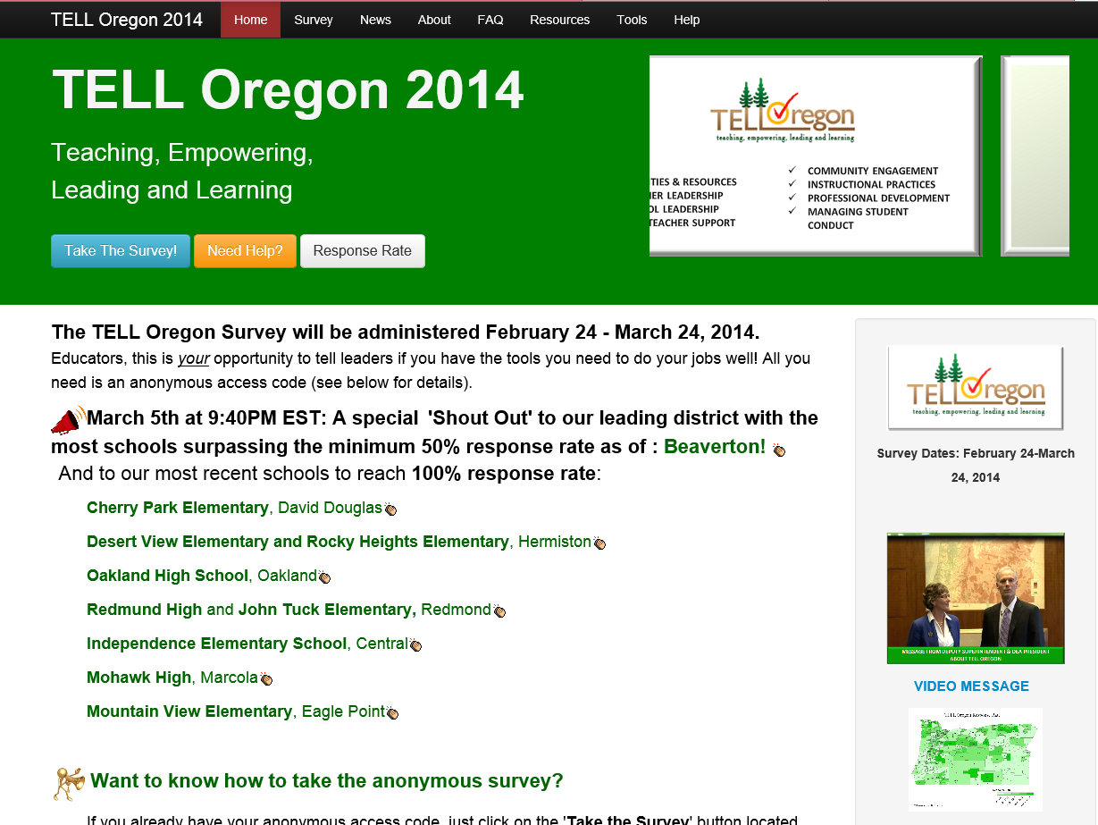

Guides are Available on the “Tools” Tab
School Guide for Using TELL Data
District Guide for Using TELL Data
Data Use Guide

Slide 33
Resources
NTC has developed a 90 minute activity designed for district leaders to begin looking at their TELL data and start the process of using the data for district improvement. Please download this document: An Activity Guide for School District Leaders

Slide 34


OEA Toolkit
Developed in 2014 and now being updated for 2016 as a tool for teacher and school leaders to use the TELL survey results to:
Reflect on the overall status of teaching conditions;
Review differences within and across schools in their district;
Consider potential strategies and solutions to improve conditions; and
Collaboratively work with fellow teachers, principals, district administrators and community members to support continuous improvement teaching and learning conditions.

Slide 35
What is the research telling us from the results?

Slide 36
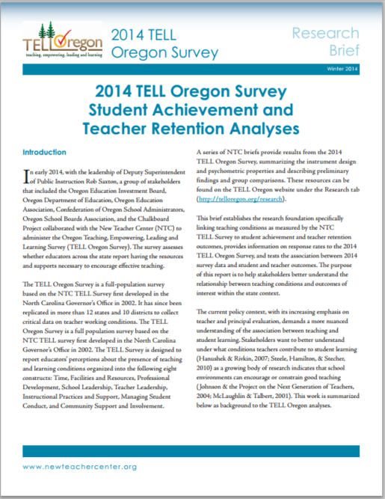
TELL Survey Results and Connections
to Student Achievement
Specifically, three teaching conditions predict student achievement: at schools with strong or sufficient rates of agreement on the following TELL constructs, more students achieve proficiency on OAKS.
Community Support
Facilities and Resources
Time
These results are important because they show the impact of teaching conditions while controlling for factors such as student poverty, total enrollment, and teacher experience at the overall state level.

Slide 37
TELL Survey Results and Connections
to Teacher Retention
Two teaching conditions are related to teacher retention:
Community Support
School Leadership
Even after including the contributions of other factors such as student and teacher background characteristics, data suggest that in schools where teachers report higher levels of support from the community, fewer teachers choose to leave the classroom.

Slide 38

For more information
Feel free to send your questions to Hilda Rosselli, State TELL Coordinator at the Chief Education Office.
Contact Information:
Hilda.rosselli@state.or.us
503 551-1739

